Slide 1

PSA Screening and “Mojo” Maintenance in Prostate Cancer

Slide 2
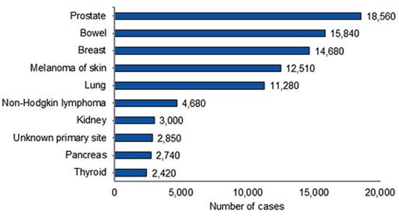
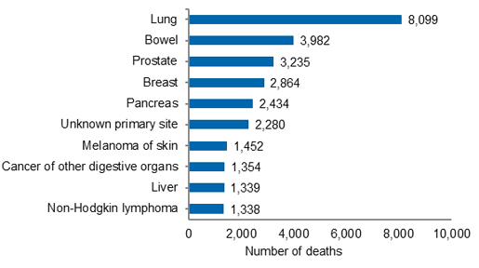
Background
Each year In Australia
18,560 new cases diagnosed
3,235 men die of prostate cancer

Slide 3
PSA Screening
70% of GP’s believe prostate cancer testing guidelines are unclear
⅓ of GP’s don’t refer to any guidelines when testing for prostate cancer
40% of men find advice re PSA testing confusing
This medical oncologist’s brain was spinning with a lack of consensus amongst NHMRC, Andrology Australia, Cancer Council of Australia, Prostate Cancer Foundation of Australia
Notes:
2012 australian GP study by the Epworth Australian Prostate cancer research centre
PCFA
National Health and Medical Research council

Slide 4
Good News
Joint Media Release 31 August 2012
NHMRC
Cancer Council Australia
Prostate Cancer Foundation of Australia
Mid 2013 – release final evaluation “PSA testing for prostate cancer in Asx men”
CCA and PCFA will develop clinical practice guidelines
www.nhmrc.gov.au
Notes:
Undertaking an evaluation of the evidence on wether PSA testing of assymptomatic men, with or without DRE reduces mortality and morbidity, and the harms and other benefits of PSA testing and of subsequent follow up investigations and treatment

Slide 5

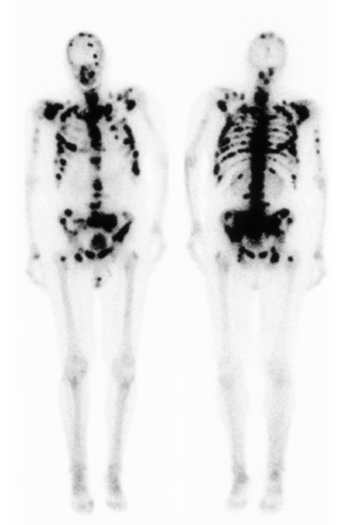
Symptomatic widespread bone metastasis
Advanced local disease and renal compromise
Notes:
Talk here about different extremes of progressive disease
Rarely visceral metastatic disease which portends poorer prognosis

Slide 6
Minimise anxiety
Avoid over diagnosis and treatment morbidity
Avoid over treatment
Reduce Mortality

Slide 7

Prostate, lung, colorectal and ovarian (PLCO) cancer screening trial
76000 men
Annual prostate screening Vs usual care practices
No reduction in death at 7 years and no indication of benefit at 10 years follow up

Slide 8

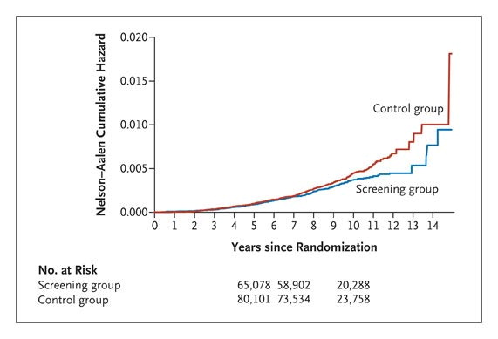
European Randomised study of screening for Prostate cancer - ERSPC
162,000 pts
Pts offered PSA screening at varying intervals Vs pts not offered screening
RR of approximately 20% in the rate of prostate deaths in men aged 55-69
Notes:
In the screening group, 82% of men accepted at least one offer of screening. During a median follow-up of 9 years, the cumulative incidence of prostate cancer was 8.2% in the screening group and 4.8% in the control group. The rate ratio for death from prostate cancer in the screening group, as compared with the control group, was 0.80 (95% confidence interval [CI], 0.65 to 0.98; adjusted P=0.04). The absolute risk difference was 0.71 death per 1000 men. This means that 1410 men would need to be screened and 48 additional cases of prostate cancer would need to be treated to prevent one death from prostate cancer.

Slide 9
PSA at aged 60 – Case control study
1167 men aged 60 provided a blood sample in 1981 and followed until 85
(screening rate during this time was low)
PSA≤ 1ng/ml at 60 – 0.5% risk of mets
- 0.2% risk of death
60 with PSA ≤ 1 ng/ml unlikely to develop life threatening prostate cancer, and could be exempt from further screening

Slide 10
Our radar is weak!
PSA poor screening tool 25% positive predictive value
Independent predictor of disease progression and treatment failure.
But does not distinguish between clinically indolent cancer and those that cause death
Further tools are under investigation

Slide 11
Improving the radar
Age adjusted reference ranges
LABORATORY “Age adjusted” reference ranges
Age (years) | Age specific Median Value
40-50 | 0.7ng/ml
50-60 | 0.9ng/ml
60-70 | 1.2ng/ml
>70 | 1.5ng/ml
Age(years) | PSA ng/ml
0-49 | 0-2.5
50-59 | 0-3.5
60=69 | 0-4.5
>70 | 0-6.5
Notes:
Dorevitch age adjusted value 0-49 0-2.5
50-59 0-3.5
60-69 0-4.5
>70 0-6.5

Slide 12
Improving the radar continued
PSA velocity (rate of change over time)
PSA density (relative to gland volume)
improves sensitivity and specificity
PSA Level (ng/ml) | Prostate Cancer prevalence
<1 | 6-10%
1-4 | 17-25%
4-10 | 20-30%
>20 | 80%
Notes:
Dorevitch age adjusted value 0-49 0-2.5
50-59 0-3.5
60-69 0-4.5
>70 0-6.5

Slide 13
Online risk calculator
http://www.prostatecancer-riskcalculator.com/

Slide 14
Australian Recommendations
RACGP – 2009 Guidelines for preventive activities – routine screening is not recommended, patients should make a decision after being fully informed of risk/benefits
CCA – no pop based screen – patient centred approach
USANZ – recommended fully informed 55-69 pt DRE and PSA
Notes:
Urological society of australia and NZ

Slide 15
BC Cancer Agency recommendations
Asx men 50-55 years of age, with life expectancy of > 10 years, who are well informed consider PSA testing for early diagnosis
Age 50 at average risk, stopped when life expectancy falls below 10 years
Optimal Starting age and frequency of testing is not know – recent studies performed testing every 2-4 years
High risk – AA, FHx of PC, BRCA mutation carrier consider testing at age 40-45

Slide 16
Abnormal results to trigger referral
- PSA>3, or PSA >2 increasing by >0.75-1ng/L year
- abnormal DRE regardless of PSA
- Decision to biopsy needs to include consideration of life expectancy, co morbidities, prostate co-conditions (Large BPH, prostatitis) PSA velocity, DRE findings and patient risk factors and preference

Slide 17
Early detection of prostate cancer should be linked to a treatment algorithm that includes discussion and prioritization of active surveillance for appropriate candidate with low risk prostate cancer
Align yourself with Urologists and Radiation Oncologists involved with active surveillance and other treatment modalities

Slide 18
http://www.bccancer.bc.ca/HPI/CancerManagementGuidelines/Genitourinary/Prostate/PSAScreening/default.htm

Slide 19


Slide 20
Maintenance of well being
Treating/controlling cancer
– establish goals of treatment using a patient
approach
Minimise Toxicity of treatment

Slide 21
Progression of incurable Prostate Cancer
PSA rises
CRPC
Failed
localized
therapy
Hormonal
therapy
Clinical Metastases
Death
Biochemical
Asymptomatic
Symptomatic
Mo M+ M+
24+ months
12-36 months
6-24 months
Notes:
Prostate cancer that is progressive despite the maintenance of castrate levels of testosterone is generally referred to as HRPC. The availability of serial PSA monitoring means that HRPC is detected in patients undergoing hormonal therapy before progression of symptoms. It can often be a year or more from the detection of biochemical failure (hormone-refractory disease) to the development of clinically symptomatic metastases. Once disease becomes symptomatic, median survival is in the order of six to 12 months.

Slide 22
Prostate Cancer
PCa is an androgen receptor (AR) dependent disease
  Blocking AR signalling = hallmark of treatment
Majority of men initially respond to androgen dependent therapy (ADT) when initiated
  Progress after 12-48 months
Over time, the cancers “castrate resistant”

Slide 23
Treatment Options
Testosterone/Androgen receptor blockade
Chemotherapy
Bone strengthening medication

Slide 24
CRPCa
Even though patients have castrate levels of serum testosterone (< 1.75 mmol/L), AR signalling is still happening
  By our current methods of “castration”, they are resistant but these tumors are still responding to AR signalling
Current methods of castration (or ADT)
  LHRH agonists (Lupron, Zoladex, Lucrin)
  LHRH antagonists (degarilex – Firmagon))
  Orchiectomy
  ± Nonsteroidal antiandrogens (cosudex, anandron, androcur)
  CYP 17 Inhibitors – Abiraterone Acetate

Slide 25
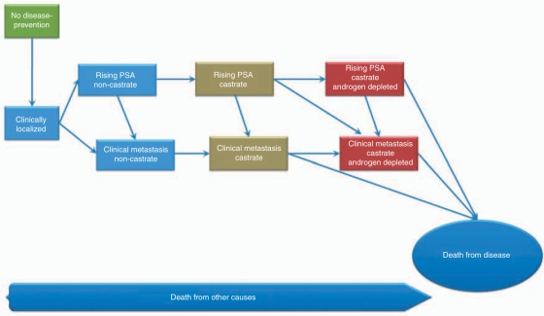

Slide 26
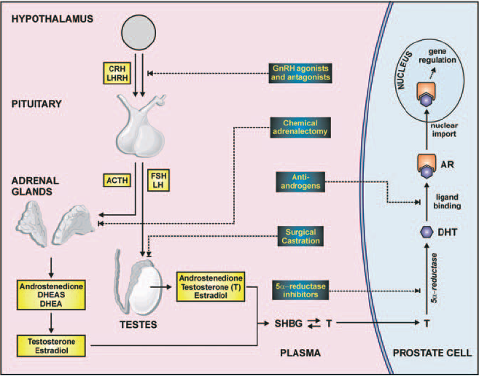
The prostate endocrine pathway
Notes:
Prostate cancer is traditionally an “endocrine” cancer – ie relying on hormones i.e. testosterone derivatives from distant sites synthesized by either the adrenal glands or testes with which rely on upstream hormonal stimulus from the hypothalamus pituitary axis. Understanding the HPGA & HPAA forms the basis of treatment of prostate cancer. How do we stop testosterone from getting into the prostate cancer cell? Cut the production via GnRH agonists which reduces the stimulus to the pituitary and subsequent target “factories” i.e. adrenals and testes, or we can prevent testosterone from binding to the receptors which would normally cause activation of down stream signalling pathways within the nucleus that lead to proliferation and survival

Slide 27
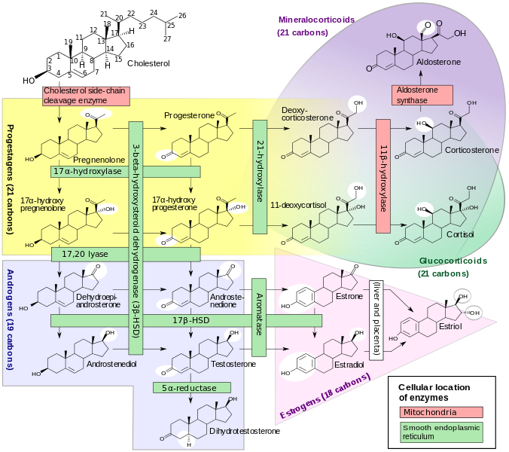

Slide 28

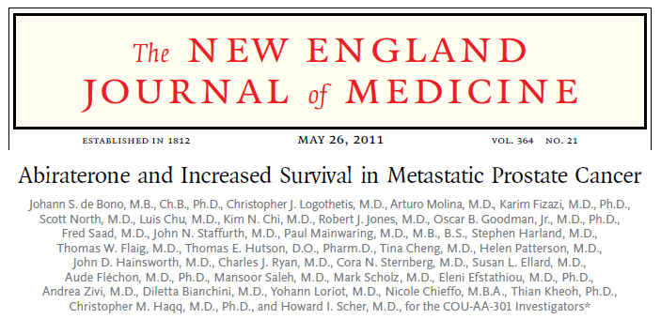
N=1195, mCRPrCa post PD on docetaxel randomized to:
Prednisone 5mg BD + Abiraterone acetate 1000mg
Prednisone 5mg BD + Placebo
PEP: OS

Slide 29
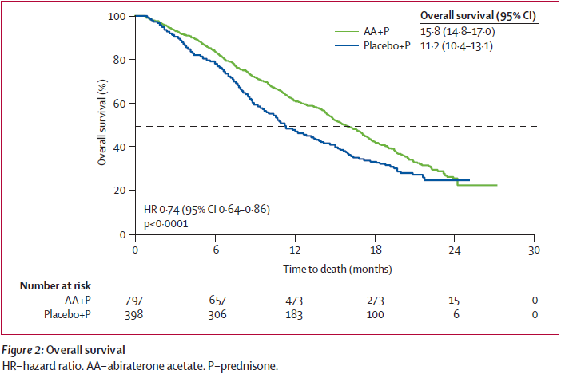
COU-AA-301 – final analysis
Notes:
Another exploratory analysis also revealed that abiraterone a/w better pain control

Slide 30
Side effects of ADT
Fatigue
Vasomotor sxs
Emotional & Cognitive changes
Body composition changes
CVD & DM
Colorectal cancer
Sexual dysfunction
Body image changes
Bone loss & #s
Anaemia

Slide 31



40% of pts on LT ADT have clinically relevant fatigue,
Depression and Pain are independent associations
Age, disease burden and treatment duration at not associated
70% of patients gained weight on ADT
Most weight gain in the 1st year, average is 4.2kg
Body composition changes -  abdo fat,
Decreased bone density and lean muscle

Slide 32
Osteoporosis and Bone Health
Older age, higher comorbidities, history of fracture and stroke are associated with 20 increase in first fracture on ADT
Ca/Vit D replacement
If no bone mets – Bone density at baseline – zoledronic acid
If bone mets – Denosumab – prevent further loss, and protected against skeletal related events

Slide 33
Bisphosphonates
Powerful inhibitor of osteoclast-mediated
bone resorption
Zoledronic acid – first bisphosphonate
to show efficacy in prostate cancer
Monitor renal function and dental hygiene (stop if having invasive dental work)
Notes:
Bisphosphonates are another treatment option for the management of bone metastases. Zoledronic acid is a third-generation, highly potent bisphosphonate that exhibits considerable activity against complications caused by diffuse bone lesions. It acts as a potent inhibitor of osteoclast-mediated bone resorption and can reduce skeletal events such as fracture and the need for surgery and radiation.
These agents are nonmyelosuppressive.

Slide 34
Denosumab
Human monoclonal antibody to RANK ligand
RANK ligand is an essential mediator of osteoclast formation, function and survival
q4 weeks s.c.
Renal Function is not affected, similar risk of osteonecrosis of the jaw (2%)

Slide 35
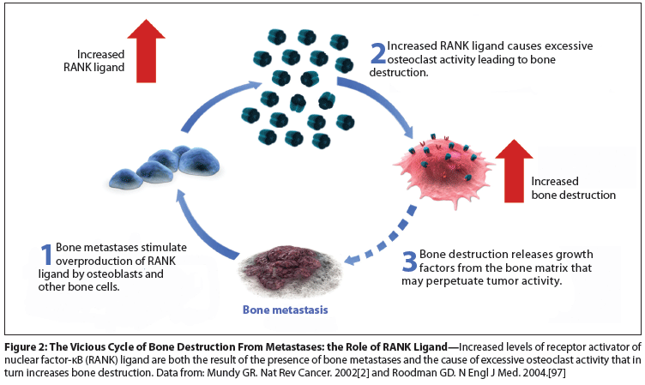

Slide 36
Study Design
Phase III RCT, placebo-controlled, double-blind
Denosumab 4mg S/C and IV placebo
Vs
Zoledronic Acid 4 mg IV and S/C placebo
Primary endpoint = time to first SRE
n = 1901
Densumab delayed SRE 3 month longer than ZA
Fizazi et al. Lancet 2011 March;377:813-822.

Slide 37
Exercise and Resistance Training
Resistance training
  Slows loss of lean mass
  Reduces fat accumulation
  Improved muscular fitness
  Improves mood

Slide 38
Diet
Health Food Pyramid
Eat like a hunter gatherer.
Fish, red meat, white meat in moderation
Fresh fruit and vegetable
Low Glycaemic Index foods
Reduce processed and convenience food

Slide 39
Intermittent ADT in castrate sensitive patients
In patients with castrate sensitive disease
With PSA responses to < 4, Stopping ADT until PSA rose to pretreatment levels or PSA 20.
Intermittent androgen deprivation was not inferior to continuous therapy in terms of median survival
Erectile function, mental health and general quality of life improved with intermittent treatment

Slide 40
Mojo Management
Acknowledge, educate and empower patients and carers
Support groups
Discuss intermittent treatment and supportive medications (Ca, Vit D, bone strengthening)

Slide 41

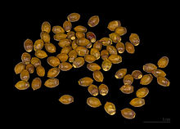




Docetaxel – extract European Yew tree (Taxus baccata)
Notes:
Very old tree up to 2000-4000years old, toxic tree (leaves > bark), Calcium channel blocker in 1021, long bows, musical instruments

Slide 42
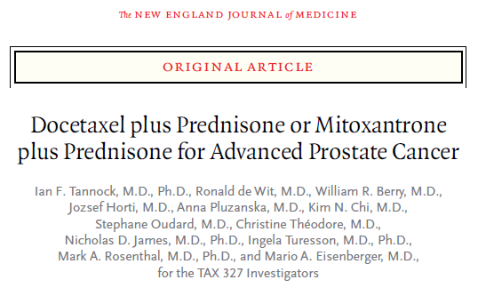
N=1006, mCRPrCa ECOG 0-1 randomized to 3 arms:
Docetaxel 75mg/m² q21/7
Docetaxel 30mg/m² weekly
Mitoxantrone 12mg/m² q21/7
Prednisone 5mg BD + maintenance gonadal androgen suppression (all)
PEP = OS

Slide 43
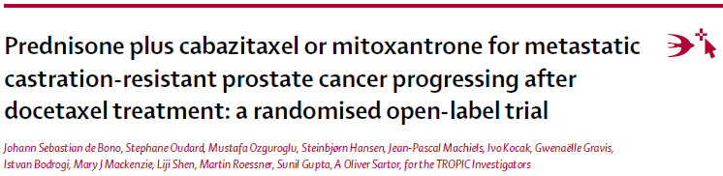
2nd line chemotherapy - TROPIC
N=755, mCRPrCa ECOG 0-2 progression on docetaxel randomized to:
Cabazitaxel 25mg/m² q21/7
Mitoxantrone 12mg/m² q21/7
Prednisone 10mg od + maintenance gonadal androgen suppression
PEP = OS

Slide 44
Progress in Prostate cancer
Last 10 years, 3 new agents – Docetaxel, Cabazitaxel, Abiratorone – improved survival in advanced disease
These agents are in clinical trials in earlier stages of disease…….Future – may improve cure rates
Work is in advanced stages on tests for better screening test
Prostate cancer profile is increasing, better funding, pt support and awareness

