Slide 1
Her2 + Breast Cancer
Laura Bidstrup

Slide 2
Intro
Mrs B is a 49 yo woman who attended for a regular 3 weekly review and Herceptin dose

Slide 3
Chronology
Dec 2000: attended GP regarding lump that had been present in L) breast for 6/12. Bx- breast ca
Jan 2001: Lumpectomy & axillary clearance
Feb 2001: Commence 4 cycles Doxorubicin & Cyclophosphamide, followed by adjuvant radiotherapy
May 2001- May 2003: Tamoxifen, Zoladex
Feb 2005: Nerve pain in R) arm, CT demonstrated 1st rib mets
Mar 2005: Commenced 4 cycles Docetaxel, followed by radiotherapy. Monthly Herceptin & Zometa
Nov 2006: Herceptin toxicity
Jan 2007: Recommenced Herceptin
Jan 2010: Inc R) arm nerve sx, MRI shows no change
Mar 2010: Admitted for 2/7 due to analgesia-related GIT upset

Slide 4
Chronology cont’
Oct 2010: Pain sx continuing despite various rx modalities. Radiographic change on MRI; subacute post-ganglionic C8T1/lower trunk brachial plexus region
Nov 2010: Radiotherapy
Mar –July 2011: Commence 4 cycles abraxane
Jan 2012: Pain controlled, dec fine motor in R) hand, retired.
Dec 2013: Tooth infection
Feb 2014: Bony spurs/abscess in mouth; Zometa discontinued
Present: Herceptin 3 weekly, specialist reviews

Slide 5
HOPC
Attended GP w/ ~6/12 hx of breast lump in L) UO quadrant
  FNA unsuccessful
  Core bx: Invasive Ductal Carcinoma
    BRE grade 3 (poorly differentiated)
  Nil other symptoms
Lumpectomy w/ axillary clearance
  Uncomplicated procedure
  Dx: Stage IIa (T2N0M0) invasive ductal carcinoma with surrounding high-grade solid DCIS
  ER + / PR + / c-erbB-2 (Her2) +
  Margins clear, 12 benign LN harvested
Commenced chemotherapy

Slide 6
Phx
Current medications: Femara, coversyl plus, cipramil, prophylactic abx (dental)
Phx
  Bilateral oophorectomy (2005)
  HTN
  Depression
  Menstrual hx normal
    Was on OCP for many years

Slide 7
Fhx/Social
FHx
  Paternal grandmother: sigmoid ca (60)
  Father: ? Throat ca (71)
  Nil other relevant family hx
Social
  Mrs B lives with her husband and pets in a Melbourne suburb. She and husband were initially planning to have kids approx at time of initial diagnosis
  Worked as community health nurse until deteriorating R) hand function prompted retirement in 2010. Now on disability pension.
  Smoking hx: occasional when young adult
  Alcohol: average 5 per night
  Poor diet/exercise

Slide 8
Mx
Initial Dx: Invasive Ductal Carcinoma, Stage IIa (T2N0M0)
    Rx: 4 cycles Doxorubicin & Taxol (paclitaxel)
Secondary dx: Invasive Ductal Carcinoma with bony metastases, Stage IV (T2N0M1)
    Rx: 4 cycles Docetaxel
    Recurrence: 4 cycles Nab-paclitaxel
Additional medications
    Hydrocortisone
    Phenergan
    Aprepitant (CINV)
    Palonsteron (CINV)
    NaCl (hydration)

Slide 9
Chemo 1 (Feb - May 2001)
4 cycles Doxorubicin & Taxol
Effects:
  Nil documented information
  Mrs B reports nil significant issues
    ~ ?well tolerated

Slide 10
Interim
2001-2005
2 years Tamoxifen and monthly Zoladex
Nil issues at R/V
Regular CT/mammograms clear
Ca markers stable
2005: neuropathic R) shoulder & arm pain; metastatic tumour at R) 1st rib on imaging

Slide 11
Chemo 2 (Mar- Jul 2005)
4 cycles Docetaxel plus Herceptin
Effects:
  Well tolerated
  Nil nausea/vomiting, appetite normal, nil weight loss
  Some fatigue, ECOG 0-1
Commenced 6 weekly Zometa
  Bone-protective, for cx from bony mets/Zoladex etc

Slide 12
Interim (2005 – 2010)
Echo demonstrated Herceptin toxicity Nov 2006, rx delayed until cleared in 2007
Nil concerns on R/V
2008: Progressing well. On Herceptin, Arimidex (anastrozole), Zometa
Mammograms normal, some inc density in L) UIQ stable since ’05
2010: Increasing R) arm neuropathic pain
    Burning/tingling/numbness
    Gastric upset/weight loss due to analgesia; Naprosyn discontinued, Durogesic increased (later ceased)
    MRI: rib/T1 body lesion shows nil change
    Neuropathic sx increase, from shoulder to hand, wasting of palmar muscles, R) hand weakness and decreasing fine motor
    Attended various specialists including pain clinic; on lyrica, cortisone, panadeine forte, morphine, ?methadone. Stellate ganglion block ineffective, 5/7 ketamine infusion ineffective
    November: radiographic change, disease progression

Slide 13
Chemo 3 (Mar-July 2011)
4 cycles Abraxane (+ Herceptin)
Effects:
  Some fatigue, decreased motivation
  ECOG 2
  Nil nausea/vomiting, appetite fine, nil weight loss
  Nil peripheral neuropathy
  Mild skin peeling L) hand, ?fungal infection
  Nil other SE
  April: febrile, brief admission
On letrozole

Slide 14
Progress
2012: Development of bilateral knee pain and R) elbow pain. Nil evidence metastatic; degen change and ?synovitis/soft tissue injury respectively
Increasing loss of fine motor skill in R) hand
2013-14: Tooth infection; attended specialist. Bony spurs in mouth due to Zometa, abscess formation in floor of mouth near exposed bone. 2nd to Bisphos related osteonecrosis of jaw.
Otherwise well, continuing on 3 weekly Herceptin.

Slide 15
Breast Cancer

Slide 16
Incidence & Aetiology
Incidence:
  Leading cause of cancer death in women > 65
  Invasive breast ca
    <50yo: 44/100,000
    >50yo: 345/100,000
  Bimodal incidence: poorly differentiated, high-grade disease usually occur earlier (~50s), whereas hormone-sensitive, slower-growing tumors are later (~70s)
  Mortality: The 2013 estimates are 39,920 expected breast cancer deaths (39,510 women, 410 men)
Aetiology:
  Multifactorial; sporadic vs genetic predisposition

Slide 17
Risk Factors
Phx of breast ca (esp invasive): 3-4x risk of a second primary cancer in the contralateral breast
Family hx
  >2 relatives with breast/ovarian cancer
  Breast cancer in relative <50 yo
  Relatives with both breast cancer and ovarian cancer
  One or more relatives with 2 cancers (breast and ovarian cancer or 2 independent breast cancers)
  Male relatives with breast cancer
  BRCA1 and BRCA2 mutations
  Ataxia telangiectasia heterozygotes (4x risk)
  Ashkenazi Jewish descent (2x risk)
High SES
Advanced age
Caucasian
Late age at first pregnancy/nulliparity
Early onset of menses/late age of menopause/HRT
Long term OCP use
Western diet
Obesity/sedentary lifestyle
Smoking/alcohol/carcinogens

Slide 18
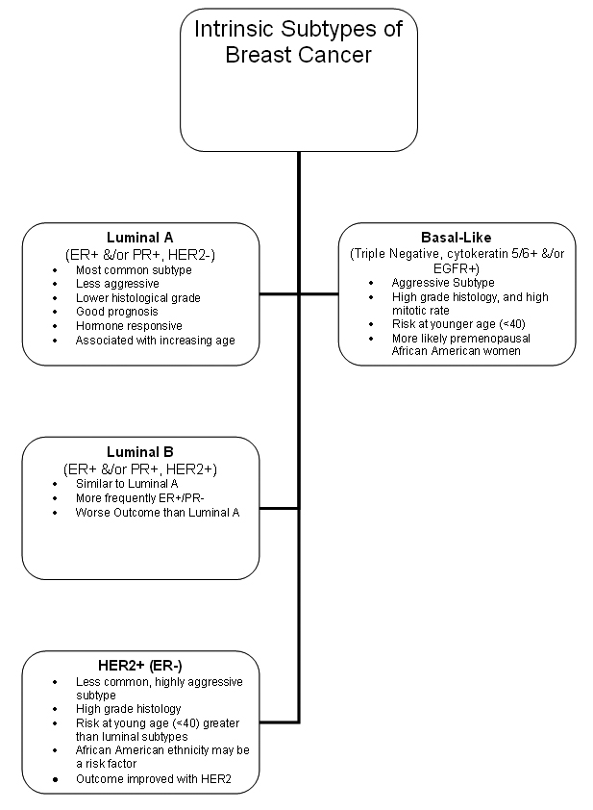
Pathophysiology
Pathophys:
  Dependent on cell morphology
    Ductal vs Lobular
      Invasive vs noninvasive
      Markers (ER/PR/HER2) present/absent
Spread:
  Lymphatic
  Vascular invasion
  Local invasion
Sites
  Regional LN, skin, bone, liver, lung, brain

Slide 19
Sg & Sx
Sx
  Primary: Asymptomatic, painless mass, breast pain (rare)
  Mets:
    Dyspnoea
    Bone pain
    Symptoms of hypercalcemia
    Abdominal distension
    Jaundice
    Localizing neurologic signs
    Altered cognitive function
    Headache
Clinical signs
  Change in breast size or shape/contour
  Skin dimpling or skin changes (eg, thickening, swelling, tethering, Pagets, redness, ulceration, dilated veins, oedema)
  Recent nipple abnormalities (eg, ulceration, retraction, or spontaneous bloody discharge)
  Lump (Hard/irreg/nodular/asymmetry/fixation)

Slide 20
Ix & Differential dx
Ix
  Clinical exam
  US
  Mammography
  Bx (FN, core, excisional etc)
  XR/CT/MRI/PET
Ddx
  Fibroadenoma
  Cysts
  Breast lymphoma
  Metastasis to the breast
  Mastitis
  Traumatic fat necrosis
  Duct ectasia

Slide 21
Staging- TNM
Primary tumour (T)
  Tx: Primary tumor cannot be assessed
  T0: No evidence of primary tumor
  Tis: DCIS/LCIS/Paget disease of the nipple with no tumor
  T1: Tumor ≤2 cm in greatest diameter
  T1mic: Microinvasion ≤0.1 cm (in greatest diameter)
  T1a: Tumor >0.1 but not >0.5 cm
  T1b: Tumor >0.5 but not >1 cm
  T1c: Tumor >1 cm but not >2 cm
  T2: Tumor >2 cm but not >5 cm
  T3: Tumor >5 cm
  T4:Tumor of any size, with direct extension to (a) the chest wall or (b) skin only
  T4a: Extension to the chest wall, not including the pectoralis
  T4b: Oedema (eg peau d’orange) or ulceration of the skin of the breast or satellite skin nodules confined to the same breast
  T4c: Both T4a and T4b
  T4d: Inflammatory disease

Slide 22
Staging- TNM
Regional lymph nodes (N)
  Nx: Regional lymph nodes cannot be assessed
  N0: No regional lymph node metastasis
  N1: Metastasis in movable ipsilateral axillary lymph node(s)
  N2: Metastasis in ipsilateral axillary lymph node(s) fixed or matted, or in clinically apparent ipsilateral internal mammary nodes in the absence of clinically evident axillary lymph node metastasis
  N2a: Metastasis in ipsilateral axillary lymph nodes fixed to one another or to other structures
  N2b: Metastasis only in clinically apparent ipsilateral internal mammary nodes and in the absence of clinically evident axillary lymph nodes
  N3: Metastasis in ipsilateral infraclavicular or supraclavicular lymph node(s) with or without axillary lymph node involvement, or clinically apparent ipsilateral internal mammary lymph node(s) and in the presence of axillary lymph node
  N3a: Metastasis in ipsilateral infraclavicular lymph node(s)
  N3b: Metastasis in ipsilateral internal mammary lymph node(s) and axillary lymph node(s)
  N3c: Metastasis in ipsilateral supraclavicular lymph node(s)

Slide 23
Staging
Distant metastasis (M)
  Mx: distant metastasis cannot be assessed
  M0: no distant metastasis
  M1: distant metastasis present
Stage grouping
  Stage 0: Tis, N0, M0
  Stage I: T1, N0, M0
  Stage IIA: T(0-2), N(0-1), M0
  Stage IIB: T(2-3), N(0-1), M0
  Stage IIIA: T(0-3), N2, M0
  Stage IIIB: T4, N(0-2), M0
  Stage IIIC: T4, N3; M0
  Stage IV: any T, any N, M1

Slide 24
Grading
Nottingham grading system:
  Criteria
    Tubule formation (?normal duct structure retained)
    Nuclear grade
    Mitotic rate
  Scoring:
    1-3 (most-least normal) per criteria
  Total score:
    3–5: G1 (Low grade; well differentiated)
    6–7: G2 (Intermediate grade; moderately differentiated)
    8–9: G3 (High grade; poorly differentiated)

Slide 25
Prognostic factors
Prognosis:
  5-year survival rates by tumour stage:
    Stage 0, 99-100%
    Stage I, 95-100%
    Stage II, 86%
    Stage III, 57%
    Stage IV, 20%
Factors
  Axillary lymph node status
  Lymphatic/vascular invasion
    Lymph node positive recurrence rates at 5yr:
      1-3 positive nodes – 30-40%
      4-9 positive nodes – 44-70%
      >10 positive nodes – 72-82%
  Tumor size
  Patient age
  Histologic grade
  Tumour subtypes (IDC, LCIS, etc)
  Response to neoadjuvant therapy
  ER/PR status
  HER2 gene amplification or overexpression

Slide 26
Treatment modalities
Surgery
  Lumpectomy
  Mastectomy
  +Axillary clearance
Chemotherapy
Other
  Radiotherapy; especially in cases of breast-conserving surgery
    Dec local recurrence risk by 70%
    Whole breast/partial breast/nodal irradiation
    Can also be done post-mastectomy
  SERMs (Tamoxifen, raloxifine)- can delay ER pos tumours ~10yr
  Aromatase inhibitors (Arimidex, Femara)- postmenopausal women (perpheral block only)
  Herceptin
  Bisphosphenates

Slide 27
HER2
  Background
    HER2: transmembrane tyrosine kinase receptor (ErbB protein family/epidermal growth factor receptor family)
    Activation→ increased activity of molecular pathways assoc with tumor proliferation, deregulation
  Incidence:
  HER2 is overexpressed in 18-20% of invasive breast cancers
Testing:
  Immunohistochemistry assay
    3+: Positive HER2 expression - Uniform intense membrane staining of more than 30% of invasive tumor cells
    2+: Equivocal for HER2 protein expression - Complete membrane staining that is either nonuniform or weak in intensity but has circumferential distribution in at least 10% of cells
    0 or 1+: Negative for HER2 protein expression
  Equivocal→ additional testing with FISH ( fluorescence in situ hybridization)
    Positive HER2 amplification: FISH ratio is greater than 2.2 or HER2 gene copy is greater than 6.0
    Equivocal HER2 amplification: FISH ratio of 1.8-2.2 or HER2 gene copy of 4.0-6.0
    Negative HER2 amplification: FISH ratio is less than 1.8 or HER2 gene copy of less than 4.0
Prognosis:
  Prior to Herceptin, HER2 overexpression was associated with a more aggressive tumor phenotype and worse prognosis
  Brain mets now more commonly seen as Herceptin cannot cross BBB
Treatment
  HER2-positive patients benefit from anthracycline-based regimens (eg doxorubicin)

Slide 28
Chemotherapy regimen
Metastatic breast cancer: Nab-paclitaxel
  Dose 3 weekly, to be continued until disease progression or unacceptable toxicity
SE:
  Caution: neutropaenic sepsis (admit)
  Immediate (onset hours to days)
    Nausea and vomiting
    Taste and smell alteration
  Early (onset days to weeks)
    Anaemia/neutropenia/thrombocytopenia (delay)
    Oral mucositis
    Skin rash – maculopapular
    Fatigue
    Diarrhoea
    Hyperlacrimation
    Arthralgia/myalgia
    Peripheral neuropathy (dose reduce/delay if >grade 2)
  Late (onset weeks to months)
    Alopecia
    Nail changes
  Delayed (months to years)
    Menopausal sx

Slide 29
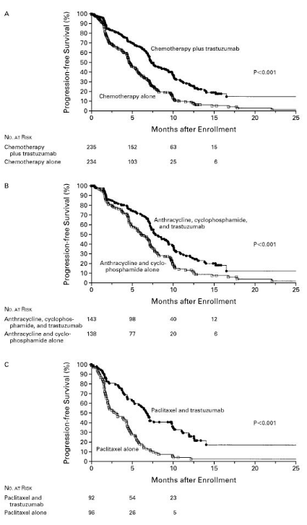
HERCEPTIN
Progression free survival
“trastuzumab produces roughly a 50% improvement in disease-free survival and 33% improvement in overall survival, regardless of the chemotherapy regimen or sequence of trastuzumab delivery”
“Trastuzumab plus chemotherapy was associated with a significant improvement in time to disease progression (7.4 mo vs 4.6 mo), objective response rate (50% vs 32%), and 1-year survival (25.1 mo vs 20.3 mo) compared with chemotherapy alone”

Slide 30
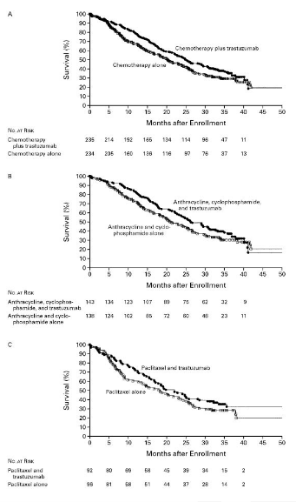
Overall survival
“adjuvant trastuzumab for 1 year improved disease-free and overall survival among women with early-stage HER2-positive breast cancer at 5 years, and found that a nonanthracycline regimen plus trastuzumab had a more favorable risk-benefit ratio than anthracycline-based regimens due to similar efficacy, fewer acute toxic effects, and lower risks of cardiotoxicity and leukemia”

Slide 31
Alternatives
  Ado-trastuzumab (Kadcyla):
    single agent for treatment of HER2-positive, metastatic breast cancer in patients who have already undergone unsuccessful treatment with trastuzumab and a taxane, either separately or in combination.
  Pertuzumab:
    elicits action at a different ligand binding site from trastuzumab to prevent HER2 dimerization. The combination of both HER2 receptor antibodies (pertuzumab plus trastuzumab) is superior to either agent alone.
    Average increase in progression-free survival of 6.1 months in patients receiving pertuzumab in addition to trastuzumab and docetaxel with minimal to no increase in cardiac toxic effects
  Lapatinib:
    Orally bioavailable TK inhib. SE: rash/diarrhoea. Synergystic w/ trastuzumab. Improves survival

Slide 32
References
EviQ
Best Practice
Medscape
Manual of Clinical Oncology, seventh ed.
Slamon D, Eiermann W, Robert N, Pienkowski T, Martin M, Press M, et al. Adjuvant trastuzumab in HER2-positive breast cancer. N Engl J Med. Oct 6 2011;365(14):1273-83.
Baselga J, Cortés J, Kim SB, Im SA, Hegg R, Im YH, et al. Pertuzumab plus trastuzumab plus docetaxel for metastatic breast cancer. N Engl J Med. Jan 12 2012;366(2):109-19.
Slamon DJ, Leyland-Jones B, Shak S, Fuchs H, Paton V, Bajamonde A, et al. Use of chemotherapy plus a monoclonal antibody against HER2 for metastatic breast cancer that overexpresses HER2. N Engl J Med. Mar 15 2001;344(11):783-92.
Welslau M. Dieras V. Sohn JH. Hurvitz SA. Lalla D. Fang L. Althaus B. Guardino E. Miles D. Patient-reported outcomes from EMILIA, a randomized phase 3 study of trastuzumab emtansine (T-DM1) versus capecitabine and lapatinib in human epidermal growth factor receptor 2-positive locally advanced or metastatic breast cancer.Clinical Trial, Phase III. Journal Article. 120(5):642-51, 2014 Mar 1.

