Slide 1
Colorectal Cancer
Laura Bidstrup

Slide 2
Intro
Mr A is a 39 yo man who attended for review and maintenance therapy for metastatic rectal cancer

Slide 3
Chronology (10-11)
Sep 2010: attended GP regarding 6/12 PR bleeding; colonoscopy= rectal carcinoma, CT= liver mets
Oct 2010: Completed 5 weeks of RT and PVI 5FU
Nov 2010- Mar 2011: Commence folfox-6/Avastin, some minor SEs (cold feet, loose bowels, fatigue), positive tumour response
Apr 2011: Combined resection of liver and rectum= moderately differentiated adenocarcinoma. Nil complications.
Jun 2011: Commenced Folfiri, dose reduced due to diarrhoea. Some periph neuro. Recovering well from surg.
Aug 2011: ECOG 1. Chemo delayed 1 week due to infective diarrhoea
Sep 2011: Ileostomy reversal
Oct 2011: Postop infection after reversal, ~8weeks no chemo

Slide 4
Chronology cont’ (11-13)
Nov 2011: Inc CEA, inc liver mets and new lung mets. Nil SEs
Jan 2012: dec liver met size, lungs cleared. Nil SEs, some haemorhoids
Feb 2012: Folfiri/cetuximab. PET= 12 foci in liver (unresectable), intense uptake in primary. Nil sig SEs, ECOG 1
Mar-Jul 2012: Rash, diarrhoea. Improving on imaging.
Aug 2012: Finished folfiri. CT clear. Commenced weekly cetuximab (maintenance)
Sep 2012-Jan 2013: Nil issues. ECOG 0. Minor rash persisting w/ abx.

Slide 5
Chronology (13-14)
Feb 2013: Progression on US/CT. PET= multifocal disease, unresectable. Commenced Folfiri-m/Bevacizumab. Minor SEs, ECOG 0-1
Mar-Jun 2013: Nil issues. CT stable.
Jul 2013: Completed 12 cycles. SE: diarrhoea. ECOG 1. Commenced bevacizumab/capecitabine.
Aug2013: Commenced de Gramont (5FU/folinic acid/avastin) 3 weekly. CT/PET= small residual liver disease.
Sep 2013- Feb 2014: Nil SEs (diarrhoea). Unstable CEAs. CT stable.
Mar 2014: Commenced Folfiri/Bevacizumab. Nil sig issues. Some mild nausea.

Slide 6
HOPC
Attended GP w/ ~6/12 hx of painless PR bleed
  Colonoscopy: rectal carcinoma
RT & avastin
Commenced chemotherapy
Combined anterior resection/liver resection
  Uncomplicated procedure
  Dx: Moderately differentiated adenocarcinoma, Stage IV
  5/10 liver lesions resected
  Margins clear, 6 benign regional LN harvested

Slide 7
Phx/Fhx
Current medications: Gastrostop, codeine phosphate. ?Dex (excitability)
Phx
  NKA
  Hernia as baby
  Nil other hx
FHx
  Nil relevant hx

Slide 8
Social
Social
  Mr A lives with his wife and two children (3 and 5). He continues to work at an office job ~4/7. Nil financial issues.
  Smoking hx: 1-2 packs/week when young adult
  Alcohol: ~20/week prior to dx, very occasional use now
  Relatively poor diet/exercise

Slide 9
Mx summary
Initial Dx: Metastatic rectal adenocarcinoma
RX (earliest→most recent):
      6x 5FU + RT
      11x Folfox 6m/beva
      15x Folfiri m/ beva
      10x Folfiri-m/cetux
      24x weekly Cetux
      12x Folfiri-m/beva
      1x Beva/cape
      11x De Gramont
      12x Folfiri/beva (until Aug 14)
Additional medications
    Hydrocortisone
    Phenergan
    Aprepitant (CINV)
    Palonsteron (CINV)
    NaCl (hydration)

Slide 10
Colorectal Cancer

Slide 11
Incidence & Aetiology
Incidence:
  2010: 14,860 new cases
  Risk of dx by 85: 1/10 (m), 1/15 (f)
  Risk of dev second primary in colon: 1%/year
  Mortality: In 2011, there were 3999 colorectal ca related deaths (second highest after lung cancer)
Aetiology:
  Multifactorial
    Genetic predisposition (eg familial adenomatous polyposis [FAP], hereditary nonpolyposis crc [Lynch syndrome])
    Environmental carcinogens

Slide 12
Risk Factors
Colorectal polyps
Genetic mutations
  FAP (defective APC = 100% chance of ca by 55yo), Lynch, kras, braf
Family hx
  First deg relative: more than 2x risk
Inflammatory bowel disease
  UC: risk= 2% at 10yr, 8% at 20yr, 18% at 30yr
  Cr: 1.5-2x risk
Phx other cancers
Advanced age
Poor diet (high fat, low fibre, high red meat etc)
Obesity/sedentary lifestyle
Smoking (2.5x risk)/alcohol/enviro carcinogens

Slide 13
Pathophysiology
Pathophys:
  Type: Majority of colorectal cancers are adenocarcinomas derived from epithelial cells
  ~71% arise in the colon, 29% in the rectum
  Other types: carcinoid tumours (rectum/caecum), GI stromal cell tumours, and lymphomas
  2/3 in left colon, 1/3 in right colon. Right-sided more common in women
  2-% CRCs are rectal, ¾ of which can be felt on PR
  ~3% CRCs are multicentric
  30% -50% have mutated KRAS gene
    respond to anti-epidermal growth factor receptor [EGFR] antibody therapy
    40% to 60% of patients with wild-type KRAS tumors do not respond to this therapy
    mutated BRAF gene (5% to 10% of tumors) can affect response
Spread:
  Lymphatic
  Vascular invasion
  Local invasion
Sites
  Regional LN (40-70%), liver (usually colon), peritoneal cavity, lungs (usually rectal), adrenals, ovaries, bone, brain (rare)

Slide 14
Sg & Sx
Sx
  Right sided often asymp; or dull/vague pain, anaemic sx (fatigue, weight loss, weakness)
  Left sided: change in bowel habit/stool consistency, PR bleed, abdominal bloating or cramping, obstruction
Clinical signs
  Bloating
  Signs of anaemia
  Weight loss
  Abdo mass

Slide 15
Ix & Differential dx
Ix
  Clinical exam/PR
  FOBT
  Bloods (FBE, UEC, LFT,CEA)
  Colonoscopy (+bx)
  Barium enema
  CT colonography
  EUS
  CT/PET/MRI
Ddx
  IBS
  IBD
  Anal fissure
  Haemorrhoids
  Diverticular disease

Slide 16
Staging- TNM
Primary tumour (T)
  Tx: Primary tumor cannot be assessed
  T0: No evidence of primary tumor
  Tis: Carcinoma in situ: intraepithelial or invasion of the lamina propria
  T1: invasion of submucosa
  T2: invasion of the muscularis propria
  T3: invasion through the muscularis propria into pericolorectal tissues
  T4a:Tumor penetrates to surface of visc peritoneum
  T4b: tumour directly invades or is adherent to other organs/structures

Slide 17
Staging- TNM
Regional lymph nodes (N)
  Nx: Regional lymph nodes cannot be assessed
  N0: No regional lymph node metastasis
  N1: Metastasis in 1-3 regional node(s)
  N1a: Metastasis in 1 regional node
  N1b: Metastasis in 2-3 regional nodes
  N1c: Tumour deposits in subserosa, mesentery, or nonperitonealize pericolic or perirectal tissues w/o regional node mets
  N2: Metastasis in >4 regional nodes
  N2a: Metastasis in 4-6 regional nodes
  N2b: Metastasis in >7 regional nodes

Slide 18
Staging
Distant metastasis (M)
  Mx: distant metastasis cannot be assessed
  M0: no distant metastasis
  M1: distant metastasis present
  M1a: mets confined to one organ/site
  M1b: mets in >1 organ/site or the peritoneum
Stage grouping
  Stage 0: Tis, N0, M0
  Stage I: T1/2, N0, M0. Dukes A, MAC A/B1
  Stage IIA: T3, N0, M0. Dukes B, MAC B2
  Stage IIB: T4a, N0, M0. Dukes B, MAC B2
  Stage IIC: T4b, N0, M0. Dukes B, MAC B3
  Stage IIIA: T1-2, N1, M0. Dukes C, MAC C1
    T1, N2a; M0. Dukes C, MAC C1
  Stage IIIB: T3-4a, N1/1c; M0. Dukes C, MAC C2
    T2-3, N2a; M0. Dukes C, MAC C1/2
    T1-2, N2b; M0. Dukes C, MAC C1
  Stage IIIC: T4a, N2a; M0. Dukes C, MAC C2
    T3-4a, N2b; M0. Dukes C, MAC C2
    T4b, N1-2; M0. Dukes C, MAC C1
  Stage IVA: any T, any N, M1a
  Stage IVB: any T, any N, M1a

Slide 19
Dukes/MAC
Dukes
  Dukes' A: Invasion into but not through the bowel wall(90% 5-y survival)
  Dukes' B: Invasion through the bowel wall but not involving lymph nodes(70% 5-y survival)
  Dukes' C: Involvement of lymph nodes (20-30% 5-y survival)
  Dukes' D: Widespread metastases (<5% 5-y survival
MAC
  Stage A: Limited to mucosa
  Stage B1: Extending into muscularis propria but not penetrating through it; nodes not involved
  Stage B2: Penetrating through muscularis propria; nodes not involved
  Stage C1: Extending into muscularis propria but not penetrating through it. Nodes involved
  Stage C2: Penetrating through muscularis propria. Nodes involved
  Stage D: Distant metastatic spread

Slide 20
Grading
GX: Grade cannot be assessed
G1: Well-differentiated (low grade)
G2: Moderately differentiated (intermediate grade)
G3: Poorly differentiated (high grade)
G4: Undifferentiated (high grade)

Slide 21
Prognostic factors
Prognosis:
  5-year survival rates by tumour stage:
    Stage I, 93% to 97%
    Stage II, 72% to 85%
    Stage III, 44% to 83% (depending on nodal involvement
    Stage IV, <8%
Factors
  Stage
  Clinical presentation (obstruction/perf)
  Tumor location (rectal, transverse, descending worse)
  Chromosome 18 (allelic loss)
  Histologic grade (well-differentiated>poorly diff)
  Tumour characteristics/markers

Slide 22
Treatment modalities
Surgery
  Open, laparoscopic, trans-anal
  Extent of the colectomy depends on tumour site/size
  Resection and examination of a minimum of 12 nodes is necessary for accurate staging
  ?Concurrent resection of mets
Chemotherapy
Radiotherapy (rx or pall)
Other
  Floxuridine for flushing hepatic arteries (supply mets; veins supply hepatocytes)

Slide 23
Chemotherapy regimen
Metastatic colorectal cancer:
FOLFIRI (Fluorouracil Leucovorin Irinotecan) with Bevacizumab
Repeated every 2 weeks continuously until disease progression or unacceptable toxicity
SE:
  Caution: neutropaenic sepsis (admit)
Immediate (onset hours to days)
  Cardiotoxicity a/w Fluorouracil and Capecitabine
  Diarrhoea & Cholinergic syndrome (a/w Irinotecan)
  N/V
Early (onset days to weeks)
    Anaemia/neutropenia/thrombocytopenia (delay)
    Oral mucositis
    Hand-foot syndrome
    Fatigue
    Diarrhoea
    Hyperlacrimation
    Actinic keratoses flare
    HTN
    Proteinuria
    Photosensitivity
    Gastric perforation
    Thromboembolism
    Expstaxis
Late (onset weeks to months)
    Alopecia
    Nail changes
    Hyperpigmentation

Slide 24
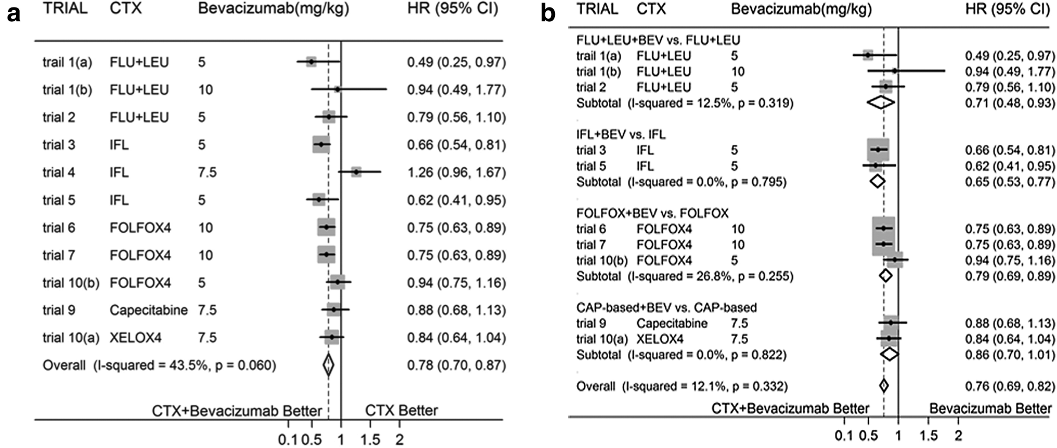
Meta analysis 2013: different chemos with and without bevacizumab
Overall survival

Slide 25
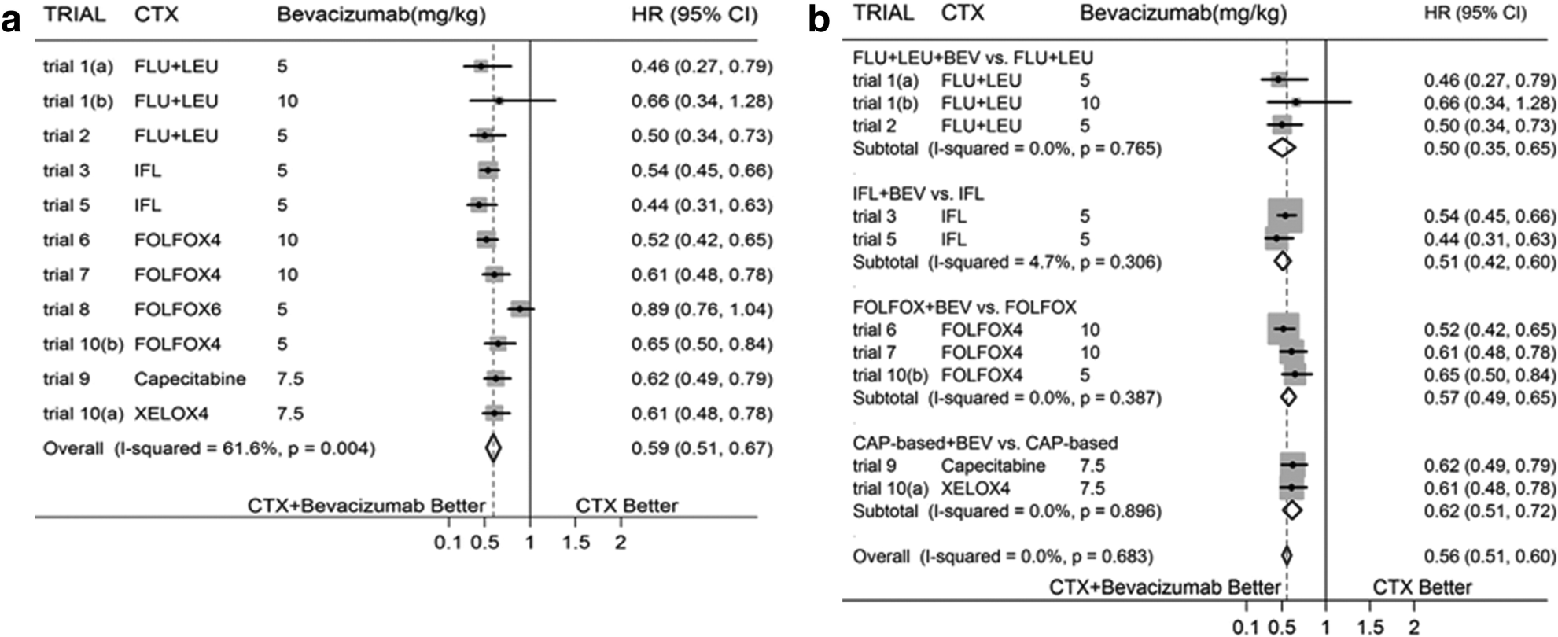
Bevacizumab: monoclonal antibody that inhibits vascular endothelial growth factor A (VEGF-A); therefore prevents stimulation of angiogenesis
Progression free survival

Slide 26
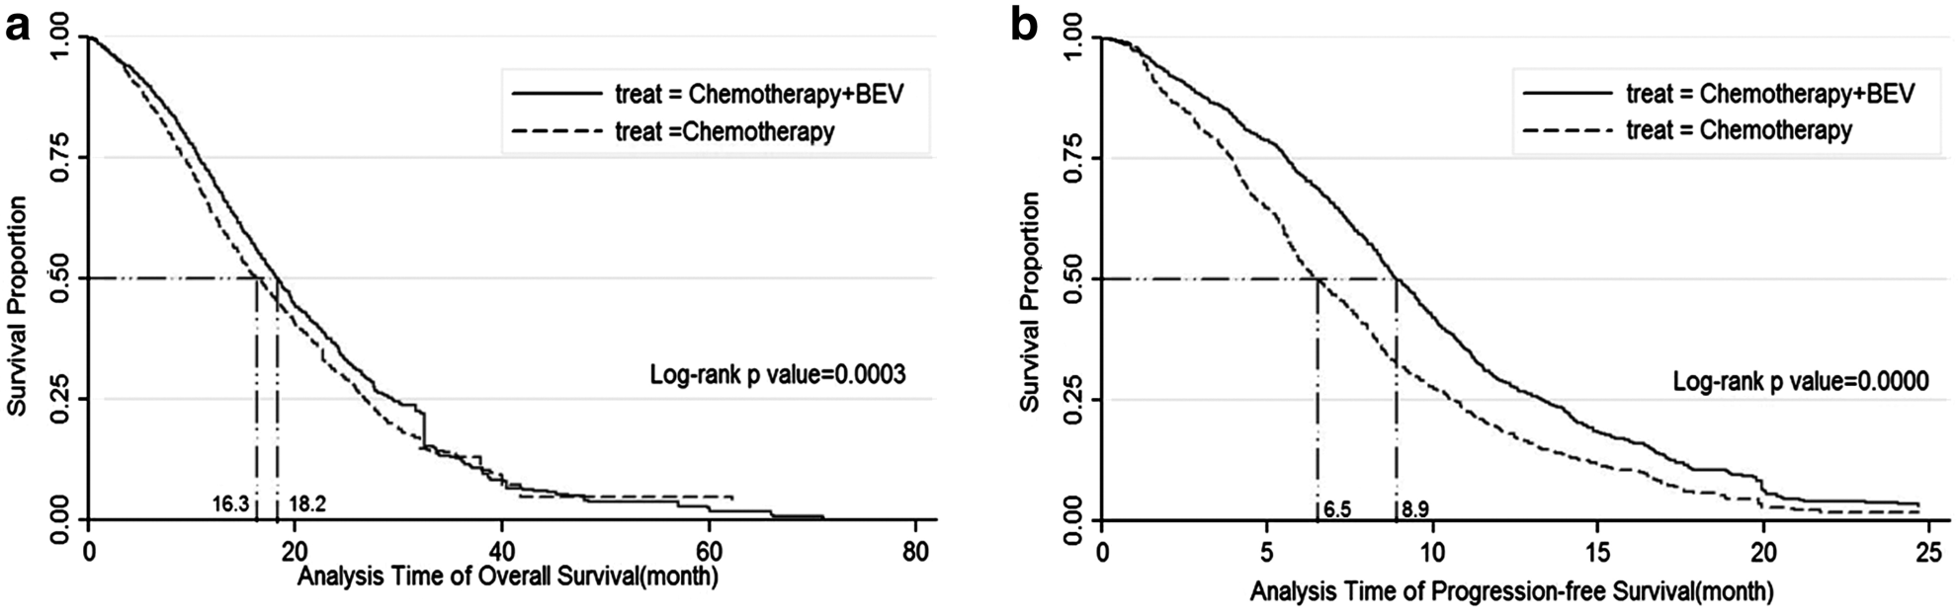
OS (18.2 vs. 16.3)
PFS (8.9 vs. 6.5)
“evident benefits of additional BEV in OS and PFS can be identified in all subgroups, except for the CTX containing capecitabine in OS”

Slide 27
References
EviQ
Best Practice
Medscape
Manual of Clinical Oncology, seventh ed.
Weitz J, Koch M, Debus J, et al. Colorectal cancer. Lancet 2005;365:153.
Chao Lv, Shuodong Wu, Duo Zheng, Yuli Wu, Dianbo Yao, and Xiaopeng Yu. Cancer Biotherapy & Radiopharmaceuticals. September 2013, 28(7): 501-509. doi:10.1089/cbr.2012.1458.
Meyerhardt JA, Li L, Sanoff HK, et al. Effectiveness of bevacizumab with first-line combination chemotherapy for Medicare patients with stage IV colorectal cancer. J Clin Oncol 2012;30:608.
Hochster HS, Hart LL, Ramanathan RK, et al. Safety and efficacy of oxaliplatin and fluoropyrimidine regimens with or without bevacizumab as first-line treatment of metastatic colorectal cancer: Results of the TREE Study. J Clin Oncol 2008;26:3523.
Thirion P, Michiels S, Pignon JP, et al. Modulation of fluorouracil by leucovorin in patients with advanced colorectal cancer: An updated meta-analysis. J Clin Oncol 2004;22:3766.
Moertel CG. Chemotherapy for colorectal cancer. N Engl J Med 1994;330:1136.
Van Cutsem E, Twelves C, Cassidy J, et al. Oral capecitabine compared with intravenous fluorouracil plus leucovorin in patients with metastatic colorectal cancer: Results of a large phase III study. J Clin Oncol 2001;19:4097.
Van Cutsem E, Hoff PM, Harper P, et al. Oral capecitabine vs intravenous 5-fluorouracil and leucovorin: Integrated efficacy data and novel analyses from two large, randomised, phase III trials. Br J Cancer 2004;90:1190.

