Slide 1
Cancer of Unknown Primary
Laura Bidstrup

Slide 2
Intro
Mr R attended for review and maintenance therapy for adenocarcinoma of unknown primary

Slide 3
Chronology
Apr 2011: attended GP regarding ~2 days severe sharp pain from RLQ to shoulder; US/CT = liver lesions. Bx = met adenocarcinoma. Commenced on Cisplatin/Gemcitabine.
May 2011: Pain continuing (dull ache, RUQ/shoulder). Markers decreasing, nil SEs
Jun 2011: ECOG 2, nil SEs. Splenic met found on CT, markers increasing; not responding to Cis/Gem
Jul 2011: Commenced Folfiri-m/beva. Mild GIT toxicity/lightheadedness for 2/7. ECOG 0. Swelling/tender in R) arm- subclav/axillary DVT. (→Clexane).
Aug 2011: Dec met size on CT, dec markers. Nil SEs.
Sep 2011: ECOG 0. Some mucositis, resolved with dec dose.
Oct 2011: ~ inc markers. Dec met size. ECOG 0.

Slide 4
Nov 2011: Mild gen abdo pain/diarrhoea. ECOG 1.
Dec 2011: Dec met size. Commenced maintenance Bev/cape. Tiredness, dec short term memory and concentration, ~diarrhoea.
Jan-Apr 2012: ECOG 1. Nil sig SEs. Dec markers. Occasional mild R) shoulder/costal margin pain. Exam normal.
May-Jun 2012: R) shoulder/CM pain resolved w/ Dex. Markers ~ increasing.
Jul 2012: Lower back pain→headache. Fatigue, nil other sx (esp neuro)
Aug-Sep 2012: Mets unchanged on Ix, nil issues.
Oct 2012: ~appetite, ECOG 1, dose reduced due to minor mucositis, nausea, changed bowel habit

Slide 5
Dec 2012-Mar 2013: RUQ pain controlled w/ panadeine forte. ECOG 1, Grade 1 Hand/foot, other SEs settled
Apr 2013: Pain→ severe. Reactions to opioids. Ref to pall med. Sig disease progression on CT, lesions markedly larger. Markers x2 in 3/52.Commenced Folfoxiri/Bev.
May 2013: Markers dec by 50%. SEs: grade 1 diarrhoea/nausea/cramps/periph neuro. ECOG 1.
Jun 2013: CT stable, but deteriorating condition. Commenced Carboplat/pacli/bev/cape.
Jul 2013: Dec markers. Severe abdo pain ~2-3/7 after C1, required endone
Sep 2013: Feb neutropaenia (Admit x5/7, Abx). Numbness over distal ½ feet. ~5/7 myalgia.
Oct-Nov 2013: ECOG 1-2. Stable periph neuro. LL wasting. Nil change on CT. Dec markers.
Dec 2013: feb neutropaenia (admit x 4/7, IV abx. ?LRTI)
Jan-May 2014: pain controlled, ECOG 1, stable.

Slide 6
Phx/Fhx
Current medications: Endone, Ativan, Dex, meloxicam, nexium, Mg2+, durogesic 25mcg
Phx
  Allergies: erythromycin (?reactions to opioids)
  Migraines
  Nil other hx
FHx
  Mother: breast ca ages 66/72. Alive and doing well.
  Grandfather: Met skin cancer, died in 70s
  Nil other known

Slide 7
Social
Social
  Mr R lives with his wife and three children. Eldest child lives out of home and has 2 children.
  Self employed motorcycle restorer; previously w/ large company. Nil financial issues.
  Smoking hx: never smoked
  Alcohol: ~ binge monthly before dx

Slide 8
Mx summary
Initial Dx: Adenocarcinoma of unknown primary
RX (earliest→most recent):
      3x Cisplatin/Gemcitabine
      12x Folfiri m/ beva
      3x Beva/cape
      5x Folfoxiri/beva
      15x Carboplatin/Paclitaxel/beva/cape
Additional medications
    Hydrocortisone
    Phenergan
    Aprepitant (CINV)
    Palonsteron (CINV)
    NaCl (hydration)

Slide 9
Cancer of Unknown Primary

Slide 10
Incidence & Aetiology
Incidence:
  8th most common cancer in men, 9th in women
  6th most common cause of cancer death in Australians (around 5% of cancer deaths)
  2009: ~2900 people in Australia were diagnosed with CUP.
Mortality: In 2007, there were 2344 CUP-related deaths
Aetiology:
  Unknown?

Slide 11
Pathophysiology
Pathophys
  Normally, mets appear like abnormal versions of the primary; if not identifiable= CUP
  Attributes of CUP: Early dissemination, clinical absence of primary tumour, unpredictable metastatic pattern, and aggressiveness
  Four major subtypes:
    Adenocarcinomas (well to moderately differentiated)
    Poorly differentiated carcinomas and adenocarcinomas
    Squamous cell carcinomas
    Undifferentiated neoplasms
  Majority of cases are adenocarcinomas, then poorly differentiated tumours
  Main hypothesis: primary tumour remains microscopic, thus evading detection by available techniques; or disappears completely after seeding the metastasis
Stage:
  Likely IV, ?III/II
Risk Factors
  Smoking, older age, poor diet, alcohol and obesity

Slide 12
Sx
Depends on the predominant site of metastatic involvement.
Often asymptomatic
Typical ca sx;
  SOB/chest discomfort
  Bone/back pain
  Ascites, abdo discomfort, jaundice
  Lymphadenopathy
  Weight loss
  Headaches
  Anorexia
  Fatigue

Slide 13
Ix & Differential dx
Ix
  Clinical exam
  FOBT
  Bloods (FBE, UEC, LFT,CEA)
  Urinalysis
  Bx
  CT/PET/MRI
Ddx
  Squamous or neuroendocrine carcinoma of unknown primary
  Met of known primary

Slide 14
Prognostic factors
Prognosis:
  Not diagnosed until metastatic disease
  Treatment difficult due to unknown primary cancer type
  Five year survival:16%.
  Median survival: 3 to 4 months, up to 6 to 11 months with combination chemotherapy in selected populations.
Factors
  Site, general health
    Potentially curable in favourable circumstances

Slide 15
Treatment options
Supportive
RT only in certain localised cases
Chemo:
  Almost every class of cytotoxic chemotherapeutic agent has been assessed. Response rates are low; however modern combo regimens more effective
  Should either be treated on trial basis with proposed future regimens, or low-toxicity (palliative/maintenance) treatment

Slide 16
Chemo Regimen
        Carboplatin/Paclitaxel/Bevacizumab/Capecitabine
    Repeated every 4-6 weeks
SE:
  Caution: neutropaenic sepsis (admit)
Immediate (onset hours to days)
  Cardiotoxicity a/w Capecitabine
  N/V
  Taste change
  Hypersensitivity reaction
Early (onset days to weeks)
    Anaemia/neutropenia/thrombocytopenia (delay)
    Oral mucositis
    Hand-foot syndrome
    Fatigue
    Arthralgia/myalgia
    Diarrhoea
    Hyperlacrimation
    Actinic keratoses flare
    HTN
    Proteinuria
    Photosensitivity
    Gastric perforation
    Thromboembolism
    Expstaxis
Late (onset weeks to months)
    Alopecia
    Nail changes
    Hyperpigmentation
    Hyperbilirubinaemia
    Cognitive changes

Slide 17
Current literature
Platinum/taxane combinations are widely used; yielding response rates of 30% and median overall survival of 9–11 months in certain CUP patients.
A ‘gold standard' of therapy for adenocarcinoma or poorly differentiated CUP site has not been found
Efficacy of any chemotherapy for CUP is relatively low (most die within 2 years) → need for an optimisation of treatment, eg by better characterisation of the tumour, or of markers for predicting response
A recent pilot study combining bevacizumab and erlotinib showed considerable efficacy; median overall survival of 7.4 months and 33% of patients alive at 1 year.

Slide 18
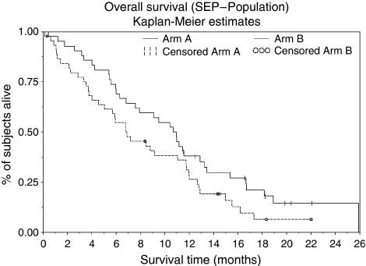
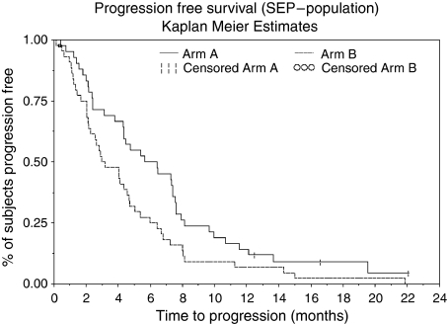
Comparison study
Paclitaxel/carboplatin (arm A) or the non-platinum non-taxane regimen gemcitabine/vinorelbine (arm B)

Slide 19
References
EviQ
Best Practice
Australian Cancer Council
Manual of Clinical Oncology, seventh ed.
Briasoulis, E. and N. Pavlidis. 1997. "Cancer of Unknown Primary Origin." Oncologist 2(3):142-152.
Briasoulis, E., H. Kalofonos, D. Bafaloukos, et al. 2000. "Carboplatin plus paclitaxel in unknown primary carcinoma: a phase II Hellenic Cooperative Oncology Group Study." J.Clin Oncol. 18(17):3101-3107.
Huebner, G., H. Link, C. H. Kohne, et al. 2009. "Paclitaxel and carboplatin vs gemcitabine and vinorelbine in patients with adeno- or undifferentiated carcinoma of unknown primary: a randomised prospective phase II trial." Br J Cancer 100(1):44-49.

