Slide 1
Endocrine resistant hormone positive metastatic breast cancer

Slide 2
HOPC
Mrs GV is a 78 year old women who presented to Cabrini ED with acute dyspnoea is the setting of recent malignant pleural effusion in the setting of Metastatic Breast Ca.
  Nov 2010: Self Detected left breast lump (AJCC Stage IIa - T1 N1 M0)
    WLE + SLNBX: 16mm BRE Gr 3 IDC w focal mucinous differentiation ER/PR Positive +++; HER-2 Negative. Multifocal LVI. Nil perineural invasion. Clear margins.
    Node positive disease: 8mm focus in 1/3 SLN
    Further Axillary Dissection: 0/6 nodes
  Jan 2011: Adjuvant Radiotherapy
  Feb 2011: Letrozole/Risedronate
    Chemotherapy not commenced in setting of severe CFS + chemical sensitivities

Slide 3
Background
PMHX
  Chronic Fatigue Syndrome
  Hypothyroidism
  Hypertension
  Hysterectomy (menorrhagia)
  Osteoporosis
  Menopause (HRT for 15 years)
SHX
  Home-maker
  From home alone (supportive daughter lives very close)
  Widow (2001) ; Children x3 (Daughter-Brighton; Sons-Brunswick/San Francisco)
  Life long non smoker- although heavy passive smoker via Husband
  Non-drinker
FHX
  Uncle: Lung Cancer (77yo) – Heavy smoker
  Niece: Breast Ca (46yo)

Slide 4
Disease Progression
  Aug 2011: Ceased Letrozole due to arthralgia/flushing. Declined further endocrine treatment.
Aug 2012: Left Anterior Chest Wall pain and Ca 15.3 rise: 199 (B/L~20)
        Scans delayed due to subsequent OS holiday
Oct 2012
  (CT CAP): multiple nodules throughout both lung fields and extensive mediastinal lymphadenopathy with evidence of calcification.
  There were no abnormalities below the diaphragm.
  (Whole body bone scan): abnormal activity in the sternum, the left pubic bone, the T4 vertebral body, left 8th rib - all consistent with bone metastases.
  The histopathology (left supraclavicular lymph node) biopsy confirms metastatic spread from breast cancer with the same hormonal profile with oestrogen and progesterone receptors both being strongly positive.
Tamoxifen / Bondronat

Slide 5
Oct 2013: Dermal metastatic spread – started on Abraxane
Apr 2014: Completed six cycles of Abraxane.
  CT scan: stable appearance of her mediastinal lymph node metastases with a very small right pleural effusion. Her bony metastatic disease is stable.
June 2014: Intraocular metastasis Rx w RT
Mid Sept: Gemcitabine/Carboplatin
Late Sept 2014: Right Pleural Effusion

Slide 6
Endocrine therapy resistance in ER positive metastatic breast cancer

Slide 7
There are three different types of hormonal therapy medicines:
Aromatase inhibitors:
  Arimidex (chemical name: anastrozole)
  Aromasin (chemical name: exemestane)
  Femara (chemical name: letrozole)
SERMs (Selective Estrogen Receptor Modulators):
  Tamoxifen
  Fareston (chemical name: toremifene)
ERDs (OEstrogen Receptor Downregulators):
  Faslodex (chemical name: fulvestrant)

Slide 8
Premenopausal
Postmenopausal
Ovaries
Peripheral Sites: adrenal gland, liver, muscle, fat
Ovarian Suppression
GnRH inhibitors or Ovarian removal
Aromatase Inhibitors
Oestrogen
Tamoxifen
Tamoxifen
ER
ER
X
Fulvestrant
Cancer Cell

Slide 9
Oestrogens
Oestrogens play a crucial role in breast tumor growth
  rationale for the use of antioestrogens, such as tamoxifen, in women with estrogen receptor (ER)-α-positive breast cancer.
However, hormone resistance is a major clinical problem.
    Intrinsic and acquired
    Heterogenous
Altered growth factor signalling to the ERα pathway has been shown to be associated with the development of clinical resistance.

Slide 10
Karolinska Cohort:
Intra-individual ER Status at Relapse
Aim
  Determine if hormone receptor and HER2 status change between primary breast cancer and relapse
Methods
  N = 1051 breast cancer patients relapsing between 1997-2007 at single center in Stockholm, Sweden
  Hormone receptor and HER2 status gathered from original patient records
Lindstrom L, et al. SABCS 2010. Abstract S3-5.

Slide 11
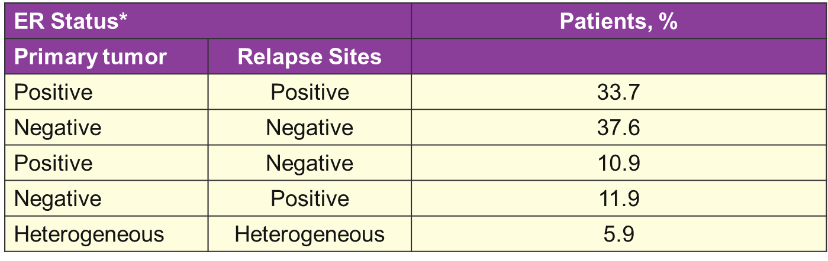
Karolinska Cohort:
Intra-individual ER Status at Relapse
Lindstrom L, et al. SABCS 2010. Abstract S3-5.

Slide 12
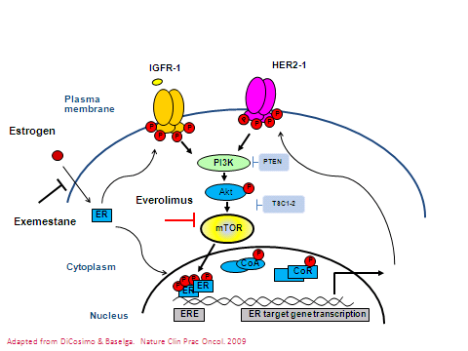
ER resistance
Crosstalk between ER and critical signalling pathways
  epidermal growth factor receptor/human epidermal growth factor receptor 2 (HER2)
  extracellular signal-regulating kinase 1/2/mitogen activated protein kinase cascade
  phosphoinositide 3-kinase (PI3K)/protein kinase B (AKT)/mammalian target of rapamycin (mTOR) pathway/fibroblast growth factor receptor 1/2 [FGFR]/ insulin-like growth factor-1 receptor [IGF-1R]
Johnston SR, et al 2005; Steroid Biochem Mol Biol 95:173–181
Johnston SRD 2010; Clinical Cancer Res 16:1979–1987

Slide 13
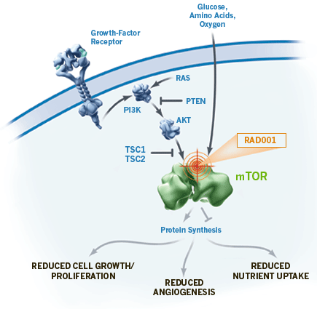
Overcoming endocrine resistance: Bolero 2
Phase III study
Population
724 postmenopausal women with hormone receptor (HR) –positive, HER2-negative metastatic breast cancer that had progressed on therapy with a nonsteroidal aromatase inhibitor
Intervention
Combination therapy with exemestane and mTOR inhibitor everolimus vs exemestane
Results
Significantly longer progression-free survival (7.8 months v 3.2 mth) and higher response rate than single-agent exemestane.
Baselga J et al N Eng J Med 2012;366:520-529

Slide 14
Overcoming endocrine resistance: Tamrad
Randomised phase II trial
Patient population
111 patients with HR+/HER2- metastatic breast cancer with prior exposure to AI treatment (in adjuvant and/or metastatic setting)
Intervention
Tamoxifen/Everolimus (n=57) vs Tamoxifen alone (n=54)
Results
Tamoxifen/everolimus had a higher clinical benefit rate (61%) and longer time to progression (8.6 months) than the group receiving tamoxifen alone (42% and 4.5 months).
Patients with secondary resistance to AI seemed to benefit more from the combination than patients with primary resistance.
Bachelot T, et al 2012; J Clin Oncol 30:2718–2724.

Slide 15
Overcoming endocrine resistance: Horizon
Multinational randomised phase III trial
Population
1112 aromatase inhibitor naive women with hormone receptor-positive advanced disease
Intervention
Temsirolimus/Letrozole vs Letrozole/placebo
Results
Stopped for futility by the independent data monitoring committee.
Response rate and overall survival were also similar between groups
Wolff AC, et al 2013; J Clin Oncol 31:195–202.

Slide 16
In conclusion
ER-positive disease is heterogeneous
  endocrine resistance is a complex problem - needs highly translational trials to solve.
Targeting mTOR should be limited to populations with acquired AI resistance and should use everolimus, not others in the class.
From a research perspective, we know that careful choice of compounds and combinations based on biologic and
Further pharmacogenomics may shed light on patient differences, and biomarker analysis on most if not all patients in clinical trials of novel targeted agents and combinations is essential.

