Slide 1

2014: A new twist in the biomarker story
KRAS
exon 2
RAS
A new label for Erbitux

Slide 2



CRYSTAL: RAS wt selection extended the OS benefit with cetuximab + FOLFIRI
1.0
Cetuximab + FOLFIRI (n=599)
Overall patient population (ITT)
0.8
FOLFIRI (n=599)
0.6
19.9
HR 0.878
p=0.0419
OS estimate
18.6
0.4
0.2
0.0
0
6
12
18
24
30
36
42
48
54
Months
Cetuximab + FOLFIRI (n=178)
1.0
FOLFIRI (n=189)
RAS wt population
0.8
HR 0.69
p=0.0024
0.6
28.4
OS estimate
0.4
20.2
0.2
0.0
0
6
12
18
24
30
36
42
48
54
Months
Cetuximab is not indicated for the treatment of patients with mCRC whose tumors have RAS mutations or for whom RAS tumor status is unknown.
Adapted from Van Cutsem E, et al. J Clin Oncol 2011;29:2011–2019 and Ciardiello F, et al. ASCO 2014 (Abstract No. 3506)
Notes:
Right patient:
Each patient should be treated as an individual; mCRC is not one single disease
Biomarker testing should influence treatment decisions in mCRC by identifying patients who are most likely to benefit from a specific treatment

Slide 3





CRYSTAL: RAS wt selection extended the OS benefit with cetuximab + FOLFIRI
KRAS exon 2 wt population
1.0
Cetuximab + FOLFIRI (n=316)
FOLFIRI (n=350)
0.8
0.6
23.5
HR 0.796
p=0.0093
OS estimate
20.0
0.4
0.2
RAS-evaluable population (65%)
0.0
0
6
12
18
24
30
36
42
48
54
Months
HR 0.75
p=0.0008
Cetuximab + FOLFIRI (n=178)
1.0
FOLFIRI (n=189)
0.8
HR 0.69
p=0.0024
RAS wt population (85%)
0.6
28.4
OS estimate
0.4
20.2
0.2
0.0
0
6
12
18
24
30
36
42
48
54
Months
Adapted from Van Cutsem E, et al. J Clin Oncol 2011;29:2011–2019
and Ciardiello F, et al. ASCO 2014 (Abstract No. 3506)

Slide 4
CRYSTAL: RAS wt selection extended the ORR benefit with cetuximab + FOLFIRI
KRAS exon 2 wt¹
RAS wt* (subgroup)²
OR 2.069
p<0.001
OR 3.11
p<0.0001
70
70
60
60
66
50
57
50
40
40
Response rate (%)
Response rate (%)
40
39
30
30
20
20
10
10
0
0
FOLFIRI
(n=350)
Cetuximab + FOLFIRI (n=316)
FOLFIRI
(n=189)
Cetuximab + FOLFIRI (n=178)
*RAS evaluable in 430/666 (65%) patients with KRAS exon 2 wt mCRC; RAS wt: 367/430 (85%), 5% sensitivity cut-off; cetuximab is not indicated for the treatment of patients with mCRC whose tumors have RAS mutations or for whom RAS tumor status is unknown.
1. Van Cutsem E, et al. J Clin Oncol 2011;29:2011–2019;
2. Ciardiello F, et al. ASCO 2014 (Abstract No. 3506)

Slide 5
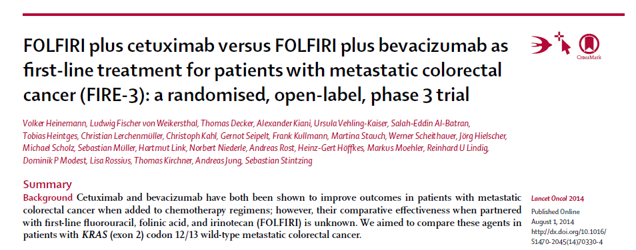

Slide 6
FIRE-3: Head-to-head IST of cetuximab + FOLFIRI vs bevacizumab + FOLFIRI in 1st line mCRC
Open-label, randomized, multicenter, Phase III IST
Cetuximab + FOLFIRI
(n=297)
Patients with untreated KRAS exon 2 wt mCRC
N=592
R
Bevacizumab + FOLFIRI
(n=295)
Primary endpoint: ORR
Secondary endpoints: PFS, OS, time to failure of strategy, depth of response, secondary resection rate, safety
Amended October 2008 to include only patients with KRAS exon 2 wt mCRC
  113 patients with KRAS exon 2 mt mCRC were enrolled before the amendment
Retrospective RAS subgroup analysis (RAS-evaluable population, including both RAS wt and new RAS mt: n=407)
Overall survival (OS) data are based on an event rate of 59%
The FIRE-3 study did not meet its primary endpoint of significantly improving overall response rate
(ORR) in patients with KRAS (exon 2) wt mCRC based on investigators’ read
The study design, cross-over treatment in 2nd line and other study attributes are
needed to better understand the data
The study was financially supported by Merck Serono GmbH
Cetuximab is not indicated for the treatment of patients with mCRC whose tumors have
RAS mutations or for whom RAS tumor status is unknown.
Heinemann V, et al. ASCO 2013 (Abstract No. LBA3506);
Modest D, et al. WCGC 2013 (Abstract No. O-0029);
Stintzing S, et al. ECC 2013 (Abstract No. LBA17),
updated information presented at meeting (available at
http://eccamsterdam2013.ecco-org.eu/Amsterdam2013/Webcasts
%20Photos/WebcastDetail.aspx?webcasturl=http://www.ecco-org.eu/webcasts/ecco17/SP0984/SP0984.flv, accessed June 25, 2014)
Stintzing S, et al. Ann Oncol 2012;23:1693–1699
Notes:
6

Slide 7
FIRE-3: Greater selection of patients further improves the benefit with cetuximab
KRAS exon 2 wt¹
Cetuximab + FOLFIRI (n=297)
Bevacizumab + FOLFIRI (n=295)
RAS wt*²
Cetuximab + FOLFIRI (n=171)
Bevacizumab + FOLFIRI (n=171)
1.0
28.7
months
1.0
33.1
months
25.0
months
Δ = 3.7 months
25.6
months
Δ = 7.5 months
0.75
0.75
HR 0.77
(95% CI 0.62–0.96)
p=0.017
HR 0.70
(95% CI 0.53–0.92)
p=0.011
0.50
0.50
OS estimate
OS estimate
0.25
0.25
0.0
0.0
0
12
48
Months
0.0
24
36
60
72
0
12
48
Months
24
36
60
72
 | Cetuximab + FOLFIRI |  | Bevacizumab + FOLFIRI | OR (95% CI) | p value
KRAS exon 2 wt (ITT), n | 592
ORR, % (95% CI) | 62.0 (56.2–67.5) | 58.0 (52.1–63.7) |  | 1.18 (0.85–1.64) | 0.183†
RAS wt*, n | 342
ORR, % (95% CI) | 65.5 (57.9–72.6) | 59.6 (51.9–67.1) |  | 1.28 (0.83–1.99) | 0.32‡
Overall survival (OS) data are based on an event rate of 59%
The FIRE-3 study did not meet its primary endpoint of significantly improving overall response rate (ORR) in patients with KRAS (exon 2) wt mCRC based on investigators’ read
The study design, cross-over treatment in 2nd line and other study attributes are needed to better understand the data
The study was financially supported by Merck Serono GmbH
Cetuximab is not indicated for the treatment of patients with mCRC whose tumors have RAS mutations or for whom RAS tumor status is unknown.
*Including KRAS exon 2, 3, 4 and NRAS exon 2, 3, 4; †One-sided Fisher’s exact test; ‡two-sided Fisher’s exact test
Adapted from 1. Heinemann V, et al. ASCO 2013 (Abstract No. LBA3506)
and 2. Stintzing S, et al. ECC 2013 (Abstract No. LBA17),
updated information presented at meeting (available at
http://eccamsterdam2013.ecco-org.eu/Amsterdam2013/Webcasts
%20Photos/WebcastDetail.aspx?webcasturl=http://www.ecco-org.eu/webcasts/ecco17/SP0984/SP0984.flv, accessed June 25, 2014)

Slide 8
FIRE-3: Choice of 2nd line therapy
(ITT, KRAS exon 2 wt) well balanced
 | Cetuximab + FOLFIRI (n=297) | Bevacizumab + FOLFIRI (n=295)
Alive after 1st line therapy, % | 87.5 (n=260/297) | 84.7 (n=250/295)
Any 2nd line therapy*, % | 78.5 (n=204/260) | 76.4 (n=191/250)
2nd line substances, % | n=204 | n=191
Fluoropyrimidine | 91.7 | 85.3
Oxaliplatin | 63.7 | 62.8
Irinotecan | 15.7 | 15.7
Bevacizumab | 46.6 | 17.3
Anti-EGFR mAb | 15.2 | 41.4
The protocol recommended 2nd line treatment with bevacizumab + FOLFOX following cetuximab + FOLFIRI and cetuximab + irinotecan following bevacizumab + FOLFIRI. However, physicians were free to choose any 2nd line regimen
Overall survival (OS) data are based on an event rate of 59%
The FIRE-3 study did not meet its primary endpoint of significantly improving overall response rate (ORR) in
patients with KRAS (exon 2) wt mCRC based on investigators’ read
The study design, cross-over treatment in 2nd line and other study attributes are needed to better understand the data
The study was financially supported by Merck Serono GmbH
Cetuximab is not indicated for the treatment of patients with mCRC whose tumors have
RAS mutations or for whom RAS tumor status is unknown.
*Treatment with a substance not being part of 1st line therapy
Modest D, et al. WCGC 2013 (Abstract No. O-0029)

Slide 9
FIRE-3: Duration of 2nd line therapy
(ITT, KRAS exon 2 wt)
A longer duration of 2nd line therapy was observed for
patients in the cetuximab + FOLFIRI arm
n=191
p=0.08
n=204
n=120
p=0.05
n=130
2nd line therapy with cetuximab
n=79
p=0.06
2nd line therapy with bevacizumab
n=95
Overall survival (OS) data are based on an event rate of 59%
The FIRE-3 study did not meet its primary endpoint of significantly improving overall response rate (ORR) in
patients with KRAS (exon 2) wt mCRC based on investigators’ read
The study design, cross-over treatment in 2nd line and other study attributes are needed to better understand the data
The study was financially supported by Merck Serono GmbH
Cetuximab is not indicated for the treatment of patients with mCRC whose tumors have RAS mutations
or for whom RAS tumor status is unknown.
Adapted from Modest D, et al. ASCO 2014 (Abstract No. 3558)

Slide 10
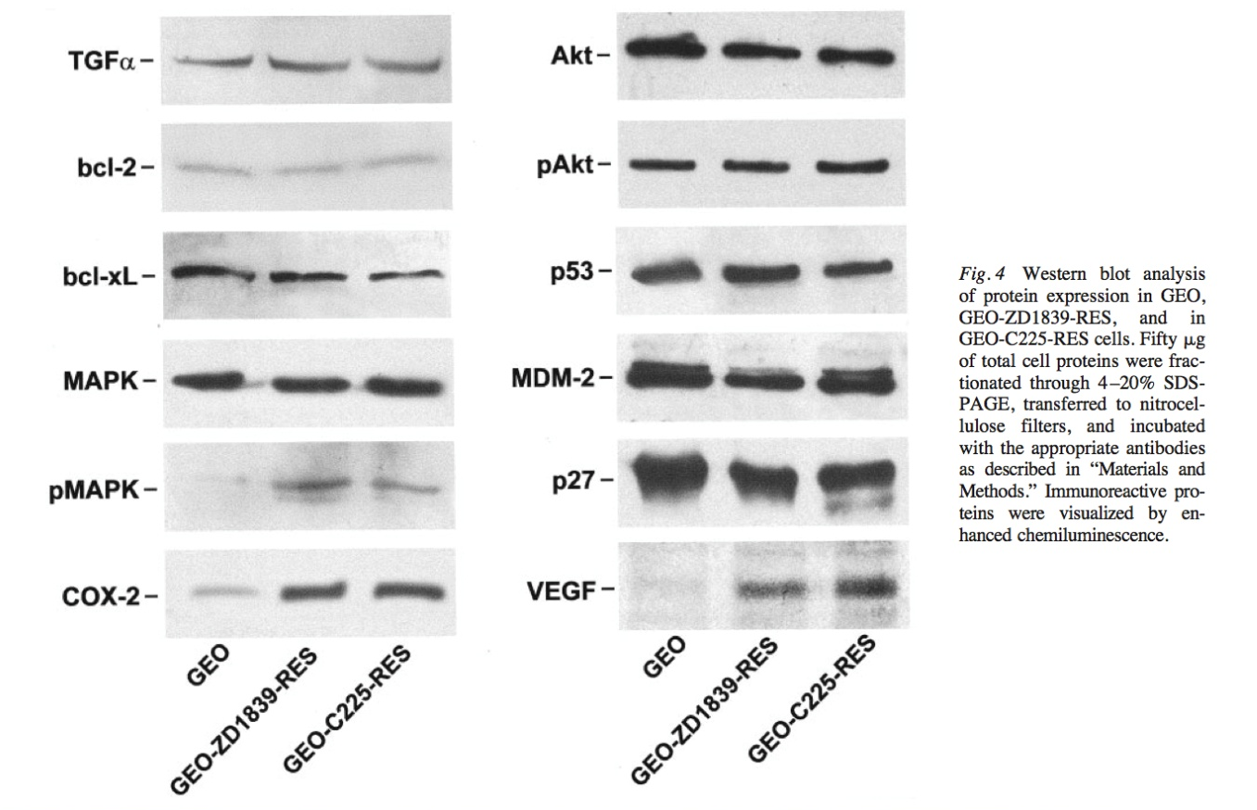
Change in tumor biology
Upregulation of VEGF as resistance to anti-EGFR agents occurs
*
C225: cetuximab (anti-EGFR mAb)
ZD1839: oral anti-EGFR tyrosine kinase inhibitor
Ciardiello F, et al. Clin Cancer Res 2004;10:784–793

Slide 11
FIRE-3: independent radiological read
p = 0.015
p = 0.0013
Cetux + FOLFIRI
RAS wt (N=266)
*KRAS wt (N=459)
70%
71.4
67.2
Beva + FOLFIRI
60%
56.5
p = 0.0005
50%
47.9
48.2
40%
66.8*
62.2*
33.0
30%
54.5*
48.3*
43.8*
20%
32.1*
10%
p = 0.0076*
p = 0.0036*
p = 0.0004*
ORR: objective response rate
ETS: early tumor shrinkage
DpR: depth of response
0%
ORR
ETS
DpR
Heinemann et al., oral presentation, WCGC 2014

Slide 12
Impact of RAS data on clinical practice today
Anti-EGFR therapies are now indicated for:
  Patients with EGFR-expressing RAS wt mCRC (cetuximab)¹
  Patients with RAS wt mCRC (panitumumab)²
And are contraindicated
  In combination with oxaliplatin-based chemotherapies for patients with RAS (KRAS or NRAS exons 2, 3, 4) mt tumors or in whom RAS tumor status is unknown^{1,2}
Evidence of RAS wt status is required before initiating
treatment with anti-EGFR therapy^{1,2}
1. Cetuximab SmPC, January 2014
2. Panitumumab SmPC, March2014

Slide 13


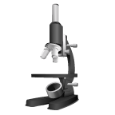
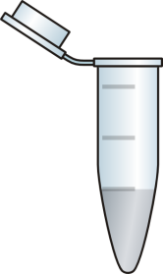
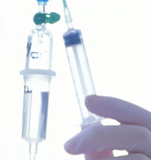
Key considerations for RAS testing
RAS testing should be performed in ALL patients,
before selecting 1st line therapy
TIMING…
request at diagnosis
QUALITY…
obtain high-quality tumor tissue
COLLABORATE…
with skilled pathologists
RELIABILITY…
use validated techniques
PERSONALIZE…
make informed treatment decisions

Slide 14
CALGB 80405: Randomized, open-label, multicenter (North America), Phase III IST*
  Comparator arm A
  Bevacizumab +
  mFOLFOX6 or FOLFIRI†
Continue treatment until PD, unacceptable toxicity or curative surgery
  Patients with untreated KRAS exon 2 wt locally advanced (unresectable) or mCRC, ECOG PS 0–1
  (N=1137**)
  Experimental arm B
  Cetuximab +
  mFOLFOX6 or FOLFIRI†
R
  Arm C
  Bevacizumab + cetuximab +
  mFOLFOX6 or FOLFIRI†
Arm C closed to accrual as of 09/10/2009
Primary endpoint: OS
Secondary endpoints:
Response, PFS, time to treatment failure, duration of response, toxicity,
60-day survival, eligibility for surgery post-treatment, quality of life
Venook AP, et al. ASCO 2014 (Abstract No. 126013)

Slide 15
CALGB 80405: OS (KRAS exon 2 wt)
+
— Cetuximab + mFOLFOX6/FOLFIRI (n=578)
— Bevacizumab + mFOLFOX6/FOLFIRI (n=559)
100
+
+
+
+
+
+
+
+
+
+
+
+
+
+
+
+
+
80
HR 0.925
(95% CI 0.78–1.09)
p=0.34
+
+
+
+
+
+
+
+
+
+
+
+
+
+
+
+
+
+
+
+
+
+
+
+
+
+
29.9
+
60
+
+
+
+
+
+
+
+
+
+
+
+
+
+
+
+
+
+
+
+
+
+
+
+
+
+
+
% Event free
+
+
+
+
+
+
+
+
+
+
+
+
+
29.0
+
+
+
+
+
+
+
+
+
+
+
+
+
+
+
+
+
+
+
+
+
+
40
+
+
+
+
+
+
+
+
+
+
+
+
+
+
+
+
+
+
+
+
+
+
+
+
+
+
+
+
+
+
+
+
+
+
+
+
+
+
+
+
+
+
+
+
+
+
+
+
+
+
+
+
+
+
+
+
+
+
+
+
+
+
+
+
+
+
+
+
+
+
20
+
+
+
+
+
+
+
+
+
+
+
+
+
+
+
+
+
+
+
+
+
+
+
+
+
+
+
+
+
+
+
+
0
0
12
24
36
48
60
72
84
Time (months)
Cetuximab is not indicated for the treatment of patients with mCRC whose tumors have RAS mutations or for whom RAS tumor status is unknown.
Adapted from Venook AP, et al. ASCO 2014 (Abstract No. 126013)

Slide 16
CALGB 80405: OS (KRAS exon 2 wt) in FOLFOX and FOLFIRI groups
FOLFOX treated
FOLFIRI treated
— Cetuximab + mFOLFOX6 (n=426)
— Bevacizumab + mFOLFOX6 (n=409)
— Cetuximab + FOLFIRI (n=152)
— Bevacizumab + FOLFIRI (n=150)
+
100
+
100
+
+
+
+
+
+
+
+
+
+
+
HR 0.9
(95% CI 0.7–1.0)
p=0.09
+
HR 1.2
(95% CI 0.9–1.6)
p=0.28
+
80
+
80
+
+
+
+
+
+
+
+
+
+
+
+
+
+
+
+
+
+
+
30.1
+
33.4
+
+
+
+
+
+
+
+
+
+
+
+
+
+
+
60
+
60
+
+
+
+
+
+
+
+
+
+
+
+
+
+
+
+
+
+
+
+
+
+
+
% Event free
+
+
% Event free
+
+
+
+
+
+
+
+
+
+
+
+
+
+
+
+
+
+
+
+
+
+
+
+
+
+
+
+
+
26.9
+
+
+
+
+
28.9
+
+
+
+
+
+
+
+
+
+
+
+
+
+
+
+
40
+
40
+
+
+
+
+
+
+
+
+
+
+
+
+
+
+
+
+
+
+
+
+
+
+
+
+
+
+
+
+
+
+
+
+
+
+
+
+
+
+
+
+
+
+
+
+
+
+
+
+
+
+
+
+
+
+
+
+
+
+
+
+
+
+
+
+
+
+
+
+
+
+
+
+
+
+
+
+
+
+
20
+
+
20
+
+
+
+
+
+
+
+
+
+
+
+
+
+
+
+
+
+
+
+
+
+
+
+
0
0
0
0
12
24
36
48
60
72
84
12
24
36
48
60
72
84
Months
Months
Cetuximab is not indicated for the treatment of patients with mCRC whose tumors have RAS mutations or for whom RAS tumor status is unknown.
Adapted from Venook AP, et al. ASCO 2014 (Abstract No. 126013)

Slide 17
Current evidence emphasizes the need for RAS wt data
 | OS HRs
 | PRIME | CRYSTAL | FIRE-3 | CALGB 80405
KRAS exon 2 wt | 0.83 | 0.80 | 0.77 | 0.93
RAS wt |  | 0.69 | 0.70 | ?
0.80
0.69
0.70
Overall survival (OS) data from the FIRE-3 study are based on an event rate of 59%
The FIRE-3 study did not meet its primary endpoint of significantly improving overall response rate (ORR) in patients with KRAS (exon 2) wt mCRC based on investigators’ read
The FIRE-3 study design, cross-over treatment in 2nd line and other study attributes are needed to better understand the data
The FIRE-3 study was financially supported by Merck Serono GmbH
Cetuximab is not indicated for the treatment of patients with mCRC whose tumors have RAS mutations or for whom RAS tumor status is unknown.
Douillard J-Y, et al. N Engl J Med 2013;369:1023–1034;
Ciardiello F, et al. ASCO 2014 (Abstract No. 3506);
Stintzing S, et al. ECC 2013 (Abstract No. LBA17),
updated information presented at meeting (available at
http://eccamsterdam2013.ecco-org.eu/Amsterdam2013/Webcasts
%20Photos/WebcastDetail.aspx?webcasturl=http://www.ecco-org.eu/webcasts/ecco17/SP0984/SP0984.flv, accessed June 25, 2014); Venook AP, et al. ASCO 2014 (Abstract No. 126013)

Slide 18
Conclusion: Significant progress has been made in mCRC survival rates – but can we do better?
CALGB 80405
No significant OS difference between cetuximab + chemotherapy and bevacizumab + chemotherapy in KRAS exon 2 wt mCRC¹, but RAS wt data are needed
RAS testing
RAS testing at diagnosis is essential for optimal choice of therapy
Combination therapies
Targeting multiple pathways has potential in the treatment of mCRC; clinical trials are underway
1. Venook AP, et al. ASCO 2014 (Abstract No. 126013).

Slide 19
Choose the right treatment strategy:
1st line treatment decision is key
1st line
The proportion of patients
receiving therapy diminishes
with subsequent lines
2nd line
3rd line

Slide 20
Test for RAS: At the right time
1st line^{1–4}
2nd line^{5–7}
3rd line^{8,9}
10–35
4.0–7.3
1–13
1.9–3.7
ORR, %*
PFS, months*
38–64
8.3–10.6
Treatment is most effective in the 1st line^{1–9}; determining RAS status at diagnosis is crucial for maximizing patient outcomes and planning the course of treatment
1. Saltz LB, et al. J Clin Oncol 2008;26:2013–2019; 2. Maughan TS, et al. Lancet 2011;377:2103–2114; 3. Bokemeyer C, et al. Ann Oncol 2011;22:1535–1546; 4. Hurwitz H, et al. New Engl J Med 2004;350:2335–2342; 5. Langer C, et al. ESMO 2008 (Abstract No. 385P); 6. Peeters M, et al. J Clin OncoI 2010;28:4706–4713; 7. Giantonio BJ, et al. J Clin Oncol 2007;25:1539‒1544; 8. Grothey A, et al. Lancet 2013;38:303–312; 9. Karapetis CS, et al. N Engl J Med 2008;359:1757‒1765
*Range of results for the targeted treatment arms of key Phase II/III trials of anti-EGFR therapies in patients with KRAS exon 2 wt mCRC
Notes:
Right time:
Determining RAS status at diagnosis is crucial to selecting the optimal 1st line treatment for individual patients with mCRC and planning the course of treatment
Treatment is most effective in 1st line^{1–9}
PFS and ORR decrease across the treatment continuum^{1–9}
The proportion of patients receiving therapy diminishes with subsequent lines^{10,11}
Only ~50% of patients receive 2nd line therapy^{10,11}
Testing for RAS (and other future biomarker) status at diagnosis gives patients the opportunity to receive the best treatment for them

Slide 21
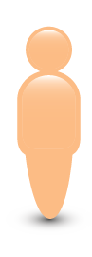
Test for RAS: So you can make the right choice
Heterogeneous
population
Patients with
KRAS exon 2 wt tumors
Increased response
to anti-EGFR therapy
Patients with RAS (KRAS exon 2, 3, 4 and NRAS exon 2, 3, 4)
wt tumors
Determining RAS status at diagnosis is crucial to selecting the optimal 1st line treatment for individual patients with mCRC and planning the course of treatment
Notes:
Right choice:
A wealth of data show that improving the selection of patients extends the OS benefit with anti-EGFR therapy + chemotherapy
Data show treating patients with RAS wt mCRC with cetuximab + CT will give them the best chance of achieving the longest OS

Slide 22
RAS Testing in Australia
List of testing sites
TTT
Sites reflex testing

Slide 23
72% of KRAS testing is done prior to choice of first line drug treatment
mCRC 1st line Patient Records – Q1’ 14
Stage when the KRAS test carried out
(n=162)
Stage when the NRAS test carried out
(n=50)
Base: mCRC physicians
Notes:
PQ110 When was the KRAS test done on this patient?
Base: mCRC 1st line physicians (n=162)
PQ110 When was the NRAS test done on this patient?
Base: mCRC 1st line physicians (n=50)

Slide 24
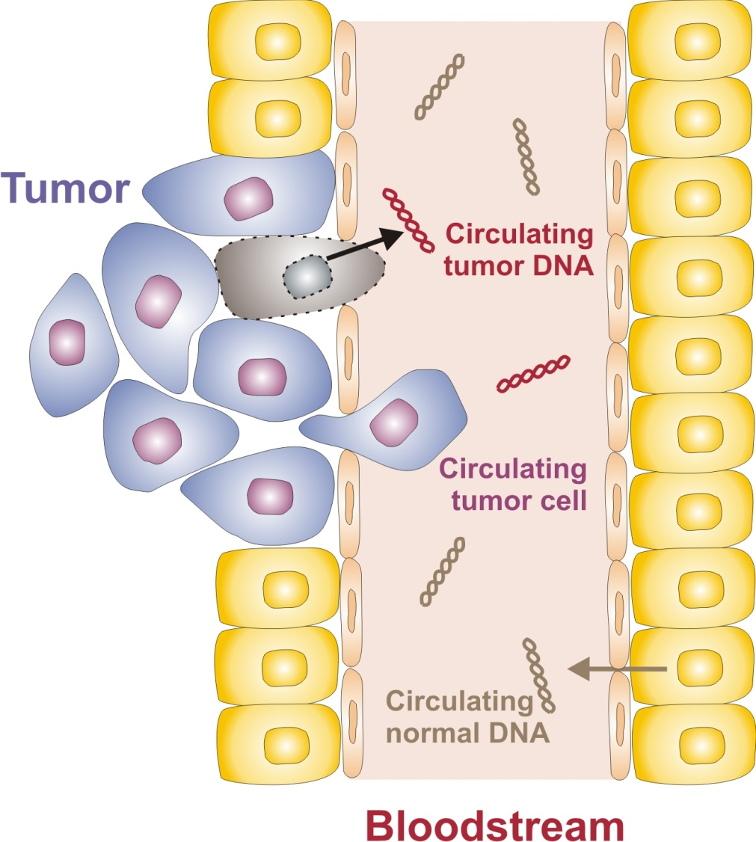
Liquid biopsies can potentially provide a less invasive way to measure biomarkers
Liquid Biopsy and Cell-Free Tumor DNA
Circulating tumor DNA is cell-free DNA released from a solid tumor
cfDNA ≠ CTCs
Origin: Necrotic or apoptotic tumor cells
Concentration: 0.01% to 60% of total DNA
Nature: small DNA fragments (<120 bp)
Clearance: Kidney → Urine
Markers: mutations, translocations
Notes:
SI034

Slide 25
Questions?

