Slide 1

Advanced Breast Cancer

Slide 2
Aims
31 year old female px severe pain right UL ‘burning’ pain
Background of lower back pain for 3/12
No past medical Hx.
Social Hx:
  Married 2 small children, works in hospital admin
  Regular Menstrual periods
Family Hx:
  Aunt: Breast Ca 55

Slide 3
Aims
O/E:
Palpable LN under the right axilla
Breast exam:
  Palpable lesion 4o’clock
Abdo: Tender RUQ, nil organomegaly
Neuro exam: NAD
X-ray L-spine: Met L2 + sclerotic lesions in pelvis
Path: Mild deranged liver function
Biopsy right breast:
  Grade 3 IDC ER,PR,Her 2 +ve
Abdo u/sound: Liver mets x4 in 2 segments of the liver
Bone scan: wide spread bony metastases
Staging CT: Nil other visceral mets

Slide 4
Mx?

Slide 5
Case 2
55 year old lady 6 years post diagnosis of breast Ca presents for routine mammography
PMHX:
L breast Ca
  WLE + Axillary clearance 23 mm Grade 2 IDC 2/10 nodes ER 3+, PR –ve, Her 2 -ve
  Completed Adjuvant Chemo/RXT + 3 years of tamoxifen
HT
Diabetes
Obesity
Post menopausal
31 year old female px severe pain right UL ‘burning’ pain
Background of lower back pain for 3/12
No past medical Hx.
Social Hx:
  Married 2 small children, works in hospital admin
  Regular Menstrual periods
Family Hx:
  Aunt: Breast Ca 55

Slide 6
Presents for routine review and reports recent back pain

Slide 7
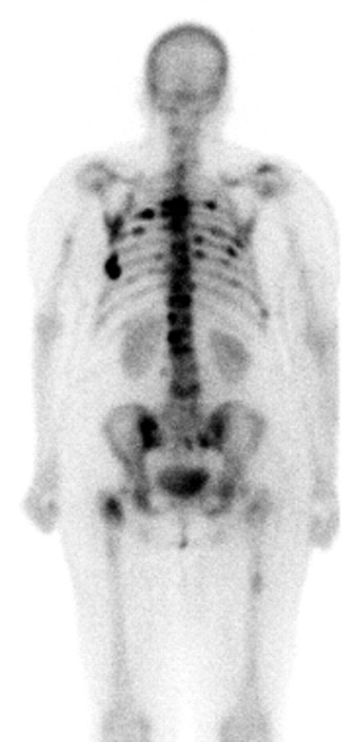
Bone Scan

Slide 8
X-ray + bone scan: Wide spread bony mets
Staging: Nil visceral disease
Biopsy of bone lesion: Grade 2 IDC Er 3+, Pr 2+, Her 2 –ve
Mx:
  ?

Slide 9
Breast Cancer
The most common cancer affecting women
In 2014 in Australia it is estimated 15,270 women will be diagnosed with breast cancer ¹
Male breast cancer rare
  113 men in Australia were diagnosed in 2008²

Slide 10
Risk Factors
Female (1 in 9 woman diagnosed )
Increasing age
Family history.
Years of oestrogen exposure.
      Early menarche
      Late menopause
      Nulliparous
      HRT
Obesity
Alcohol consumption

Slide 11
Incidence of Breast CA 1982-2006
Female (1 in 9 woman diagnosed )
Increasing age
Family history.
Years of oestrogen exposure.
      Early menarche
      Late menopause
      Nulliparous
      HRT
Obesity
Alcohol consumption

Slide 12
Mortality⁶
Mortality ↓
age-standardised mortality rate
  1994: 30.9 deaths per 100,000 women
  2011: 21.9 deaths per 100,000 women
  70-80% patients with early stage disease are cured, meaning 20-30% will relapse.

Slide 13
Types of Breast Cancer
Breast cancer divided into
Invasive ductal carcinoma (85%)
Invasive lobular carcinoma (15%)
Classified
  Estrogen receptor +ve/-ve
  Progesterone receptor +ve/-ve
  Her 2+ve/-ve

Slide 14
Hormone Receptors
Measure ER and PR on all tumors.
The more hormone positive the more sensitive to endocrine treatment.
ER more important than PR.
60-70% of breast cancer is hormone positive.

Slide 15
Her 2
Human epidermal growth factor receptor 2 (HER2)
Belongs EGFR family of receptors.
HER2 overexpression 20–30% of breast cancer⁷
Aggressive disease, higher recurrence rate
  ? Mortality

Slide 16
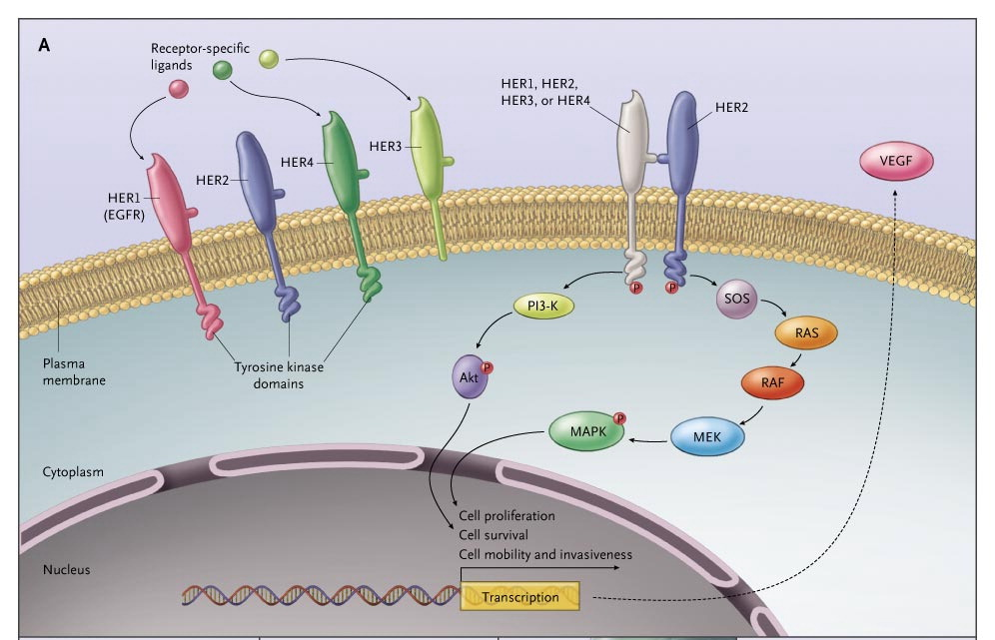
Female (1 in 9 woman diagnosed )
Increasing age
Family history.
Years of oestrogen exposure.
      Early menarche
      Late menopause
      Nulliparous
      HRT
Obesity
Alcohol consumption

Slide 17
Triple Negative
Means tumor does not express ER/PR or HER2
Associated with poorer prognosis.
Limited treatment options

Slide 18
Advanced Breast Cancer
The proportion of metastatic breast Ca in Australia 7%⁹
In the US
  5% have metastatic disease at diagnosis
  30 % will develop distant metastatic disease¹⁰
Metastatic breast
  not generally curable
  meaningful improvements in survival with newer systemic therapies
5-year relative survival for women diagnosed with secondary breast cancer in Australia is around 40% ¹¹

Slide 19
Management of repeat Breast Cancer
Repeat biopsy —
  discordance hormone status, HER positivity
  Different studies show different levels discordance
  Vary 5-35%
  This may change treatment options
Assess menopausal status
Assess general health + co-comorbidities

Slide 20
Treatment
Primary goals
prolongation of survival
alleviation of symptoms
quality of life
  maintenance or improvement

Slide 21
Treatment Options
Hormone blockade
Her 2 targeted agents
Systemic cytotoxic
Radiation therapy
  symptom management only
Surgery
Surgical removal of primary tumor ?
  (LRT) surgery or radiation after chemotherapy¹²
  No benefit unless there is bleeding or ulceration
  median overall survival LRT vs LRT
    18.8 months and 20.5 months

Slide 22
Treatment of Metastatic Breast Cancer
Dependant on 2 major issues
  cancer characteristics, patient characteristics
Cancer characteristics
  Grade
  HR
  HER2 status
  Sites of disease- important organ involvement.
  Time from initial diagnosis and relapse

Slide 23
Treatment of Metastatic Breast Cancer
Dependant on Patient Characteristics
  Age
  Co-morbidities
  Menopausal status
  Patients wishes
  Previous treatments

Slide 24
Breast cancer and estrogen
? A new phenomena
George Thomas Beatson
  Connection between the ovaries and the breast 1896
    castration in cattle to continue lactation
The Lancet article entitled:
“On the treatment of inoperable cases of carcinoma of the mamma: suggestions for a new method of treatment with illustrative cases”.
Removed the ovaries of his 33 year-old patient and within 4 months
“the cancerous tissue had been reduced to a very thin layer”.
Thus the age of hormone treatment for breast cancer was born.

Slide 25
Estrogen, ER and Breast CA
estrogen binds and activates the ER
  → growth of normal and cancerous cells
Process can be interrupted in 3 ways
1)Alter binding of estrogen to the ER
  Selective ER modulators
    tamoxifen and raloxifene
2)Reduce or eliminate ER expression.
  Fulvestrant
3)Reduce the amount of estrogen
by interfering with its production
  ovarian ablation pre-menopasual
  (AIs) in postmenopausal women

Slide 26
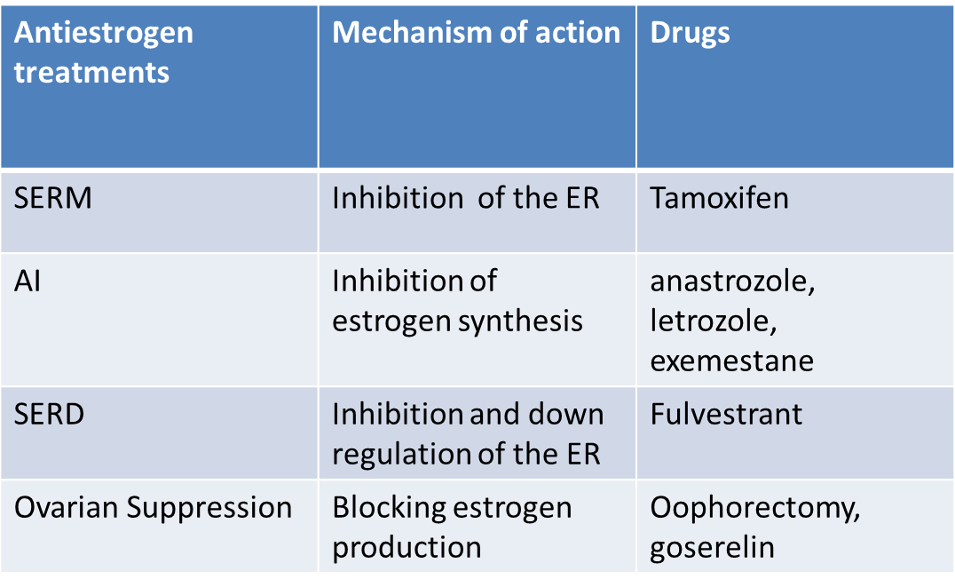
Estrogen and Breast Cancer CA

Slide 27
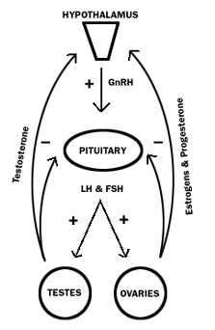
Ovarian Suppression
LHRH analogues effective in reducing estrogen levels to below postmenopausal levels within 21–28 days in >90% of premenopausal women¹²

Slide 28
Tamoxifen
A prodrug
Metabolized in the liver
  Cyp450 2D6 and 3A4
    important for drugs interactions
Active metabolites
  30-100 times more affinity with the ER
  compete with estrogen for binding with the ER

Slide 29
SERM
Agonist and antagonist properties
Breast
    estrogen receptor antagaonist
      transcription of estrogen-responsive genes is inhibited.
  Endometria
  A partial agonist
    increase is of endometrial CA
  After 5 years 2.4-fold increased risk of uterine cancer
  No adverse effect on mortality from uterine cancer

Slide 30
SERM
Bone
  estrogen receptor agonist
Cardiovascular and metabolic
  Beneficial effects on serum lipid profiles.
  Variable data of its effect in CVD
    On balance,
    not associated with either a beneficial or adverse cardiovascular effect
S/E
  thromboembolisim
  steatorrhoeic hepatosis

Slide 31
Tamoxifen
Objective response 20%
Tam vs ovarian suppression
equivalent to ovarian ablation in premenopausal women
  meta-analysis by Crump 1997
    no statistically significant difference
Tamoxifen plus ovarian suppression
Better than ovarian suppression alone¹³
  RR 39% vs 30% P. 03
  PFS, HR 0.70, p = 0.0003 and OS (HR 0.78, p = 0.02)
  ? combined treatment is superior to single-agent tamoxifen
    UNKNOWN
S/E
No significant difference in tolerability
  Combination well tolerated, no additional safety issues.

Slide 32
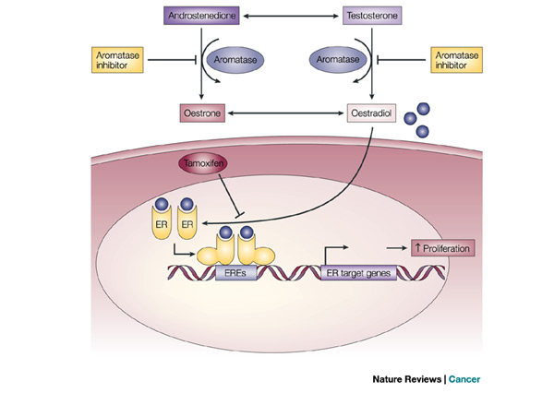
Aromatase Inhibitors (AI’s)
Suppress plasma estrogen levels
MOA
  Inhibit ‘aromatase’
    Enzyme responsible for the peripheral conversion of androgens to estrogens

Slide 33
AI’s
2 classes of third-generation Ais
Non-steroidal AIs
  reversibly bind to the aromatase enzyme
  anastrozole and letrozole
Steroidal AI
  binds to aromatase irreversibly
  Exemstane
Other:
fulvestrant,
  A selective ER down-regulator
  Binds competitively to the ER with no known agonist effects
  Downregulates the ER protein

Slide 34
AI’s
Side effects
  hot flushess
  vaginal dryness
  loss of libido
  fatigue
  arthralgias
  joint stiffness
  loss of bone mineral density with subsequent increased risk of fracture
One better than the other?
no data to suggest that one AI is better than the others
letrozole ? better
  Pharmacokinetic differences suggested
  unlikely to be clinically threshold aromatase inhibition is reached¹⁴

Slide 35
AI’s over Tam
Treatment with an AI resulted in an improvement in OS compared with Tam
  2006 meta-analysis 23 randomized trials
  (n = 8504 patients) Pavlidis et al
    (HR 0.89, 95% CI 0.80-0.99)

Slide 36
Fulvestrant
Equivalent efficacy to anastrozole
FIRST trial
    Robertson et al 2009
  A similar ORR (36 percent in both arms)
  median time until progression ,
    23 versus 13 months, HR 0.66; (95% CI 0.47-0.92)
    OS was not reported
Still generally second line
More experience required

Slide 37
Other agents ER +ve
mTOR inhibitors
  interaction b/w mTOR pathway and ER signaling
Everolimus inhibits mTOR
block the downstream signaling →
  resulting in cell cycle arrest
Effective when combined with an AI
Breast Cancer Trials of Oral Everolimus
  (BOLERO-2) trial
    Improved RR, PFS and OS
      OS 10.7% of patients combo vs and 13.0%
        HR for mortality 0.43, 95% CI 0.35-0.54

Slide 38
Choosing an endocrine Rx
?prior Rx
?pre or post menopausal

Slide 39
Premenopausal Women
1)Ovarian suppression or ablation
2)Selective estrogen receptor modulator (SERM)
3)Combination treatment tamoxifen plus ovarian suppression
1st Line:
Ovarian suppression with tamoxifen or AI
Or
Single Agent Tamoxifen
2nd line:
Ovarian suppression/oophorectomy and alternative endocrine agent.

Slide 40
2nd line endocrine
If disease progression despite ovarian suppression →check serum estradiol levels
  If high estradiol levels
    oophorectomy
3rd line
  menopause induced and confirmed
→treatment approach for postmenopausal women is used

Slide 41
AI’s in Premenopausal women?
Previously thought to be CI
  reactivation of ovarian function.
TEXT/SOFT
Phase II trials in combination with ovarian suppression with promising results
  Park et al 2010
  time to progression premenopausal and postmenopausal women
  9.5 versus 9 months, respectively
GnRH agonist plus an AI may be as effective in premenopausal women as it is in postmenopausal women
? benefit to combined with ovarian suppression alone is not known.

Slide 42
Post menopausal women 1st line
Aromatase Inhibitors
Alternative?
  SERMs
    Reasonable alternative
      Unable to tolerate AI
      osteoporosis
      cardiovascular disease

Slide 43
Post menopausal women 2nd line
Nil optimal sequence from the first to the second-line setting
No differences in efficacy
Options
  non-cross-resistant AI
  tamoxifen
  fulvestrant
  Alternative
    endocrine therapy plus the mammalian target of rapamycin (mTOR) inhibitor,
choice between them should be individualized based on prior treatment received.

Slide 44
Her 2 Targeted Agents
HOT TOPIC

Slide 45
HER 2 Targeted agents
Changed the natural history of metastatic HER2 positive breast cancer.
Prolonged control of metastatic disease
  ?sometimes cure
improved control of systemic disease→
  higher rates of brain metastases seen
  affecting 25-38% of patients.

Slide 46
Trastuzumab
  Targeted HER2 therapy.
  More active when given with chemotherapy than when given alone.
  Well tolerated, main toxicity reversible cardiotoxicity.
  Available through Medicare

Slide 47
Trastuzumab vs chemo in Her 2 +ve disease
Eiermann 2010 Annals of Oncology
RR compared to chemo
  49% vs. 32%, P = 0.0002
Time until progression
  7.6 vs. 4.6 months, P = 0.0001
survival at 29 months
  25.4 vs. 20.3 months, P < 0.025 trastuzumab + chemo plus chemotherapy vs chemo

Slide 48
Pertuzumab
A humanized, monoclonal antibody
Binds to Her 2 at a different epitope.
Binding prevents dimerization
Efficacy?
  pertuzumab +trastuzumab + docetaxel
  VS
    placebo +trastuzumab + docetaxel
RR 80.2 % vs 69.3%
Median PFS 18.5 vs was 12.4 months
(HR, 0.62; 95% CI, 0.51–0.75; P < .001).

Slide 49
TDM1
Ado-trastuzumab emtansine
An antibody-drug conjugate
  HER2–targeted Rx + cytotoxic activity of the microtubule-inhibitory agent DM1.
intracellular drug delivery to HER2-overexpressing cells
S/E:
  thrombocytopenia, elevated aminotransferase levels
  Minimal cardiac toxicity
Lapatinib
It is a dual tyrosine kinase inhibitor
HER1/HER2
Significant toxicity of diarrhoea limits clinical use.

Slide 50
Emilia
T-DM1 versus lapatinib plus capecitabine.
2nd line Traz exposed
Improved RR, PFS
Median OS at the second interim analysis
  30.9 months vs. 25.1 months;
    HR, 0.68; 95% CI, 0.55–0.85; P < .001).

Slide 51
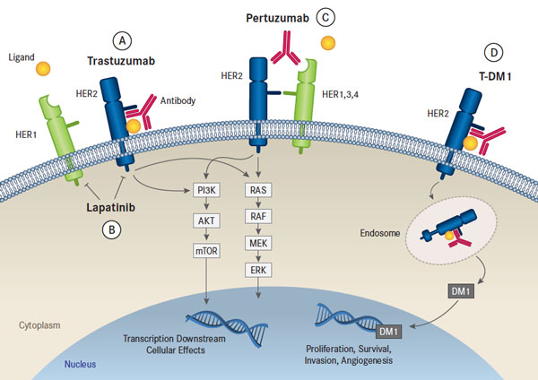
Her 2+ Disease? Optimal medical Therapy

Slide 52
Her 2+ Disease Optimal medical Therapy
Currently only trastuzumab and lapatanib are available on PBS.
TDM1 and pertuzumab are not
  but are available for patients through an access scheme, but involves significant cost

Slide 53
Her 2 +ve^{16,17}
1st line
  Combination of trastuzumab, pertuzumab and taxane
    unless the patient has a contraindication to taxanes
2nd line
  T-DM1
    Or
  Pertuzumab (if not already given )
3rd line
  Cap +lapatinib
  other combinations of chemotherapy

Slide 54
Cytotoxic chemotherapy

Slide 55
Chemo
Breast Metastatic AC (DOXOrubicin and CYCLOPHOSPHamide)
Breast Metastatic Anastrozole
Breast Metastatic Capecitabine
Breast Metastatic Capecitabine and Lapatinib
Breast Metastatic cARBOplatin and Gemcitabine
Breast Metastatic CMF Classical (CYCLOPHOSPHamide Methotrexate Fluorouracil)
Breast Metastatic CYCLOPHOSPHamide and Methotrexate (Low Dose Oral)
Breast Metastatic DOCEtaxel and Trastuzumab Three Weekly
Breast Metastatic DOCEtaxel Pertuzumab Trastuzumab
Breast Metastatic DOCEtaxel Three Weekly
Breast Metastatic DOXOrubicin
Breast Metastatic DOXOrubicin Weekly
Breast Metastatic EC (Epirubicin and CYCLOPHOSPHamide)
Breast Metastatic Everolimus and Exemestane
Breast Metastatic Exemestane
Breast Metastatic FEC (Fluorouracil Epirubicin CYCLOPHOSPHamide)
Breast Metastatic Fulvestrant
Breast Metastatic Goserelin (Zoladex)
Breast Metastatic Letrozole
Breast Metastatic Nab PACLItaxel (Weekly) and Trastuzumab
Breast Metastatic Nab PACLItaxel Three Weekly
Breast Metastatic Nab PACLItaxel Weekly
Breast Metastatic PACLItaxel Weekly
Breast Metastatic PACLItaxel Weekly and Trastuzumab Three Weekly
Breast Metastatic Pegylated Liposomal DOXOrubicin
Breast Metastatic Tamoxifen
Breast Metastatic Trastuzumab Emtansine
Breast Metastatic Trastuzumab Three Weekly
Breast Metastatic vinORELBine (IV)
Breast Metastatic vinORELBine (Oral)
Breast Metastatic Weekly Gemcitabine and Nab PACLItaxel
Breast Metastatic Weekly Gemcitabine and PACLItaxel

Slide 56
Which Treatment?

Slide 57
Good candidates or endocrine
No or limited visceral metastases
Bone-only metastatic disease
Slowly progressive disease
No OS benefit in systemic chemo over endocrine
Generally always endocrine 1st line
- unless
rapidly progressive, high burden disease

Slide 58
Common agents
Anthracycline
Taxanes
Gemcitabine
Capecitabine
Other:
Cyclophosphamide
Vinorelbine
Platinums
  ? efficacious in tumors where DNA repair pathways are faulty
  triple negative
  not commonly used

Slide 59
Choice of treatment
? Ideal sequence
  No
individualize therapy as much as possible.
  metastatic breast cancer will receive many rx

Slide 60
Combination vs single agent
Several trials examined this
    X2 Cochrane reviews 2005, 2009^{19,20} Sledge et al 2003
Sequential use of single agents is safe and effective in the absence of rapidly progressive disease.

Slide 61
When would you use combination?
Rapidly progressive disease
Higher chance of response more important than toxicity
Good performance status
Good organ function

Slide 62
1st line
Anthracyclines
  If no CI if not previously treated
Taxane
  Docetaxel, Paclitaxel, Abraxane NAB- Paclitaxel
    3-weekly docetaxel and weekly paclitaxel better than 3 weekly pacitxael²²
      ↑ RR, time to progression OS
      No randomised trials 3/52 docetaxel vs weekly paclitaxel
  NAB-P more efficacious than standard 3-weekly paclitaxel²³
    causes more neuropathy
    Nanoparticle albumin-bound paclitaxel has not been compared with standard paclitaxel given weekly

Slide 63
2nd line
No Ideal sequence
Individualize therapy
Consider oral vinorelbine

Slide 64
Monitoring
Tumor response should be assessed every 6-12 weeks (2-3 cycles)
If stable + min toxicity
  continue for 18-24 weeks (6-8 cycles)
extending chemotherapy beyond 18-24 weeks; 6-8 cycles)
  is an option if toxicity is minimal and the goal is to delay progression
Extending chemotherapy beyond the standard duration has little or no effect on overall survival

Slide 65
Summary
Her 2 +ve disease
  Multiple options
Hormone positive
  Always consider Endocrine Number 1
  Use chemo
    If rapidly progressive high volume metastatic disease
Triple negative
  Use Chemo
Chemo
  Sequential single agent treatment
    similar efficacy less toxic
Don’t forget bisphosphonates

Slide 66
Bone protection
Bisphosphonates and denosumab
Effective in reducing bone complications of breast cancer.
oral, intravenous or subcutaneous.
Should be given to all patients with bone metastases from breast cancer.
Reduce bone pain, fractures and hypercalcaemia.
S/E:
Hypocalcaemia
Rare
  osteonecrosis of the jaw

Slide 67
Considerations for Rx
General health status
  Comorbidities
  Menopause
Tumor burden
Location of disease metastatic lesions
Prior Treatment

Slide 68
Case 1
Mx?
? Endocrine
  No
? Chemo
  Yes
  Age, fitness, disease burden
? Her 2 targeted Rx
-Yes
Refer for clinical trial to access trastuzumab+ pertuzumab
Bisphosphonate
  yes
Pain relief

Slide 69
Case 2
Mx
? endocrine
  Yes
  Type?
    AI
?Chemo
  No
  Low volume disease
?Bisphosphonate
  Yes
Dexa pre
Education and counselling re; weight loss

Slide 70
Future
Targeting RANKL
  Altering RANK/OPG
Circulating tumor cells
Improved treatments for triple -ve

