Slide 1
Treatment of Non-Hodgkin’s Lymphoma in a Patient with Acute Intermittent Porphyria

Slide 2
History
Noticed lump in right groin (Sept 2014)
  Painless
  Nil inflammation or discolourations
  Nil associated symptoms
U/S guided core biopsy with GP (Oct 2014)
  17x13x21mm lymph node, slightly hypervascular
  Microscopic examination showed features suggestive of low grade follicular lymphoma; nil evidence of metastatic disease

Slide 3
History
CT brain, chest, abdo & pelvis
  Non-contrast due to poor renal function
  Pathologically enlarged right inguinal lymph node, no other lymphadenopathy
  No hepatosplenomegaly

Slide 4
Work-up
PET scan (Nov 2014)
  Avid lymph nodes in coeliac axis
  Nil distant or extra-lymphatic metastasis
  Stage II follicular B cell lymphoma below diaphragm
BMAT : infiltration with low volume lymphoma

Slide 5
Past medical history
Acute intermittent porphyria – history of three attacks; asymptomatic past 10 years
CKI – 2010
  Cr 119, eGFR 46
Hypertension – on candesartan
GORD – oesophagitis visualised on recent PET scan
Vitamin D deficiency
Pap smear in March 2013 showed low grade changes

Slide 6
History
First episode in 2000
  Generalised abdominal cramps
    Stabbing pain, relieved by movement
    Believed to be triggered by floor board polish??
  Urine sample turned red overnight
  Hospitalised – initially thought to be constipation/bowel obstruction
    Mx – pethidine and suppository
  Porphyria diagnosis – heme arginate (thrombophlebitis)

Slide 7
History
Second episode in 2003
  Triggered by homeopathic agents
Third episode in 2005
  Triggered by naturopathic agents
No acute episodes since

Slide 8
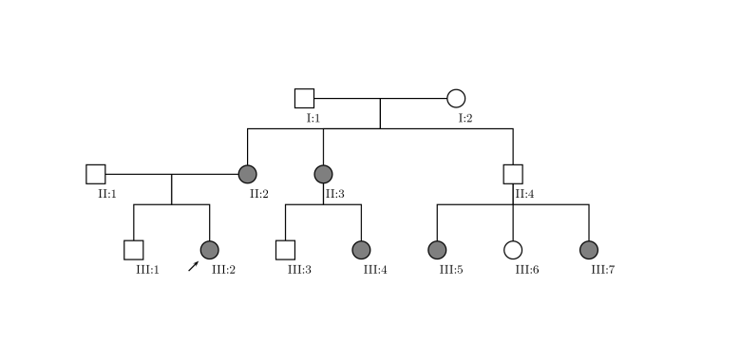
Family history

Slide 9
Family history
No family history of cancers
Strong family history of CVA/IHD
  Mother – CVA and IHD, passed away from STEMI
  Uncle – CVA and IHD, triple CABG
  Maternal grandmother – CVA and IHD

Slide 10
Social history
Home alone with dog
Myotherapist and educator
Well supported by extended family

Slide 11
Management
Chemotherapy
  R-CHOP – 4 cycles
  Followed by maintenance Mabthera

Slide 12
Porphyria and Drug Interactions
Discussion:

Slide 13
Porphyria
Porphyria are a group of metabolic disorders caused by altered enzyme activities within the heme synthesis pathway, due to inherited genetic mutation¹
Heme production
  Bone marrow (~80%) – prosthetic group for haemoglobin
  Liver (~20%) – production of cytochrome P450 enzymes
  Others (<1%)
Notes:
1. Puy H, Gouya L, Deybach JC. Porphyrias. Lancet. 2010;375(9718):924.

Slide 14
Porphyria and Drug Interaction
Medication is one of the most important exacerbating factors for porphyria (especially acute intermittent porphyria)
Build-up of neuro-toxic porphyrin (any of the heme pathway intermediates) due to upregulation of the heme pathway

Slide 15
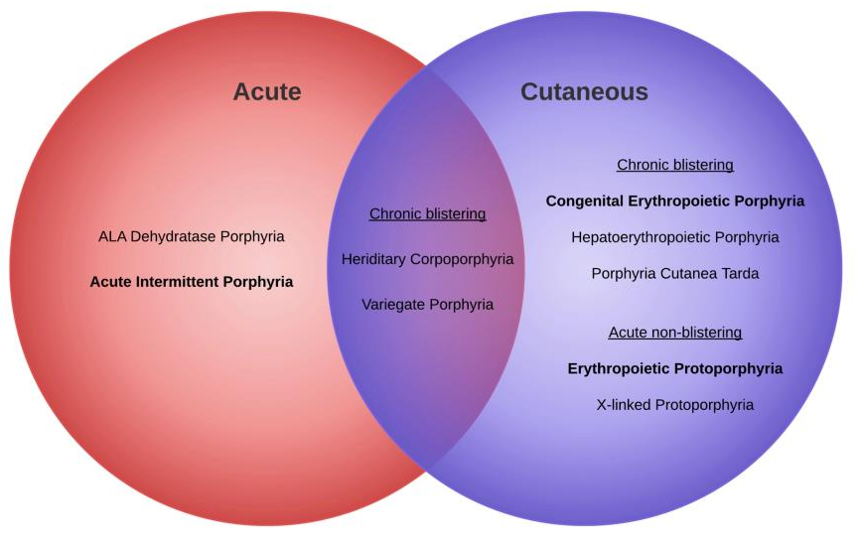

Slide 16
Porphyria and Drug Interaction
Exacerbation of porphyrin can be caused by
  Induction of Cytochrome P450 enzymes (CYP’s)
    Superfamily of hemoprotein commonly involved in drug metabolism²
  Induction of hepatic delta-aminolevulinic acid synthetase-1 (ALAS1)
    Rate-limiting enzyme in the heme synthesis pathway³
  Transactivation of Pregnane X receptor
    Induces CYP3A4 in presence of foreign toxic substance⁴
Notes:
2. Anderson KE, Mahoney DH, Tirnauer JS. Porphyrias: An overview. UpToDate 2015. Last updated Jan 2014. Accessed Feb 4 2015.
3. Guengerich FP. Cytochrome p450 and chemical toxicology". Chem. Res. Toxicol. January 2008 21 (1): 70–83.
4. Kliewer S, Goodwin B, Willson T. The nuclear pregnane X receptor: a key regulator of xenobiotic metabolism. Endocr. Rev. 2002. 23 (5): 687–702.

Slide 17
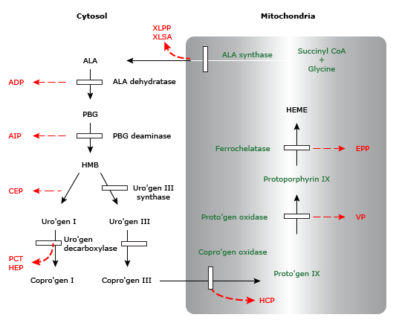

Slide 18
Implicated Chemotherapeutic Agents
Likely unsafe; consistent evidence
  Busulfan
  Procabazine
  Flutamide
  Megestrol
  Chlorambucil
  Lomustine
*According to American Porphyria Foundation database
Possibly unsafe; inconclusive evidence
  Tamoxifen
  Etoposide
  Paclitaxel
  Topotecan
  Ironotecan
  Idarubicin
  Mitomycin
  Mitoxantrone
  Letrozole
  Estramustine
  Dacarbazine
  Ixabepilone
  Vinblastine
  Vinorelbine
  Ifosfamide

