Slide 1
Ovarian cancer
Talking point:
Genetics of ovarian cancer

Slide 2
49F
Underwent risk-reduction surgery
  Total hysterectomy and bilateral salpingo-oophorectomy
Significant family history
  Sister passed away in her 40s due to breast cancer
    Sister was tested negative for BRCA mutation
  Paternal grandmother had ovarian cancer
  Mother had cervical cancer
  Of Jewish descent, but not Ashkenazi

Slide 3
49F
Histopathology
  Right ovary – 5mm borderline endometroid tumour
  Left ovary – 9mm high grade serous carcinoma (solid pseudoendometrioid transitional cell carcinoma like appearance)
  No lymphovascular or perineural invasion seen
Imaging
  CT-CAP – no metastatic disease detected
  F-18 FDG PET CT scan – no FDG avid metastatic disease
Staging
  IB – tumour limited to both ovaries; no tumour on ovarian surface
Notes:
F-18 FDG mainly has two medical application – assessment of glucose metabolism in major organs especially the heart, lung and brain; or in assessment of uptake by highly metabolic tissues (most useful in detection of malignant tissue, particularly in the case of Hodgkin’s or NHL, CRC, breast cancer, melanoma, lung cancer)

Slide 4
49F
Tumour markers
  Negative for CEA, CA 125/153/199, AFP, hCG
Receptor status
  ER+/PR+
BRCA1 and BRCA2 mutation associated with pattern of tumour growth

Slide 5
49F
Past medical history
  Otherwise healthy
  Non-smoker
  No medication
Social history
  Lives at home with husband and two daughters, supportive
  Currently IADL with expectation of full recovery post-treatment

Slide 6
49F
Management
  Counseling
    Prognosis of the cancer
    Treatment option and expected outcomes
    Expected side effects
    Patient concerns – alopecia
  Adjuvant chemotherapy
    Carboplatin and paclitaxel
  Other
    Psychologist
    Dietician
    Exercise physiologist

Slide 7
Genetics
And ovarian cancer

Slide 8
Introduction
Although family history of breast and/or ovarian cancer is common in women diagnosed with breast or ovarian cancer, less than 10% of breast cancers and 15% of ovarian cancers are associated with inherited genetic mutation¹
Majority of inherited breast or ovarian cancer are associated with BRCA1 and BRCA 2
Notes:
1. Foulkes WD, Inherited susceptibility to common cancers. N Engl J Med. 2008;359(20):2143.

Slide 9
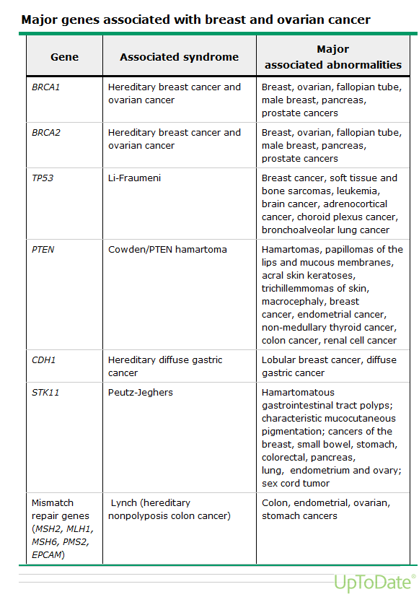
Associated Genes

Slide 10
BRCA-associated cancer
BRCA1 and BRCA2 mutations are inherited as autosomal dominant, highly penetrant, germline mutations
Up to 80% of BRCA mutation-associated breast cancers are triple-negative²
The cumulative risk of breast and ovarian cancer by age 70 years for
  BRCA1 mutation carriers are 57% and 40% respectively
  BRCA2 mutation carriers are 49% and 18% respectively
  Meta-analysis of 10 studies conducted in high-risk clinics and population-based settings³
Notes:
2. Atchley DP, Albarracin CT, Lopez A, Valero V, Amos CI, Gonzalez-Angulo AM, Hortobagyi GN, Arun BK. Clinical and pathologic characteristics of patients with BRCA-positive and BRCA-negative breast cancer. J Clin Oncol. 2008;26(26):4282.
3. Chen S, Parmigiani G. Meta-analysis of BRCA1 and BRCA2 penetrance. J Clin Oncol. 2007;25(11):1329.

Slide 11
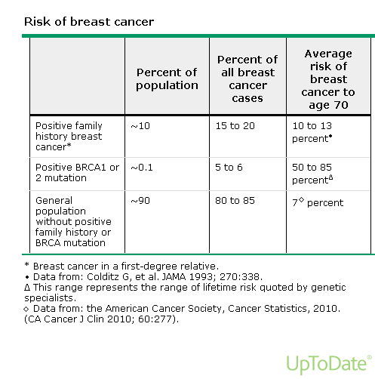
Risk of Cancer

