Slide 1
Treatment in Advanced
Non-Small Cell Lung Cancer

Slide 2
NSCLC| Epidemiology- Australia
5th most commonly diagnosed cancer in Australia
  8.9% of new cancer diagnoses
  In 2009:
      10,193 cases (6034 men, 4159 women)
      Projection to 2020→ 13,640
Mortality
  In 2010 most common cause of cancer death
    18.9% of cancer deaths
    8099 deaths ( 4934 men, 30165 women)
Age of diagnosis
  Average 71
Notes:
Following prostate, bowel ,breast, melanoma
Age: 85 % in men and 81 % in owmen over the age of 60

Slide 3
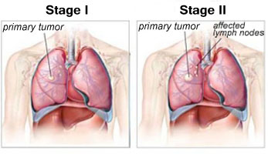
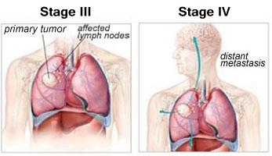
NSCLC| Staging
Notes:
Patients with stage I, II, III NSCLC are generally approached with a plan to attempt curaitve intent with a combination of surgery, chemotherapy and radiation therapy
Systemic therapy is undertaken for patients with stage III and IV

Slide 4
NSCLC| Chemotherapy: should we give it?
Meta-analysis of 8 trials (778 patients) using cisplatin-based chemotherapy^{[1]}
  Absolute improvement in survival of 10% at 1 yr^{[1]}
  Median survival, BSC vs chemo: 4 vs 8+ mos, respectively
Median survival now 12+ mos in more recent trials
  VEGF-targeted therapy plus platinum doublet^{[2]}
Quality-of-life benefit from chemotherapy^{[3]}
1. NSCLC Collaborative Group, et al. BMJ. 1995;311:899-909.
2. Herbst R, et al. Clin Lung Cancer. 2009;10:20-27
3. Klastersky J, et al. Lung Cancer. 2001;34(suppl 4):S95-S101.
4. Chambers et al. BMC Cancer. 2012; 12: 184
Notes:
Particullary relevant in lung cancer as there is increasing evidence of a culture of stigma and nihlism associated with lung cancer can delay the presentation of patients or ecrease their likelihood of accepting treatment

Slide 5
NSCLC| Who should we give Chemotherapy to?
Age
  Elderly patients with a good PS enjoy longer survival and a better quality of life when treated with chemotherapy compared with supportive care alone
  May have higher toxic effects in bone marrow but derive the same survival benefit
Co-morbidities
Langer CJ, Vangel M, Schiller J, et al.: Age-specific subanalysis of ECOG 1594
Langer CJ, Manola J, Bernardo P, et al.: Cisplatin-based therapy for elderly patients with
advanced non-small-cell lung cancer: implications of Eastern Cooperative Oncology Group 5592
Notes:
2/3 rds of patient with NSCLC are aged over 65 year old and > 50% are > 70
Comorbidities are cumulative and are indicative of a poor overall survival

Slide 6
NSCLC | The patient in front of you
Performance Status
  Patients with PS 2 have significantly worse median survival and overall survival when compared to patients with PS 0-1.
Grade | ECOG Performance Status
0 | Fully active
1 | Restricted in physically strenuous activity but ambulatory and able to carry out work of light or sedentary nature
2 | Ambulatory and capable of all self care. Up > 50% of waking hours
3 | Capable of only limited self care, confined to bed or chair for > 50% of working hours
4 | Completely disabled. Cannot carry on any self care. Totally confined to bed or chair
Notes:
Prognostic factors:
Most significant is age
Age is an independent prognostic feature in that younger women (<50) are at higher risk of both local and systemic disease recurrence and there fore the threshold for offering CTx is reduced in this setting
and ECOG status, menopausal status
And many patients will also have a strong opinion on their choices

Slide 7
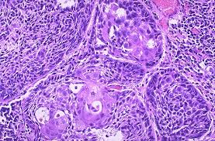
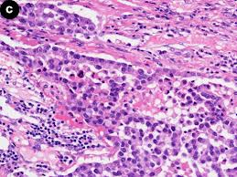
NSCLC | Histology
Squamous cell carcinoma:
(25% to 30%)
Arise in early versions of squamous cells that line airways, tend to be central, near a bronchus
Strongly linked to smoking
Adenocarcinoma:
(40%)
More common in smokers ,but most common type of lung cancer seen in non-smokers.
Women > men, and it is more likely to occur in younger people than other types of lung cancer.
More peripheral, higher rates of metastases on presentations
Large cell (undifferentiated) carcinoma:
(10% to 15%)
Rapid growth,

Slide 8
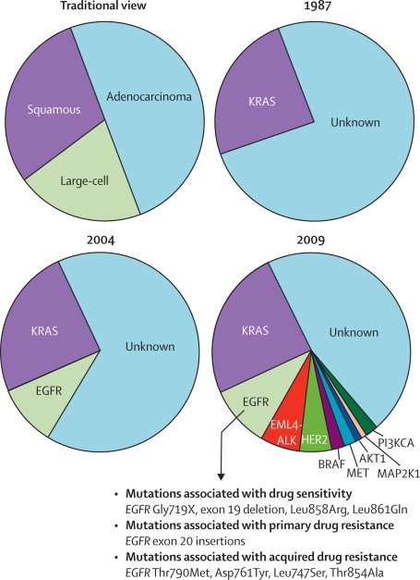
NSCLC| Tumour Biology
Heterogenous group of diseases
Histopathology and molecular characterisation guide treatment
Distinct prognostic and predictive implications

Slide 9

NSCLC| First line Therapy
Adenocarcinoma
Squamous Cell Carcinoma
EGFR Wildtype
EGFR Mutation
Carboplatin &
Pemetrexed
Erlotinib
Gefitinib
Afatinib
Carboplatin &
Gemcitabine
+/- Bevacizumab
+/- Cetuximab
+/- Cetuximab
Notes:
9
For non-elderly patients without significnat comorbidiities the choice of initial systemic therapy should be individualised upon molecular and histologic features ofh e tumours
Whenever possible patients should be tested for EGFR or driver mutations

Slide 10
NSCLC| Absent Mutations
Combination cytotoxic chemotherapy remains the backbone of initial systemic treatment

Slide 11
NSCLC| Initial Systemic Therapy: how many drugs?
Meta-analysis: 65 trials (N = 13,601) between 1980-2001
  Compared efficacy of
    Doublet vs single-agent regimens
    Triplet vs doublet regimens
Survival Outcome | Doublet vs Single-Agent Regimens | Triplet vs Doublet Regimens
1-yr OS | Doublet > single-agent OR: 0.80; 95% CI: 0.70-0.91; P < .001 5% absolute benefit | Triplet = doublet OR: 1.01; 95% CI: 0.85-1.21; P = .88
Median OS | Doublet > single-agent MR: 0.83; 95% CI: 0.79-0.89; P < .001 | Triplet = doublet MR: 1.00; 95% CI: 0.94-1.06; P = .97
Delbaldo C, et al. JAMA. 2004;292:470-484.
Notes:
In first line treatment what approach should be used to aid with management- which drugs
MR, median survival ratio; OR, odds ratio

Slide 12
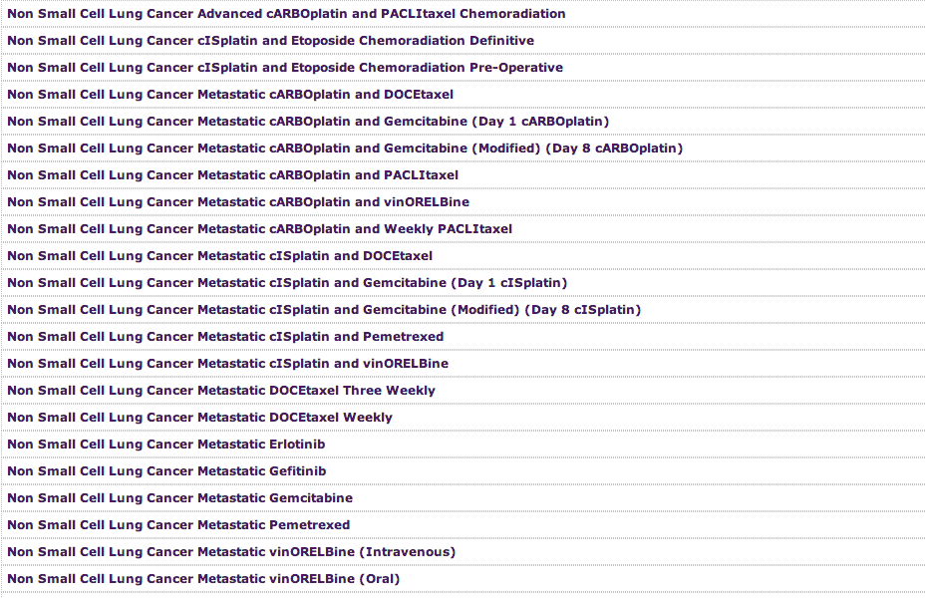
NSCLC| Which regimen?

Slide 13
NSCLC| History of Therapy in Advanced NSCLC
Docetaxel
2002
Gefitinib
2003
Standard therapies
First line
Second line
Third line
Maintenance
Not approved
Erlotinib
Pemetrexed
2004
Docetaxel
1999
Paclitaxel
Gemcitabine
1998
Bevacizumab
2006
*Label does not include
NSCLC-specific indication
Pemetrexed
2008/2009
Vinorelbine
1994
Carboplatin*
1989
12+
Median
OS (mos)
Cisplatin*
1978
~ 8-10
~ 6
~ 2-4
1970
1980
1990
2000
Bevacizumab + PC
BSC
Single-agent platinum
Doublets
Histology-directed therapy
1. FDA Web site. 2. NCCN. Clinical practice guidelines in oncology. v.3.2011. 3. Schrump, et al. Non-small cell lung cancer. In: Cancer: Principles and Practice of Oncology. 7th ed. Philadelphia, PA: Lippincott Williams & Wilkins; 2005.
Notes:
Initially there was best supportive care 1970→ 1980s before the introduction of the platinum agents
BSC, best supportive care; C, carboplatin; P, paclitaxel

Slide 14
ECOG 1594: Comparison of 4 First-line Doublet Regimens in Advanced NSCLC
NSCLC| Which Chemotherapy?
Reference Arm
Paclitaxel 135 mg/m² over 24 hrs on Day 1
Cisplatin 75 mg/m² on Day 2
3-wk cycle
Gemcitabine 1000 mg/m² on Days 1, 8, 15
Cisplatin 100 mg/m² on Day 1
4-wk cycle
Advanced-stage, previously untreated NSCLC patients
(N = 1207)
Docetaxel 75 mg/m² on Day 1
Cisplatin 75 mg/m² on Day 1
3-wk cycle
Stratified by:
ECOG PS (0/1 vs 2)
Weight loss in previous 6 mos
(< 5% vs ≥ 5%)
Disease stage (IIIB vs IV or recurrent)
Brain metastases (yes vs no)
Paclitaxel 225 mg/m² over 3 hrs on Day 1
Carboplatin AUC 6.0 mg/mL/min on Day 1
3-wk cycle
Schiller JH, et al. N Engl J Med. 2002;346:92-98.
Notes:
All have a platinum agent include

Slide 15
NSCLC| Which Chemotherapy?
Survival by Treatment Group
All Randomized Cases
1.0
0.8
Cisplatin/paclitaxel
Cisplatin/gemcitabine
Cisplatin/docetaxel
Carboplatin/paclitaxel
0.6
Proportion of patients
0.4
0.2
0
0
5
10
15
20
25
30
Mos
Schiller JH, et al. N Engl J Med. 2002;346:92-98.
Notes:
There is no single optimal chemothearpy combination with randomised trials showing reasonably similar efficacy for carboplatin v cisplatin (possibly increased in cisplatin) with different toxicities

Slide 16
NSCLC| Which Chemotherapy?
Patients with squamous cell cancer can have gemcitabine-based therapy, pemetrexed is not recommended and bevacizumab is contra-indicated.
Patients with adenocarcinoma benefit from treatment with pemetrexed, EGFR inhibitors, and bevacizumab.
Notes:
There is no

Slide 17
NSCLC| Chemotherapy overview
Doublet chemotherapy for 4-6 cycles is standard
Platinum combinations with vinorelbine, paclitaxel, docetaxel, gemcitabine, irinotecan, and pemetrexed yield similar improvements in survival.
  Caveat: Patients with adenocarcinoma may benefit from pemetrexed.
Cisplatin and carboplatin yield similar improvements in outcome with different toxic effects.
Non-platinum combinations offer no advantage to platinum-based chemotherapy, and some studies demonstrate inferiority.
Notes:
TKI, tyrosine kinase inhibitor
Three-drug combinations of the commonly used chemotherapy drugs do not result in superior survival and are more toxic than two-drug combinations.
Caveat: Certain three-drug combinations that add targeted agents may result in superior survival

Slide 18
NSCLC| Additional Agents
Antiangiogenesis:
  VEGF targeted (bevacizumab)
EGFR-targeted antibody
  (cetuximab), TKI (erlotinib)
Newer targets
  (ALK and others)
Recent identification of “driver mutations” in 50% of NSCLC adenocarcinomas

Slide 19
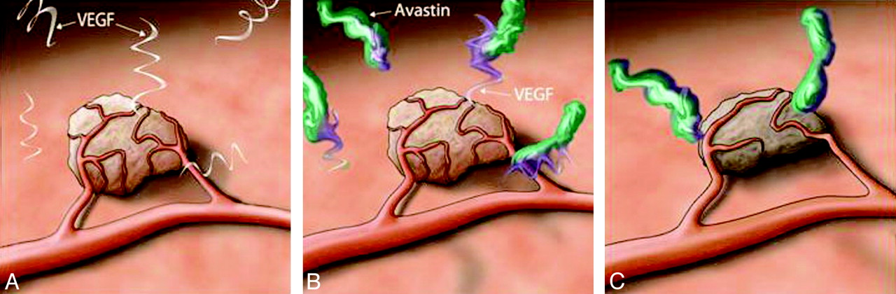
NSCLC| Bevacizumab
Bevacizumab
Antibody targeting vascular endothelial growth factor
Can be added to standard first-line combination chemotherapy in non-squamous lung cancer.
Notes:
Bevacizumab targets the VEGF
?? PBS supported

Slide 20
NSCLC| Bevacizumab: Adverse Effects
Hypertension
Bleeding
  Haemoptysis
  Brain mets
  Squamous cells more likely to bleed
Poor wound healing

Slide 21
NSCLC| Unknown mutation status
Testing for EGFR can take time.
Current recommendations are if patient has commenced CTx should continue and complete the treatment
  ? Commence maintenance
  ? Watchful waiting then commence once progression
  If toxic SEs can swap to EGFR TKI if possible

Slide 22
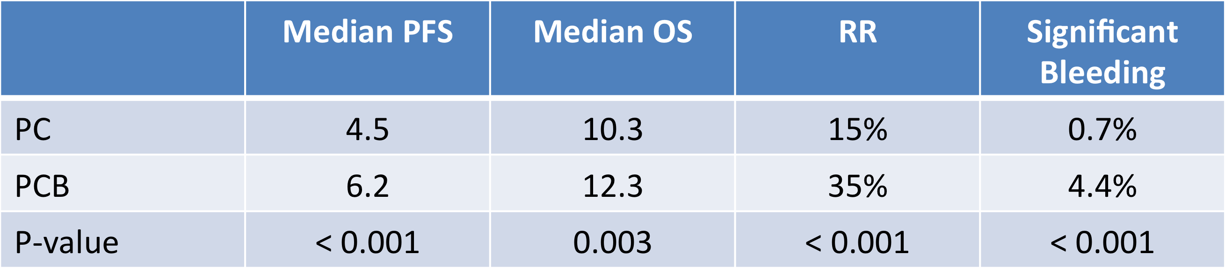
NSCLC| Bevacizumab
E4599
Advanced NSCLC (stage IIIB or IV)- non- squamous
  Randomised to paclitaxel/ carboplatin or paclitaxel/carboplatin + bevacizumab
  Excluded brain mets and haemoptysis
AVAiL
Advanced NSCLC (stage IIIB or IV)- non- squamous
  Randomised to cisplatin/gemcitabine + placebo/low dose bevacizumab/ high dose bevacizumab
  Excluded brain mets and haemoptysis
  Confirmed outcome with less spectacular results
Reck M, et al. J Clin Oncol. 2009;27:1227-1234..
Sandler A, et al. N Engl J Med. 2006;355:2542-2550.

Slide 23
NSCLC| Genotype Directed Therapy
Oncogenic Activation
  Epidermal Growth Factor Receptor
  Anaplastic Lymphoma Kinase gene
MET as a therapeutic target in NSCLC
Notes:
Tumour growth and progression depend upon acitvitiy of the cell surface membrane receptors that control intracellular signal transduction pathways → regulate cell proliferation, apoptosis, angiogenesis, adhension and motility
Identification of oncogenic activation of particular tyrosine kinases in some advanced advanced NSCLC tumours has lead to the development of specific molecular treatments for patients

Slide 24
NSCLC| Driver Mutations
Mutations within cancer cells
  Genes essential for cell growth and survival
Transformative
  Initiate the evolution of a non-cancerous cell- to malignancy
Notes:
These mutations occur in cancer cells within genes encoding for proteins criticial to cell growth and survival
Driver mutations are not found in the germline genome of the host and are usually mutually exclusive
Transformative: initiate the evolution of a non-canceroius cells to malignancy,
Ananlogy:
Normal cells may have a switch in its circuitry which is sometime on (ie when more cells needed) and sometime off (when not needed) with the switch controlled by feeback inhibition loops and speicifc stimulation,
In an oncogene addicted cancer cell the switch becomes stuck to the on position with no ability to be regulated
This reliance to the “on” switch also makes the cancer cells vunerablle to down regulation (ie if we continuously have the switch in the off position no further cancer growth can coccur)

Slide 25
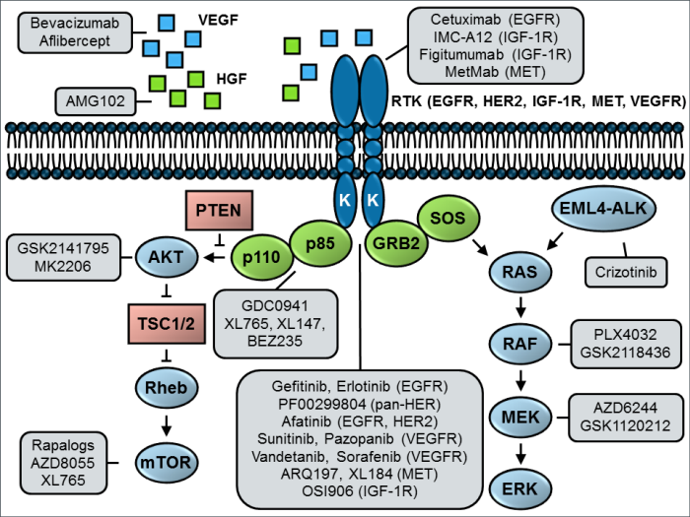
Current molecular targets for NSCLC

Slide 26
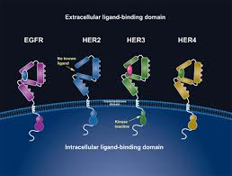
NSCLC| Epidermal Growth Factor
Notes:
Human Epidermal Growth Receptor is a member of the Epithelial growth factor family, this also includes EGFR.
Discovered the family of receptors in early 1990s
Activation of these receptors results in a chain or events which then stimulated cellular growth, cell survival, migration and angiogenesis
Normally the TK activitiy of EGFR is tightly controlled

Slide 27
NSCLC| EGFR
15% of NSCLC overall
Higher rates within
  Adenocarcinoma
  Non-smoker
  Asian
  Women
  Young
Notes:
Asian up to 62% in the PIONEER study which looked at seven Asian regions, the rate was increased in smokers.
These are surrogate markers for a specific activating mutation in the tyrosine kinase domain of EGFR (exon 19 deletions, L858R point mutation in exon 21)
Despite the thought that these are indiicators of a positive EGFR status all patients are tested, even if they have already commenced CTx

Slide 28
NSCLC| Single Agent EGFR TKI
Gefitinib
  IPASS trial (gefitinib v carboplatin/paclitaxel)
  EGFR not initially tested (clinical criteria only)
 | Progression Free Survival (12 month) | Overall Survival
Gefitinib | 25 (HR 0.74) | 18.8*
Carboplatin/Paclitaxel | 7 | 17.4*
Notes:
IPASS trial 1217 patients for first line therapy
Patients were: asian, adenocarcinoma, never or former light smokers (not EGFR tested)
Patients were randomized, as first-line therapy, to receive either gefitinib at 250 mg daily or standard chemotherapy with carboplatin and paclitaxel. The primary endpoint of the study was progression-free survival with secondary endpoints of overall survival, response rate, and a preplanned exploratory analysis by biomarker status for various biomarkers including EGFR mutational status.
When EGFR tested 60% of the patients had EGFR mutations (only 437 patients avaliable for testing)

Slide 29
NSCLC| IPASS trial
Status | Treatment | PFS | OS
EGFR + | Gefitinib | 9.5 (HR 0.48) | 22
EGFR+ | Carboplatin/Paclitaxel | 6.3 | 22
EGFR - | Gefinitib | 1.5 (HR 2.85) | 11.2
EGFR - | Carboplatin/ Paclitasel | 6.5 | 12.7
Notes:
The important take home message from this was that patients treated with ECFR TKI that do not have a mutation run a significantly higher rate of relapse and a non-stastically sinigificant change indeath
And specifically, if patients have an EGFR mutation, they had a markedly better progression-free survival if they were randomized to gefitinib as first-line therapy, with a hazard ratio of 0.48. But in contrast, patients who did not have an EGFR mutation, even if they had the demographic features of being a never-smoker Asian patient with an adenocarcinoma, actually did far better randomized to chemotherapy, with a hazard ratio of 2.85, clearly favoring chemotherapy. In fact on 1% had any repsonsed to the gefitinib therapy
These finding were echoed in the North- East and West Japan Oncology Group Findings from their Phase III trials retuned similar results.

Slide 30
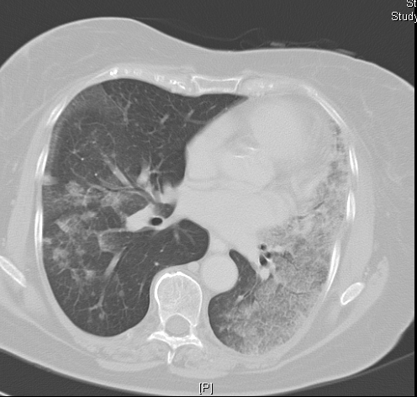
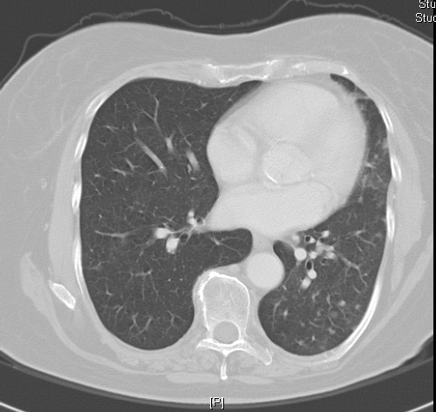
NSCLC| Results!
January 2002
October 2004
Notes:
Women with adenocarcinoma following treatment with gefintinib

Slide 31
NSCLC| Erlotinib
OPTIMAL | PFS | OS
Erlotinib | 13.1
Gemcitabine/ Carboplatin | 14.6
EURTAC | PFS | OS
Erlotinib | 9.7 | 19.3
Platinum doublet | 5.2 | 19.5
Notes:
OPTIMAL trial
All patients were tested for EGFR mutation: only entered if +ve first line therapy
another asian trial (China): erlotinib or gemcitabine/ carboplatin
EURTAC trial
174 patients with EGFR mutations
Significant difference in PFS, no difference in OS, but as any future treatment not regulated 76% went on to have EGFR TKI prior to death
Afatinib: an irreversible EGFR TKI has also been approved by the FDA has also been aassessed as effical`

Slide 32
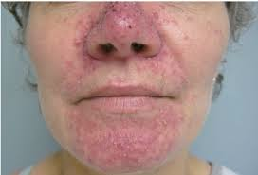
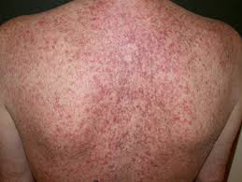
NSCLC| Erlotinib
Toxicity
  Rash
  GI toxicities:
    Diarrhoea
  Pneumonitis
  Hepatic
    Hepatic failure
    Hepatorenal syndrome
Notes:
RASH; all agents that target the EGFR pathway( noth monocoloncals and small molecule TKIs: due to the high levels of EGFR expression in the basal layers of the epidermis
DIARRHOEA: up to 60% and can normally be managed with loperamide
PULMONARY: potenitally fatal pneumonitis
HEPATIC: can cause hepatic failure with increased risk in patients with elevated bilirubin

Slide 33
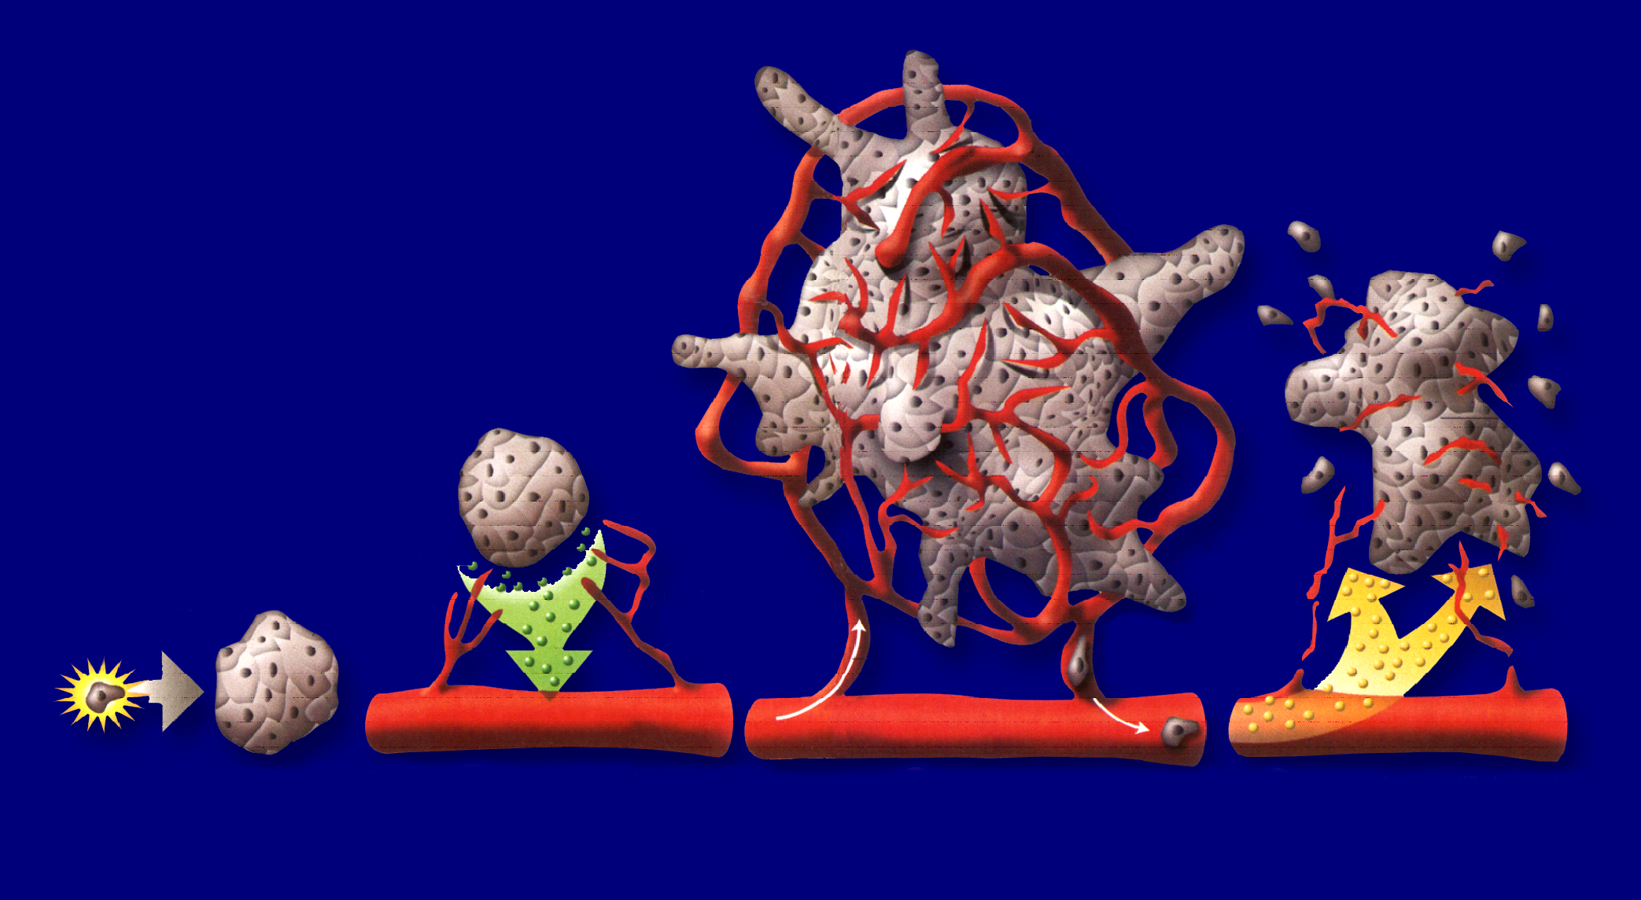
NSCLC| Anti-Antiangiogenesis
Somatic
mutation
Small
avascular
tumor
Tumor secretion of proangiogenic factors stimulates angiogenesis
Angiogenic inhibitors may reverse this process
Rapid tumor growth and metastasis
Folkman J. N Engl J Med. 1971;285:1182-1186.
Notes:
To better understand these developments, it is useful to go to the original hypothesis regarding the concept of using antiangiogenic drugs for cancer treatment that Judah Folkman, MD, published in 1971, and to note how much has changed since then.
The basic elements of the hypothesis, as shown here, are well known. Small incipient tumor masses will not grow beyond the size of approximately 1-2 millimeters unless they can develop a blood vessel supply to provide the necessary oxygen and nutrients to allow progressive expansion of tumor mass. Dr. Folkman envisaged that during the course of tumor development, cells within some of the small microscopic occult tumors—for reasons that were unknown back then—would start to secrete a single tumor angiogenesis factor (TAF); we now call TAF a signaling molecule. TAF would diffuse out from the tumor cell population, bind to adjacent endothelial cells of mature blood vessels, and trigger a form of angiogenesis called sprouting angiogenesis, leading to the development of new blood vessel capillaries. Those capillaries would then infiltrate the microscopic tumor mass and set in motion the possibility of progressive expansion of tumor mass and hematogenous metastatic spread.
Dr. Folkman hypothesized that it might be possible to block this process, for example, by developing a monoclonal antibody to the hypothetical TAF molecule made by the tumor cell population. Blocking the activity of TAF would reverse or retard the process of tumor angiogenesis and reintroduce a state of tumor dormancy, thereby prolonging survival.
One of the ways that the angiogenesis model changed is that there is no longer any evidence of a single TAF. Instead, a large family of different proangiogenic growth factors contributes to the development of new blood vessels. In addition, the model now includes evidence that starving a tumor of oxygen and inducing an elevated state of tumor hypoxia can have both positive and negative effects, at least in theory, and probably in practice.

Slide 34
NSCLC| Acquired resistance to EGFR
Over time there is formation of acquired resistance
  50% of acquired resistance is due to T790M
  ? blocks binding of TKIs such as gefitinib and erlotinib
  Irreversible EGFR-TKIs in development (afatinib, HKI272, PF00299804, BMS690514)
Kobayashi S, et al. N Engl J Med. 2005;352:786-792. Engelman JA, et al. Science. 2007;316:1039-1043. Balak MN, et al. Clin Cancer Res. 2006;12:6494-6501. Bean J, et al. Clin Cancer Res. 2008;14:7519-7525.
Notes:
EGFR, epidermal growth factor receptor; TKI, tyrosine kinase inhibitor

Slide 35
NSCLC| Afatinib
Randomized 2:1 (double blind)
Afatinib 50 mg QD + BSC
(n = 390)
Patients with stage IIIB/IV lung cancer, progression after 1-2 lines of chemo,
≥ 12 wks of erlotinib or gefitinib, and ECOG PS 0-2
(N = 585)
Placebo QD + Best Supportive Care
(n = 195)
Primary endpoint: OS
Secondary endpoints: PFS, response, QoL, safety
Miller VA, et al. Chicago Multidisciplinary Symposium in Thoracic Oncology 2010. Abstract LBPL3.
Notes:
BSC, best supportive care; ECOG PS, Eastern Cooperative Oncology Group performance score; NSCLC, non-small-cell lung cancer; OS, overall survival; PFS, progression-free survival; QD, once daily; QoL, quality of life.

Slide 36
NSCLC| Afatinib
1.0
Placebo (133 events): median PFS: 1.1 mos (95% CI: 0.95-1.68)
Afatinib (275 events): median PFS: 3.3 mos (95% CI: 2.79-4.40)
HR: 0.38 (95% CI: 0.306-0.475; log-rank P < .0001)
0.8
0.6
Estimated PFS Probability
0.4
0.2
0.0
0
3
6
9
12
15
18
PFS Time Since Randomization (Mos)
Pts at Risk, n
Placebo
Afatinib
195
390
15
152
4
65
2
16
9
3
Miller VA, et al. Chicago Multidisciplinary Symposium in Thoracic Oncology 2010. Abstract LBPL3.
Notes:
HR, hazard ratio; NSCLC, non-small-cell lung cancer; PFS, progression-free survival

Slide 37
NSCLC| Afatinib
1.0
Placebo (144 deaths; 58.5%): median OS:
11.96 mos (95% CI: 10.15-14.26)
Afatinib (244 deaths; 62.6%): median OS:
10.78 mos (95% CI: 9.95-11.99)
0.8
HR: 1.077 (95% CI: 0.862-1.346; log-rank P = .7428)
0.6
Estimated Survival Probability
0.4
0.2
0
0
3
6
9
12
15
18
21
24
Time to Death Since Randomization (Mos)
Pts at Risk, n
Placebo
Afatinib
195
390
169
344
142
283
112
217
65
122
33
69
18
32
5
12
Miller VA, et al. Chicago Multidisciplinary Symposium in Thoracic Oncology 2010. Abstract LBPL3.
Notes:
HR, hazard ratio; NSCLC, non-small-cell lung cancer; OS, overall survival

Slide 38
NSCLC| Erlotinib
Met amplification ~ 20% of acquired resistance
  Multiple drugs in development (XL184 [cabozantinib], MetMab, ARQ197)
  Often combined with EGFR-TKI
Other resistance mutations in EGFR reported
  T854A, D761Y . . .

Slide 39
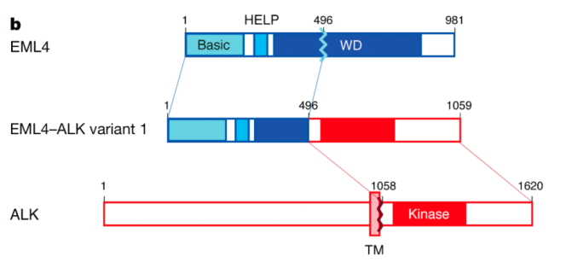
NSCLC| ALK rearrangement in NSCLC
Anaplastic Lymphoma Kinase (ALK) is a receptor tyrosine kinase that is normally not expressed in the lung.
Fusions of ALK with another upstream partner, EML4, were found in NSCLC in 2007. EML4-ALK fusions result from diverse small inversions within the short arm of chromosome 2.
Biologically, EML4-ALK fusions result in protein oligomerisation and constitutive activation of the kinase.
ALK mutations are found in 4% of the NSCLC and occur more frequently in young and non-smoking patients
Soda M, et al. Nature. 2007;448:561-566.
Notes:
ALK, anaplastic lymphoma kinase; EML4, echinoderm microtubule-associated protein-like 4.
39

Slide 40
NSCLC| Crizotinib in ALK +ve NSCLC
Crizotinib
  Dual selective inhibitor of ALK and c-MET
    ATP-competitive inhibitor
    Orally available small molecule
  Potent inhibition of cell growth and induction of apoptosis in NSCLC cell lines
  Demonstrated safety in dose-escalation study
Tan W, et al. ASCO 2010. Abstract 2596.
Notes:
NSCLC, non-small-cell lung cancer

Slide 41
NSCLC| Crizotinib in ALK +ve NSCLCz: Tumour response
Kwak and colleagues evaluated safety and efficacy of crizotinib in ALK-positive NSCLC patients (N = 82)
60
PD
SD
PR
CR
40
20
0
Percent Change From Baseline
-20
-40
-30%
-60
-80
-100
10
20
30
40
50
60
70
79
Patient No.
Kwak EL, et al. N Engl J Med. 2010;363:1693-1703.
Notes:
NSCLC, non-small-cell lung cancer

Slide 42
NSCLC| Crizotinib in ALK +ve NSCLC
1.00
0.75
0.50
Probability of PFS
0.25
95% Hall-Wellner confidence limits
Median follow-up for PFS: 6.4 mos
(95% CI: 5.5-7.2)
0
0
2.5
5.0
7.5
10.0
12.5
15.0
17.5
Mos
Kwak EL, et al. N Engl J Med. 2010;363:1693-1703.
Notes:
CI, confidence interval; NSCLC, non-small-cell lung cancer; PFS, progression-free survival

Slide 43
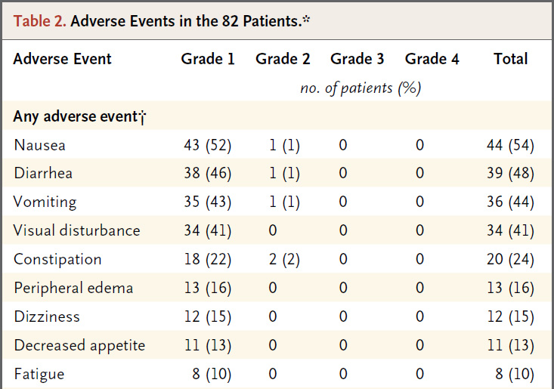
NSCLC| Crizotinib in ALK +ve NSCLC
Visual disturbances include the appearance of flashing lights, floaters, and overlapping shadows
Visual Symptom Assessment Questionnaire for patients in PROFILE 1005 – 63% (114/182) had experienced visual side effects by C#2 of crizotinib. Improved to 41% (46/112) by C#5.
Kwak EL, et al. NEJM 2010; 363 (18): 1693-1703.
Salgia R, et al. ASCO 2012. Abstract 7596.
Notes:
Visual disturbances include the appearance of flashing lights, floaters, and overlapping shadows. There was a study presented at ASCO this year looking at the visual effects in ALK positive patients treated with crizotinib

Slide 44
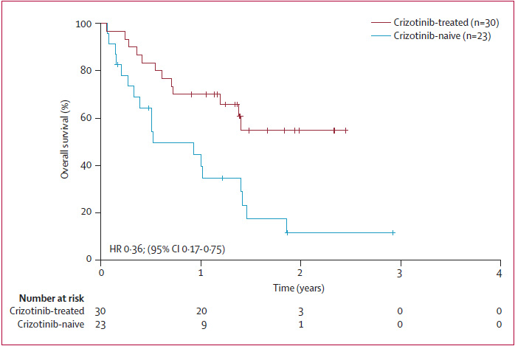
NSCLC| Crizotinib in ALK +ve NSCLC
Patients with EML4-ALK fusion NSCLC have a better OS with crizotinib than with standard therapy
Median OS – not reached ~ 18 months
Median OS – 6 months
Shaw AT, et al. Lancet Oncol 2011; 12 (11):1004-1012.
Notes:
Second or 3rd line crizotinib
2nd line chemotherapy

Slide 45
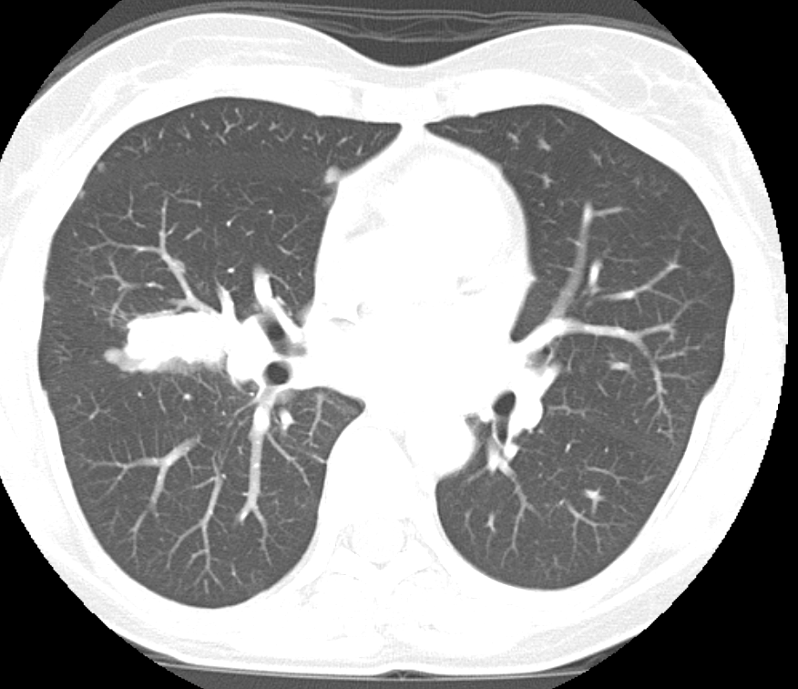
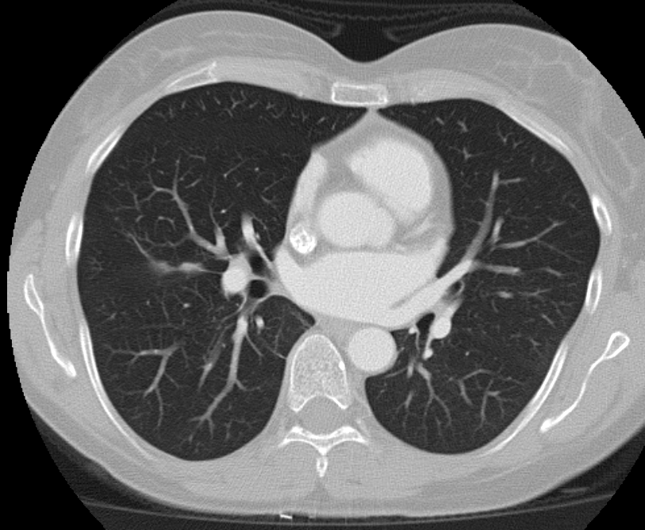
NSCLC| Crizotinib in ALK +ve NSCLC
September 2011
April 2012
Notes:
ALK, anaplastic lymphoma kinase; NSCLC, non-small-cell lung cancer.

Slide 46
NSCLC| Crizotinib in ALK +ve NSCLC
EML4-ALK defines a new molecular subset of NSCLC
Patients are more likely to be young, never/light smokers with adenocarcinoma
Crizotinib results in a 6-month PFS of 72% and overall response rate of 57% at 6.4 months
Ongoing clinical trials to assess benefit of chemotherapy vs. targeted therapy
Over time tumours can develop resistance
  2nd generation ALK TKIs and HSP90 inhibitors offer promise in patients with crizotinib resistance

Slide 47
Incorporating Novel Data in the Molecular Features of Lung Cancer Into the Treatment Paradigm
NSCLC| Crizotinib in ALK +ve NSCLC
Unknown
EGFR
KRAS
MET
Amplification
PIK3CA
ALK
ERBB2 Amplification
MEK1
ERBB2
BRAF

Slide 48
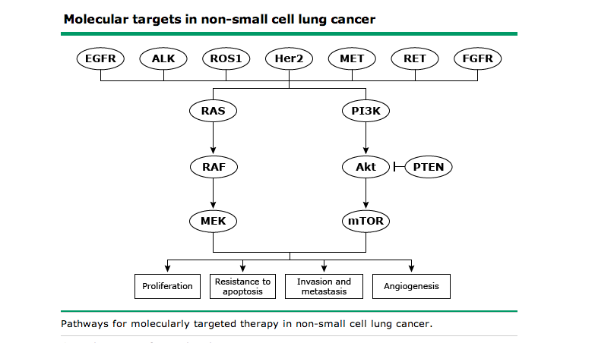
NSCLC| More Targets

Slide 49


