Slide 1
Mismatch Repair deficient CRC: implications for clinical practice
Yoland Antill
Medical Oncologist
Cancer Genetics

Slide 2


Mismatch Repair pathway
Microsatellites are short repeats within the DNA sequence that are prone to replication error.
Intact MMR system functions to repair these errors
  If repair of the error not possible then apoptotic pathway is activated
IHC can be utilised to determine expression of MMR proteins, whereby indicating an intact MMR function.

Slide 3
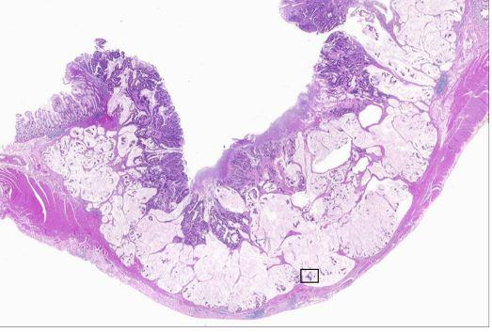
MMR deficient tumours
  Histological features (Jass 1998, Ribic 2003)
  Mucinous histology
  Poor differentiation
  Right sided
  Lymphocytic infiltrate
  Expanding growth pattern
  Absence of intraglandular neutrophil-rich ‘dirty’ necrosis
    Sporadic dMMR CRC can be predicted using the presence of any three of these factors (sens. 98% spec. 48%) (Halvarsson 2008)
Prevalence of ~15% sporadic CRCs (Koopman 2009)
  More commonly seen in stage II than stage III
  ~4% stage IV
  More common in females (Poynter 2008)
  Less frequent in Asian populations

Slide 4
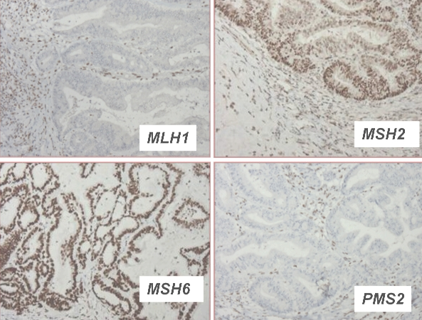
Immuno for MMR proteins
Advantages
  Effective for detecting tumours resulting from MMR deficiency. (92% sensitivity for identifying tumours that arise in individuals with a germline mutation) (Shia 2008).
  Readily available and is technically easy to perform.
  Identifies the gene in which either a germline mutation or a somatic alteration that silences gene expression is most likely to be found (de Leeuw 2000, Cunningham 2001)
    significantly reducing the cost of molecular genetic testing
Limitations
  Variation in tissue fixation and other technical issues can result in weak or equivocal staining patterns (Shia 2008)
  Some missense germline mutations will be missed as they may not result in the absence of a detectable protein product (Wahlberg 2002, Bellizzi 2009)
  It may be less reliable when performed on small tissue samples (Zhang 2008).

Slide 5
National Comprehensive Cancer Network (NCCN)
Now recommends that patients with colorectal cancer (CRC) be tested for Lynch syndrome.
The syndrome is the most common inherited form of CRC, accounting for 2% to 4% of all cases. This translates to roughly 1 of every 35 CRCs.
The universal testing recommendation includes an optional age-related consideration:
  for CRC patients younger than 70 years, test everyone;
  for CRC patients 70 years and older, test only those who meet the Bethesda criteria.

Slide 6


Slide 7
Outcome variations
Stage for stage MMR deficient CRCs are associated with improved prognosis
  Observational studies (Myrhoj 1997, Watson 1998, Halling 1999, Gryfe 2000, Wright 2000, Samowitz 2001, Benetti 2005, Lenza 2006)
  Clinical Trials (Ribic 2003, Caruthers 2004, de Vos 2004, Jover 2006, Sargent 2010, Hutchins 2011, Roth 2010)
  Meta-analysis (Popot 2005)

Slide 8
Chemotherapy response variation
Risks and possible benefits of adjuvant chemotherapy be discussed with medically fit patients who have higher-risk stage II disease
  <13 lymph nodes resected, a T4 primary, perforation, LVSI or poorly differentiated histology, including signet ring and mucinous tumors.
No significant PFS or OS benefit from 5FU chemotherapy in dMMR tumours when compared to pMMR tumours (Ribic 2003, Carethers 2004, de Vos 2004, Jover 2006, Sargent 2010)
FOLFOX assessed in a number of studies but underpowered to compare dMMR v pMMR tumours (Lee 2013)

Slide 9
Implications of Lynch Syndrome
These patients have a 16% to 30% risk for a second primary CRC in the 10 years after their first diagnosis.
Patients with the syndrome should have a colonoscopy every 1 to 2 years for life.
  For those without the syndrome, colonoscopy is indicated 1 year after the cancer diagnosis, 1 to 3 years later, and every 3 to 5 years thereafter, depending on the findings.
Lynch syndrome patients also have a higher risk for other cancers.
  Women <70 yrs have a 15% to 60% risk for endometrial cancer and a 1% to 24% risk for ovarian cancer (depending on which mismatch repair genes are implicated in the syndrome).
  In contrast, women in the general population have a 2.7% risk for endometrial cancer and a 1.6% risk for ovarian cancer.
Implications for other family members

Slide 10
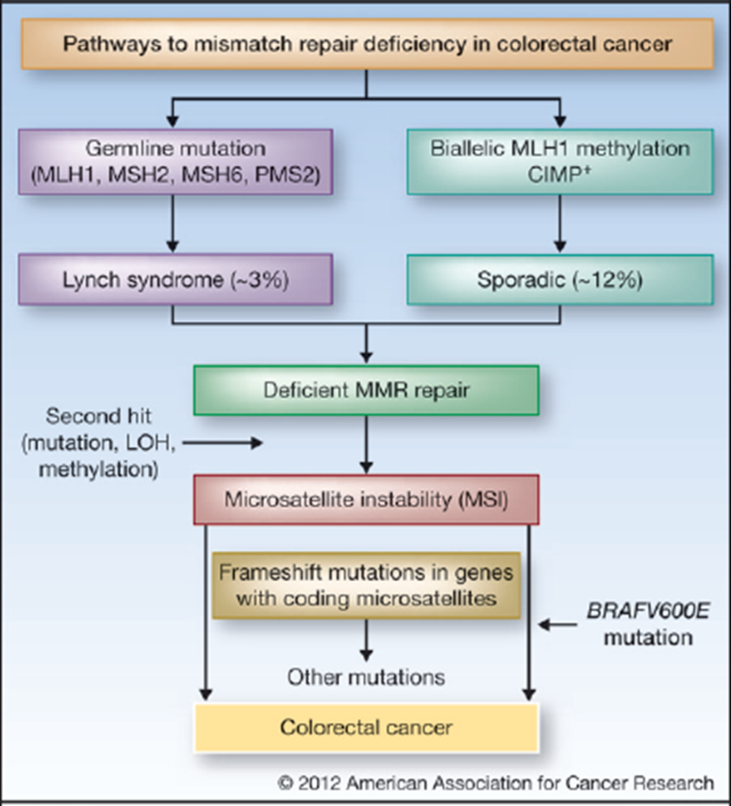

Slide 11
BRAF mutations
Associated with BRAF V600E mutation in 63% cases associated with CIMP CRCs
  5% in pMMR sporadic tumours
  ?<1% in Lynch CRCs
BRAF mutations assoc with poorer prognosis in CIMP CRCs
Causal relationship between CIMP CRCs and BRAF mutations is unclear but a useful means of differentiating Lynch from CIMP dMMR tumours

Slide 12
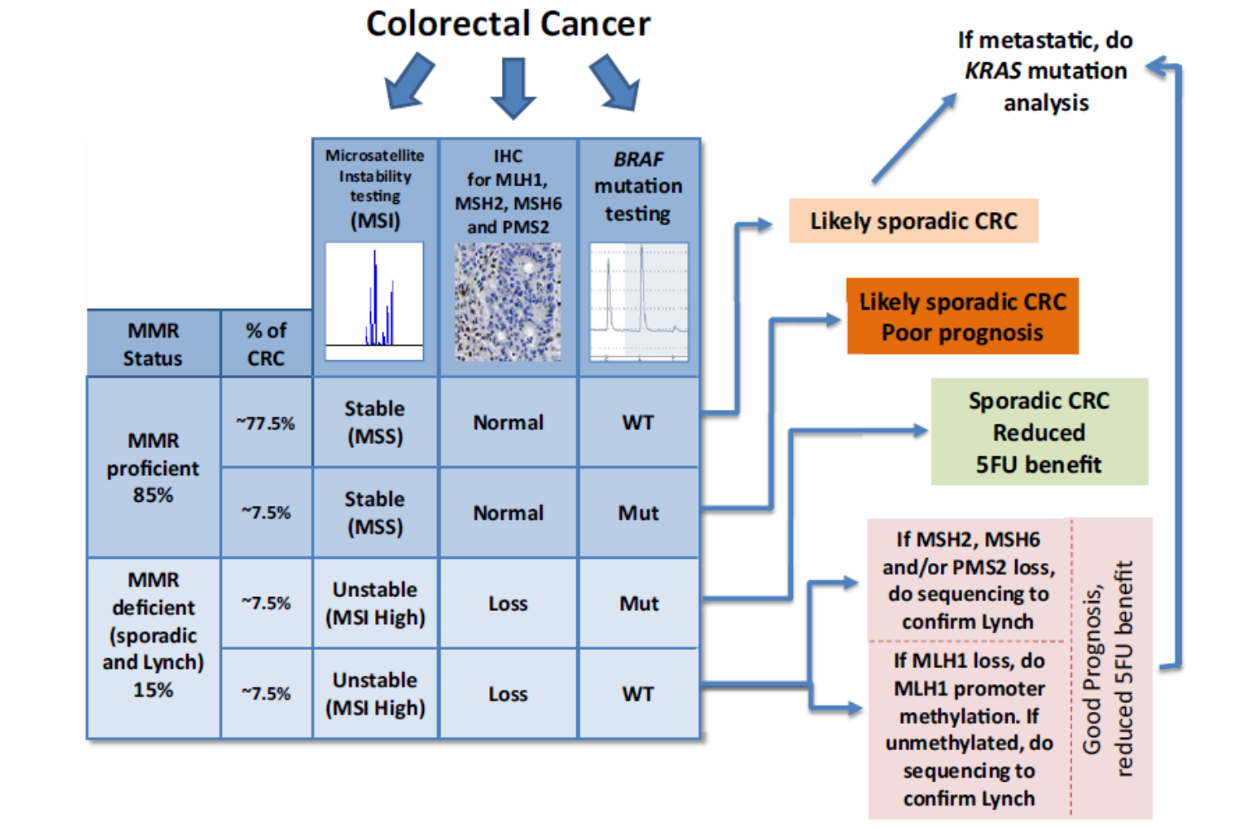

Slide 13

Tumour assessment possibilities
Panel testing
Thrown in for free at Healthscope
with RAS testing: node + or Met Disease
Alfred panel of 7 genes- includes BRAF
Medicare rebate for met disease
BRAF
IHC V600E: (Melb Uni ~ $150)
Sequencing V600E:
($230 at Healthscope)
Methylation
MLH1 methylation at PMCC
or Ludwig- non commercial
$200-300

Slide 14
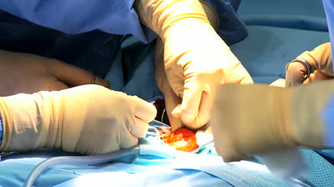

BOTTOM LINE

Slide 15
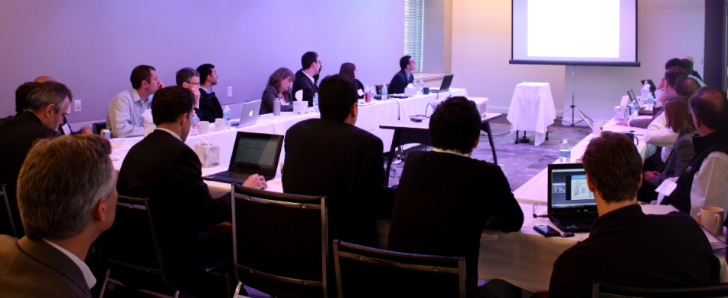

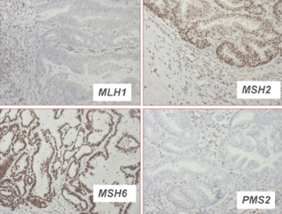
BOTTOM LINE

Slide 16
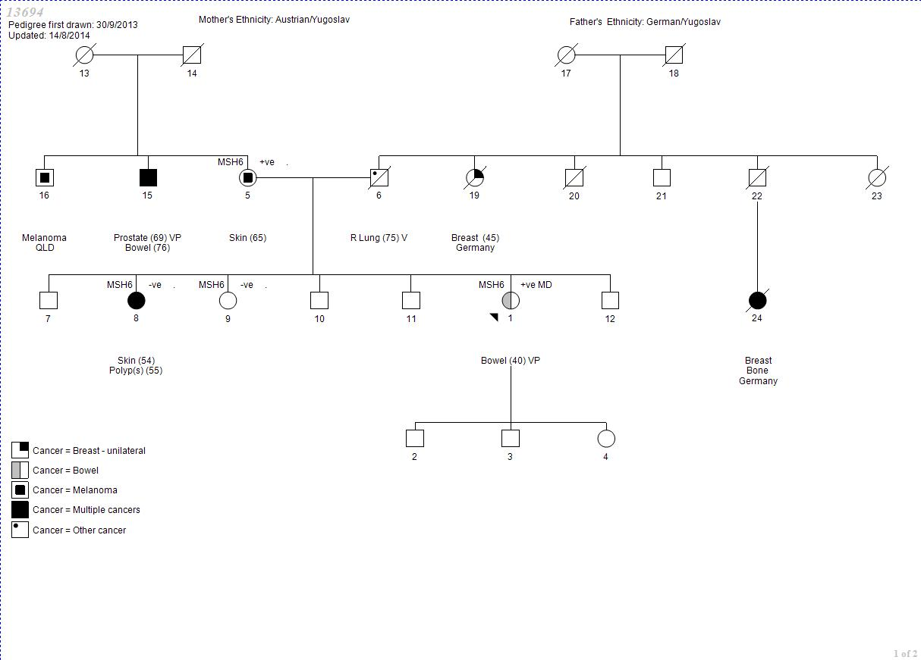

Slide 17


Slide 18


