Slide 1
Prostate Cancer:
Endocrine Therapies

Slide 2
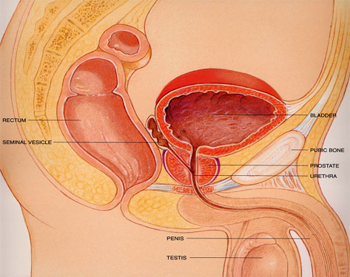
Prostate Cancer| The Prostate
Is an organ forming part of the male reproduction system
  Its main function is to produces fluid which protects and enriches sperm
It is found immediately below the bladder and in front of the bowel
In young men it is the size of a walnut encircling the ureter
Surrounding area richly supplied by nerves
Notes:
What is the prostate

Slide 3
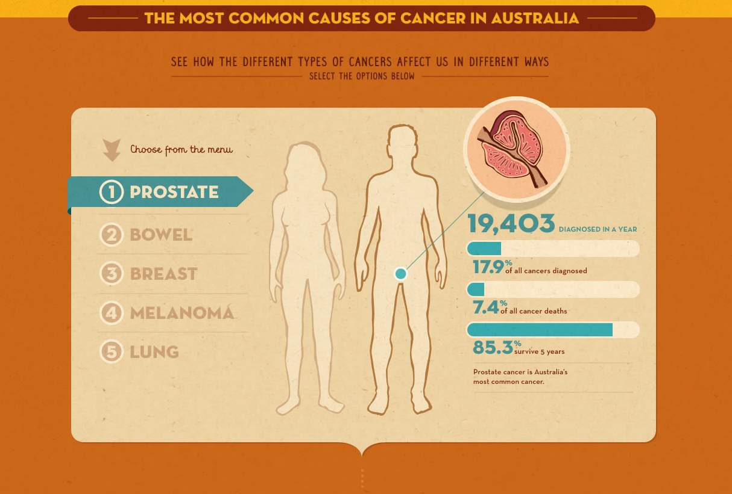
Prostate Cancer| Australian Epidemiology
Notes:
Almost 20,000 men are diagnosed with prostate cancer each year in Australia, contributing to 18% of all cancers diagnosed overall, and 30% of all cancers diagnosed in men
Overall prostate cancer accounts for 7.4% of all cancer deaths, increasing to 13% of all cancer deaths in males
Therefore the lifetime risk of prostate cancer is 16% but the risk of dying from prostate cancer in only 2.9%

Slide 4
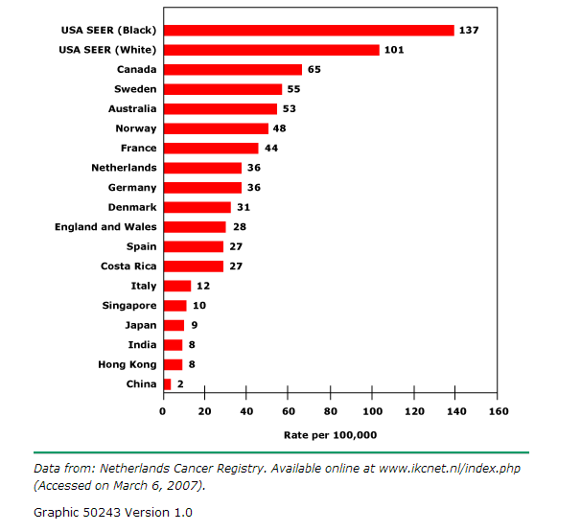
Prostate Cancer| Epidemiology
Notes:
There is a significant variation in incidence of up to 50 fold across international populations
This has become increasingly evident over the past several decades, predominantly driven by the increased utilisation of prostate biopsies in asymptomatic men with elevated PSA

Slide 5
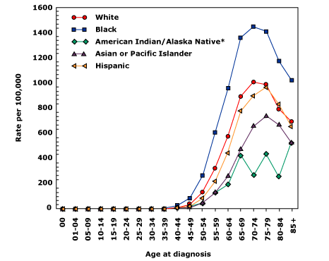
Prostate Cancer| Risk Factors: Age
Notes:
Age: prostate cancer has one of the strongest correlations between age of any human malignancy
Clinically diagnosed prostate cancer rarely occurs before the age of 40 but the incidence rises rapidly thereafter
The National Cancer Institute of America quote the annual incidence of prostate cancer of 0.1, 0.6 and 1 percent for men in their 50,60 and 70s respectively
Although the incidence appears to decrease in pateints aged into their 80s this is almost certainly secondary to a decreased rate of biopsies being performed
This is shown by autopsy studies which show an occult pathological diagnosis of prostate can in 40-73% of men aged between 81-90

Slide 6
Prostate Cancer| Risk Factors: Genes
Genetics Factors
  No specific genes currently identified
    One affected first degree relative
      two-fold increased risk
    Two affected first degree relatives
      Five fold increased risk
    Three affected first degree relatives
      Eleven fold increased risk
  BRAC1 and BRCA2
    4.5 fold increase BRCA2, 1.8 fold increase BRCA1
    Associated with a higher Gleason score, earlier onset and worse prognosis
  Lynch Syndrome
  HOXB13
Notes:
This increased genetic risk is confirmed by twin studies showing up to a 42% concordance for prostate cancer, much higher than bowel or breast.
The genetic profile also appears to influence prognosis, with the 5 year survival of fathers correlating to those of their sons
Possibly due to multiple foci in the 8q and 17q region, a panel of 5 SNPs can be examined over three loci from 8q and two loci from 17q with a dramatic increase in risk in those with 4 out of 5 SNPs present.
Lynch Syndrome
Autosomal dominant disorder cause by a germ line mutation in one of several mismatch repair genes
Increased cumulative risk of prostate cancer
HOXB13
Gene codes for a transcription factor that is important in prostate development

Slide 7
Prostate Cancer| Risk Factors: Other
Ethnicity
  Increased in patients from African descent, and lower in patients from Asian descent
    Possibly due to variations in testosterone levels
Diet (increased risk with)
  High in
    Animal fat
    Omega 3 fatty acids (retrospective trials only)
  Low in
    Vegetables
    Tomatoes
    Coffee
Smoking, Obesity, Agent Orange
  Increased incidence of prostate cancer and risk of progression
Notes:
Animal fat: high intake of alpha-linolenic acid and low amount of linoleic acid, common in red meat
Vegetables: higher rates in those having < 14 serves per week
Tomatoes: lycopene→ potent anti-oxidant properties (Health Professionals Follow Up study ) showed a lower incidence of prostate cancer and decreased lethal prostate cancer
Coffee (Health Professional Follow UP study)
Smoking: only in heavy smokers, but

Slide 8
Prostate Cancer| Screening in Australia
There is no government funded screening program in Australia

Slide 9
Prostate Cancer| Screening: Prostate Specific Antigen
Glycoprotein produced by prostate epithelial cells
  Elevated in prostate cancer because of increased production and disruption of tissue barriers
  Can be elevated preceding clinical disease by up to 5-10 years
Causes for elevated PSA
Malignant | Prostate Cancer
Benign | Benign Prostatic Hyperplasia
 | Acute Prostatitis
 | Subclinical inflammation
 | Prostate Biopsy/Cystoscopy/ TURP/ DRE/ Perineal trauma
 | Urinary Retention
 | Prostatic Infarction
Notes:
PSA has a half life of 2.2 days and therefore screening PSA should not be performed within 2 weeks of the above procedures
Five-alpha reductase inhibitors finasteride and dutasteride lower PSA levels

Slide 10
Prostate Cancer| PSA
Originally
  introduced as a tumour marker to detected cancer recurrence or disease progression
Introduced
  As a screening marker in the 1990s
  Majority were localised disease which lead to a increase in radical prostatectomies and radiation therapy
PSA cut off 4.0 ng/mL | Cancer
Sensitivity | 21% (low grade) 51% (high grade)
Specificity | 91%
Positive Predictive Value | 30%
Negative Predictive Value | 85%
Notes:
Positive Predictive Values:
the proportion of men with an elevated PSA who then go on to have prostate cancer (i.e one in three men who have an elevated PSA will have prostate cancer detected on biopsy)
Negative Predictive Value
The proportion of men with a low PSA who then go on to NOT have cancer
NO clear cut off value

Slide 11
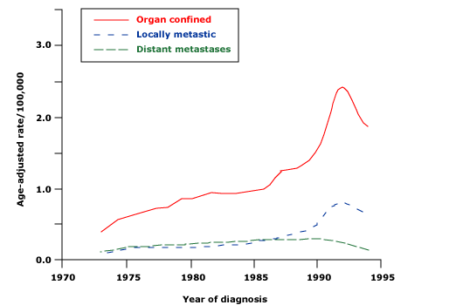
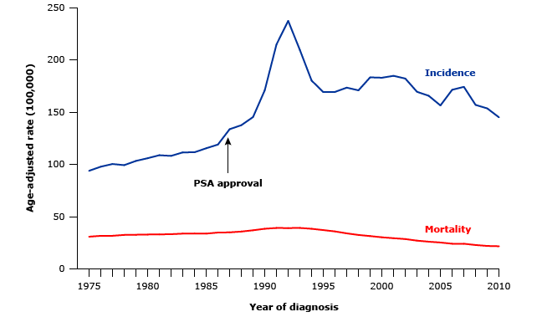
Prostate Cancer| Screening: why the controversy
Notes:
Two major trials looking at screening
ERSPC ( European Randomised Study of Screening for Prostate Cancer) 182,000 men offered 5 yearly PSA compared to control.
Did show a survival benefit with 1055 men needing screening to prevent one prostate cancer related death over 11 years and 37 additional cases of prostate cancer would need to be diagnosed to prevent one death
PLCO (prostate, lung, colorectal and ovarian) screening trial looked at 76,693 men randomised to 2 yearly PSA and DRE to control group.
No benefit from screening in terms of death
PIVOT ( prostate cancer intervention versus observation trial)

Slide 12
Prostate Cancer| Harm from Screening
Biopsy
  Infection→ sepsis with a hospitalisation rate of 0.6- 4.1%
  Anxiety, physical discomfort
Over diagnosis
  The lifetime risk of being diagnosed with prostate cancer has increased from 1 in 11 to 1 in 6
  The lifetime risk of dying from prostate cancer has remained 1 in 34
  Simulation models have predicted between 23-50%
  Increases with increased age
Notes:
Conflicting studies regarding the mortality rate of transrectal biopsy→ if at 0.2% may indicated a net overall increased mortality from prostate screening.
The term overdiagnosis refers to detection by screening of a cancer that would never have become clinically significant
This is a particular concern in prostate cancer because most men with screen detected prostate cancer have early stage disease and will be offered aggressive treatment

Slide 13
Prostate Cancer| Screening Considerations
Needs to involve discussion with patient:
  Prostate cancer is an important health problem
  Prostate cancer screening is controversial
  Prostate screening may reduced the chance of dying from prostate cancer however the evidence is mixed and the absolute benefit is small
  In order to determine if cancer is causing an abnormal tests: men need to undergo a prostate biopsy
  No current test can accurately determine which men with a cancer found by screening are most likely to benefit from aggressive treatment
    Most men with prostate cancer will die from other causes

Slide 14
Prostate Cancer| Harms from Screening: Therapy
Risk of therapy
  Surgery
    Urinary incontinence (15-50%)
    Sexual dysfunction (20-70%)
      Erectile dysfunction
    Bowel dysfunction
  External Beam Radiotherapy
    Erectile dysfunction (20-45%)
    Urinary Incontinence (2-15%)
    Bowel dysfunction (6-25%)
Notes:
Many men with prostate cancer, even in the absence of treatment will have lengthy periods of time without clinical problems.
However undergoing radical prostatectomy can lead to immediate issues:
Therefore as mentioned before with 37 diagnoses needed to be made to prevent one death, there is significant morbidity

Slide 15
Prostate Cancer| Symptoms
All four main disorders of the prostate can present in the same way
  Waking frequently at night
  Sudden or urgent need to urinate
  Difficulty in starting to urinate
  Painful ejaculation
  Blood in urine or semen
  Decreased libido
  Sexual dysfunction
Notes:
Prostatitis, BPH, Prostadynia
Therefore investigations at that point involve PSA, imaging (US/ CT/MRI) and biopsy

Slide 16
Prostate Cancer| Tumour Grade
Gleason scoring system
  Founded on the glandular appearance and architecture at a low powered magnification.
  Two scores of 1- 5 points are given for:
    The predominant pattern
    The second most prevalent site pattern
      Therefore Gleason’s score varies from 2 to 10 points
    Scores of 7 and above have a worse prognosis than patients with lower scores

Slide 17
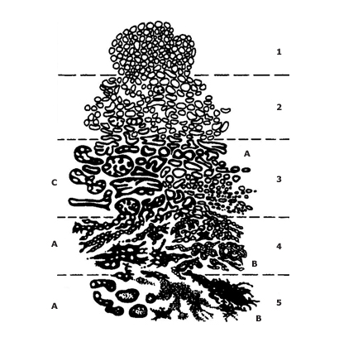
Prostate Cancer| Tumour Grade
A higher scores indicates a greater likelihood of having non-organ confined disease as well as a worse outcome after treatment of localised disease
New guidelines have now classified Gleason score of < 6 not malignant
Notes:
Predomantly gives one score and secondary give the other

Slide 18
Prostate Cancer| Tumour Grade
Gleason Score
Malignant | Score | Differentiation
NOT MALIGNANT | 2,3,4 | Well differentiated (low grade)
 | 5,6 | Moderately differentiated (intermediate grade)
MALIGNANT | 7 | Moderately differentiated (intermediate grade)
 | 8,9,10 | Poorly differentiated (high grade)
Notes:
Predomantly gives one score and secondary give the other

Slide 19
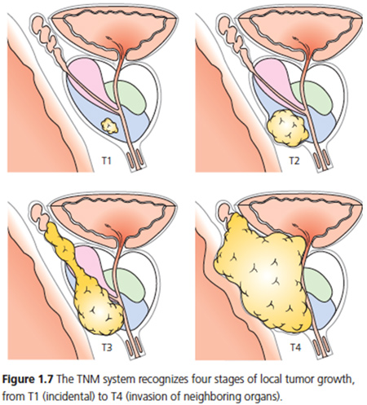
Prostate Cancer| Staging: Tumour
Primary Tumour
TX |  | Primary tumour can’t be assessed
T0 |  | No evidence of primary tumour
T1a | a | Incidental histological finding in <5% of tissue resected
 | b | Incidental histological finding in > 5% of tissue resected
 | c | Tumour identified because of needle biopsy (due to high PSA)
T2 | a | Tumour invades one-half of one lobe or less
 | b | Tumour involves one half of one lobe but not both lobes
 | c | Tumour invades both lobes
T3 | a | Extracapsular extension (unilateral or bilateral)
 | b | Tumour invades seminal vesicles
T4 |  | Tumour is fixed or invades adjacent structures other than seminal vesicles
Notes:
T1 lesions are niether palpable nor detectable by imaging

Slide 20
Prostate Cancer| Screening: Nodal and Metastatic disease
Nodes
NX | Regional lymph nodes were not assessed
N0 | No regional lymph node metastasis
N1 | Metastasis in regional lymph nodes
Distant Metastasis
M0
M1 | a | Nonregional lymph nodes
 | b | Bones
 | c | Other sites with or without bone disease

Slide 21
Prostate Cancer| Risk Factors: Genes
Common Complications
  Acute urinary retention
  Bilateral ureteric obstruction→ Acute renal failure
  Spinal Cord Compression
  Pacnytopenia from bone marrow infiltration
  Bilateral lower limb lymphoedema secondary to pelvic obstruction

Slide 22
Prostate Cancer| Prognosis
Poor prognosis is associated with
  Invovlement of thee seminal vesicles
  Extension of the tumour beyond the prostate capsule
  High PSA values, rapid doubling time, high PSA velocity

Slide 23
Prostate Cancer| Management overview
Localised
Active Surveillance
Radiotherapy
Surgery
Advanced
Hormonal therapy
Chemotherapy
Supportive therapy
Radiotherapy
Bisphosphonates
Palliative Care
Notes:
Localised prostate cancer can be cured

Slide 24
Prostate Cancer| Choice of Therapy
There are no adequate RCT that provide adequate data comparing active surveillance, radiation therapy, brachytherapy and radical prostatectomy for men with isolated, low risk prostate cancer
Awaiting ProtecT trial in the UK

Slide 25
Prostate Cancer| ProtecT Trial
Early Stage Prostate Cancer in males aged 50-69
Radical Prostatectomy
Active Surveillance
Radical Radiotherapy

Slide 26
Prostate Cancer| Active Surveillance
Active Surveillance is NOT watchful waiting
  Entails observation rather than intervention, with curative intent treatment deferred until there is evidence that the patient is at an increased risk for disease progression
  Optimal selection criteria not established

Slide 27
Prostate Cancer| Early stage Prostate Cancer Management
Active Surveillance
  Available with low grade tumours
    T1c or T2a tumours (not detectable of DRE), Gleason score <6 in single core biopsy, absence of a large tumour , low PSA at diagnosis (possibly less strict for patients > 70)
Procedure
  Three monthly PSA
  Prostate biopsy at 1 year detect disease progression, then condiserable variation in timing of biopsy following this

Slide 28
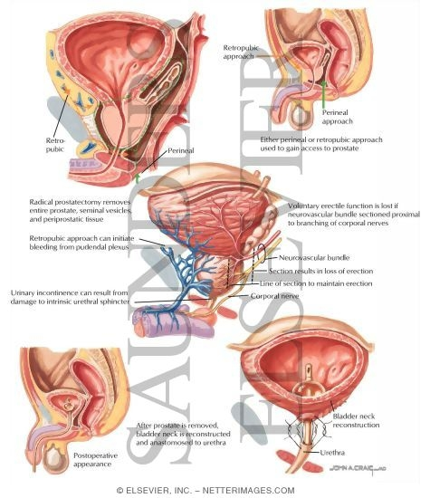
Prostate Cancer| Prostatectomy
Reteropubic radical prostatectomy is the standard approach to definitive surgery
  Aim to perform minimally invasive and nerve sparing approach
For those with intermediate- high risk tumours
  Addition of lymph node dissection is incorporated into surgical approach
SE
  Urinary incontienance
  Erectile dysfuntion
Notes:
With positive margins or seminal vesicle invasion, extracapsular extension, detectable PSA→ postoperative adjuvant RTx can be used

Slide 29
Prostate Cancer| Prostatectomy
Scandinavian Prostate Cancer Group 4 Trial 695 men
 | OS | Death from prostate cancer | Distant Metastases | Use of ADT
Radical prostatectomy | 56% | 18% | 26% | 43%
Watchful waiting | 69% | 29% | 38% | 67%
PIVOT Trial 731 men
 | OS | Death from prostate cancer | Bone metastases
Radical Prostatectomy | 47.0 HR 0.88 | 0.63 (not SS) | 4.7
Observation | 49.9 |  | 10.6
Notes:
Scandinavian trial: T1 or T2 prostate cancer
The differences in the Sandinavian trial were most prononuced in those under the age of 65 and with intermediate disease
PIVOT trial
Observation arm offered palliation and symptoms control

Slide 30
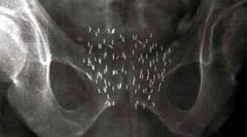
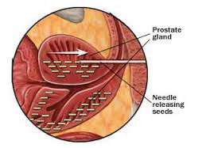
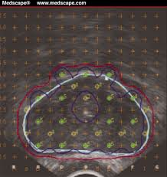
Prostate Cancer| Brachytherapy
Radioactive sources are implanted directly into the prostate gland to administer a high dose of radiation directly to the prostate while minimizing radiation to normal tissues
Notes:
Low dose brachytherapy which delivers low intensity beads of radioactive material to the prostate
Down falls are inability to provide radiation outside the prostate to any great efficencency

Slide 31
Prostate Cancer| External Beam Radiotherapy
External Beam Radiotherapy
  Increasingly complicated regimens
  Current preference for intensity-modulated radiation therapy
  Needs 74Gy or higher at up to 2Gy per session.

Slide 32
Prostate Cancer| Disseminated disease
Although most men with prostate cancer are diagnosed and successfully for localised disease, some will present with or subsequently manifest after definitive treatment

Slide 33
Prostate Cancer| Androgen Deprivation Therapy
The optimal timing of ADT for men with a PSA-only recurrence is controversial
ADT is the mainstay for symptomatic advanced prostate cancer
  There are no current trials that establish that treatment in asymptomatic patients provides a survival advantage

Slide 34
Prostate Cancer| Disseminated disease
EARLY
  Delay disease progression, may prolong survival
  Observational study (Moul 2004) showed a delay in clinical metastases in patients only with a Gleason score> 7, PSA doubling time of 12 months or less
LATE
  No consistent benefit proven
  Adverse effects
Notes:
Looked at a database of 5000 men undergoing radical prostatectomy with a clinical endpoint of metastatic disease

Slide 35
Prostate Cancer| Disseminated disease
Peter MacCullum Centre
  RCT 300- 2000 men
Group 1:
PSA relapse post definitive therapy
Group 2:
Not suitable for radical treatment
ARM II: EARLY ADT
ARM I: DELAYED ADT
at least 2 years post study entry OR after evidence of disease progression
Immediately after randomization commencing
Continuous ADT: GnRH +/- anti-androgen
Intermittent ADT: GnRH +/- anti-androgen
Bilateral Orchiectomy
Notes:
Group 1: PSA relapse post radical treatment
Post prostatectomy PSA levels > 0;2, at least 3 rising PSA levels obtained > 1 month apart
No metastatic disease
Group 2: not suitable for radical treatment at primary diagnosis
Not planning to receive curative treatment
No localised or metastic disease
No age limit but must have a life expectancy of > 5 years

Slide 36
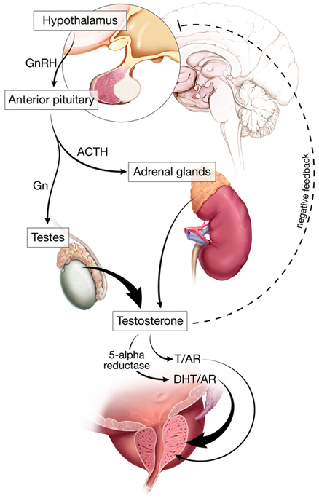
Testosterone is the main growth factor for prostate cancer cells
The release of testosterone is controlled by the HPA axis
Notes:
Explain HPA axis

Slide 37
Prostate Cancer| Role of Androgens
Androgen are known to stimulated the growth of both normal and cancerous prostate cells
Therefore the standard approach to the initial treatment of men with symptomatic metastatic prostate cancer is to lower testosterone levels
This can be accomplished in a number of ways
  Surgical orchiectomy, medical orchiectomy

Slide 38
Prostate Cancer| Hormonal Treatment
Androgen Deprivation therapy
Orchiectomy
Medical Orchiectomy
Testosterone antagonist
Inhibitor of adrenal steroidal synthesis
Surgical Orchiectomy
GnRH agonist

Slide 39
Prostate Cancer| Orchiectomy
Bilateral Orchiectomy involves surgical removal of the testicles
Post- surgery
  Serum testosterone rapidly decrease to castrate levels
Issues
  Very efficient but irreversible produced
  Not well recieved by patients

Slide 40
Prostate Cancer| GnRH analogues
Synthetic GnRH analoges:
  Look similar to the GnRH but
    have greater receptor affinity
    reduced susceptibility to enzymatic degradation
    100-fold more potent than the natural GnRH molecule
Bind to GnRH receptors on pituitary gonadotropic-producing cells
There are BOTH agnoist and antagonists
Notes:
Gonadotropin releasing hormone is relased by the hypothalamus
AGONIST: is an analogue that activates the GnRH receptor restulsin in increased secretions of FSH and Lh
ANTAGONIST blocks the GnRH receptor

Slide 41
Prostate Cancer| GnRH antagonist/LHRH agonist
GnRH agonists bind to the GnRH receptors on pituitary gonadotropin-producing cells
  causing an initial release of both luteinizing hormone (LH) and follicle stimulating hormone (FSH)
  which causes a subsequent increase in testosterone production from testicular Leydig cells
Negative feedback leads to down regulation in GnRH receptors with a decline in the pituitary production of LH and FSH→ decreased testosterone

Slide 42
Prostate Cancer| GnRH analogues
Leuprolide, Goserelin
  Given as depot injections with slow acting formulations
Seindenfeld J,
  Metanalysis of 1908 men
    OS HR for death 1.13 CI 0.92-1.39 (therefore not statistically worse than orchiectomy)

Slide 43
Prostate Cancer| GnRH anagonist
GnRH antagonists also bind to the GnRH receptors on pituitary gonadotropin-producing cells
  Developed to supress testosterone while avoiding the flare phenomenon with minimal LH or FSH release from the anterior pituitary

Slide 44
Prostate Cancer| GnRH antagonist
 | PFS
Degarelix | 25%
Leuprolide/ Goserelin | 18%
2014 Meta-analysis of the 5 RTC compating GnRH antagnoist to GnRH agonist
1925 men analyzed
Issues
  Only 3 or 12 months of treatment given/ results collated
  Difficult to assess longer term survival advantage from this
  Significantly more injection site reactions
Still awaiting long term data

Slide 45
Prostate Cancer| Anti-androgen Therapy
Anti-androgen
  Flutamide, Biclutamide
    Bind to androgen receptors
    Inhibit the action of testosterone
    Ongoing normal action of the HPA axis→ therefore normal testosterone levels
  Not used as a first line monotherapy only to prevent flare, often used in combination for disseminated disease

Slide 46
Prostate Cancer| Anti-androgen Therapy
Long term combined androgen blockade
  Combination of both an anti-androgen and a medical or surgical castration

Slide 47
Prostate Cancer| Dual Blockade
Intergroup trial INT 0036 603 men with metastatic disease
 | PFS | OS
Leuprolide + flutamide | 16.5 | 35.6
leuprolide | 13.9 | 28.3
Intergroup trial INT 0015 1387 men with metastatic disease
 | PFS | OS
Orchidectomy + flutamide | 20 | 34
Orchidectomy + placebo | 19 | 30
Notes:
Frequently utilised seoncd line as may increase the efficacy of the first line therapy
Althougth there is indication that combined therapy may have improved results → however there is also increased costs and toxicites

Slide 48
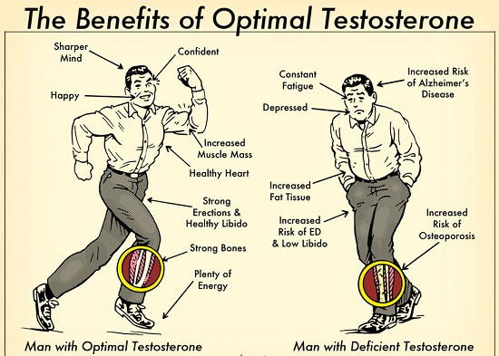
Prostate Cancer| ADT: side effects

Slide 49
Prostate Cancer| ADT: side effects
Prolonged androgen therapy:
  Hot flushes
  Weight gain
  Erectile dysfunction/ decreased libido
  Osteoporosis
  Metabolic syndrome
    Diabetes
    Cardiovascular disease, stroke
    Obesity

Slide 50
Prostate Cancer| Intermittent Androgen Deprivation
Intermittent Androgen Deprivation
  Treatment for a fixed period of time
  OR based on achieving a maximal response from the PSA
  Patients then remain off treatment until reaching a pre-defined PSA or with evidence of new metastatic disease
Rationale
  Prolonged ADT may theoretically facilitate progression from androgen dependence to independence
  Decrease testosterone related SE to increased QOL
Notes:
Men managed on IAD can be expected to be off therapy for 35-50% of the time
Time off treatment in the first cycle ranges from 6-15 months and may be lone for less advanced disease
Off treatment assocaited with recovery of libido and potency

Slide 51
Prostate Cancer| Anti-androgen Therapy
Intergroup trial INT 0162 (non-inferiority trial) for metastatic disease
 | OS
Continuous ADT | 5.8
Intermittent ADT | 5.1 (HR 1.1 95% CI 0.99-1.23)
Crook et al (Canada) Intermittent Androgen Suppression for localised prostate cancer (non-inferiority trial) for PSA only recurrence
 | OS | Prostate related deaths | Non-prostate related deaths
Continuous ADT | 8.8 | 94 | 162
Intermittent ADT | 9.1 (HR 1.02 95% CI 0.86- 1.21 ) | 120 | 148
Notes:
Non-inferioirity trial looking for a HR excluding 1.2 (ie 20 % difference or roughly one year)
Treated with GnRH and antiandrogen for 7 months→ if PSA <4 randomised
Intermittent remained off until: serum PSA >20, back to original baseline,
Therefore can not be classified as non-inferior
1386 men with rising PSA following RTx, those assigned to IAD had 8 months then restarted with PSA >10
Possible QOL benefit
Possibly non-inferior however not many patients had died

Slide 52
Prostate Cancer| Anti-androgen Therapy
Ist line therapy
  GnRH threapy
2nd line therapy
  GnRH AND testosterone antagonist
3rd Line therapy
  Abiraterone
Others
  5-alpha reductase inhibitors
  Enzalutamide

Slide 53
Prostate Cancer| Novel/New Hormonal Treatment
Biological Event | Therapeutic Intervention | Agent
Androgen Production | Adrenal steroid synthesis CYP17 inhibitors | Ketoconazole Abiraterone
Androgen Transport | Block transport | HE-3235: Apoptone (I)
Conversion DHT (most potent androgen to bind to AR) | 5 alpha reductase inhibitors Sulfatase inhibitors | Dutasteride (BPH)
Androgen Receptor Binding (AR amplification is common in stage mCRPC) | Novel AR inhibitors | Enzulatamide

Slide 54
Prostate Cancer|
Androgen based pathways continue to have a significant role in the progression of castrate resistance prostate cancer
Several of the enzymes involved in the synthesis of testosterone and dihydrotestosterone (CYP450) are highly expressed in the tumour

Slide 55
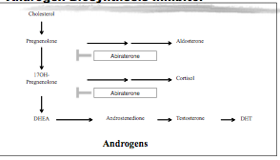
Prostate Cancer| Anti-androgen Therapy
Abiraterone
  Orally administered small molecule that
    Irreversibly inhibits the products of the CYP17 gene ( 17 alpha hydoxylase & C17,20 (CYP450c17) lyase enzymes ).
    In doing so it blocks the synthesis of androgen in the tumour as well as in the testes and adrenal glands.
Notes:
Oral medication

Slide 56
Prostate Cancer| Anti-androgen Therapy
 | OS | PSA progression | PSA response rate
Placebo + Prednisolone | 11.2 months | 6.6 months | 6.5%
Abiraterone + Prednisolone | 15.8 Months (HR 0.74) | 8.5 months | 29.5%
COUGAR 1 (post docetaxel
  Also noted symptomatic improvement in
    Bone pain- both intensity and onset of action
Allowed for PBS listing post-docetaxel
  Toxicity
    HTN and hyperkalaemia ( less with prednisolone)

Slide 57
Prostate Cancer| Anti-androgen Therapy
COUGAR (2013) Trial 1088 men
 | OS | PFS (radiological)
Placebo + prednisolone | 30.1 | 8.2
Abiraterone + prednisolone | 35.3 (HR 0.79) | 16.5 (HR 0.52 )
Not PBS listed for treatment prior to Docetaxel
Notes:
Men with metastatic aysmptomatic or minimal symptomatic castration resistance prostate cancer
End point was radiological PFS and OS
OS complicated by use of additional therapy post protocol participation
Secondary endpoints showed: SS superiorioty for
- time to chemotherapy, opiate use, PSA progression, decline in PS

Slide 58
Prostate Cancer| Enzalutamide
Enzalutamide
  Small molecule agonist of the androgen receptor
  Binds to the androgen binding site in the androgen
    Reduce efficiency of nuclear translocation
    Impair binding of the androgen receptor to androgen response elements on DNA
  Does not need to be used with glucocorticoids
    Presented at ASCO 2013:
      AFFIRM: worse prognosis with corticosteroids (median 11.5 vs not reached, HR 0.4)

Slide 59
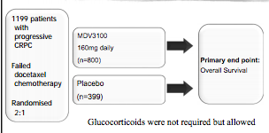
Prostate Cancer| Enzalutamide
AFFIRM
Notes:
Heavily pre-treated population with 50% of patients having received three or more prior endocrine threarpies and 25% recieiving two or more chemotherapy regimens
Was unblinded at 520 deaths at the interim analysis and cross over was allowed

Slide 60
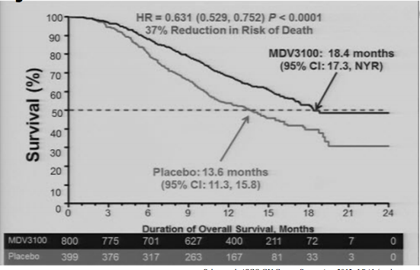
Prostate Cancer| Enzalutamide
AFFIRM
 | OS | PSA response (>50% decrease) | QOL response | Radiographic PFS
Enzalutamide | 18.4 months (HR 0.63) | 54% | 43% | 8.3
Placebo | 12.6 months | 2% | 18% | 2.9

Slide 61
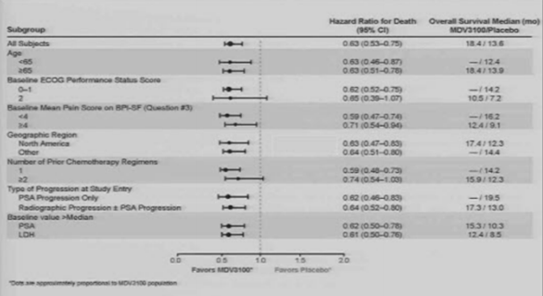
Prostate Cancer| Enzalutamide
Notes:
Enzalituamide, a once a day oral androgen receptor signaling inhibitor, significantly and meaningfully prolonged survival by nearly 5 months in men with late stage prostate cancer
The secondary measures of response and time to progression were consistent with the survival benefits
Ezalutamide improved health-related quality of life
The results confirm the androgen receptor and androgen receptor signaling as a therapeutic target Enzalutamide was well tolerated with a good benefit:risk
Profile

Slide 62
Prostate Cancer| Enzalutamide
PREVAIL Trial (2014 ASCO GO symposium)
 | OS | Radiographic PFS
Enzalutamide v placebo | HR 0.7 | HR 0.19
Notes:
Looking at chemotherapy niave patients mCPC

Slide 63
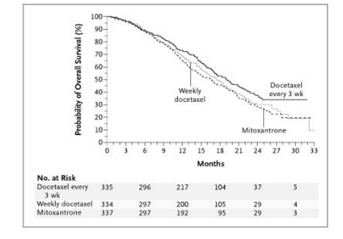
Prostate Cancer| Chemotherapy: Docetaxel
TAX-327 Trial
 | OS (months) | 3 year survival | PSA response
Docetaxel (3 weekly) | 19.2 | 18.6% | 45
Docetaxel (weekly) | 17.8 | 16.6% | 48
Mitoxantrone | 16.3 | 13.5% | 32
Notes:
Tax- 327 trail
1006 men wit hCTx niave mCPC, all patients received prednisilone 5mg orally bd with mintenance gonadal androgen supression (anti-androgens ceased)
led to superior survival and improved rates of response in terms of pain, serum PSA level, and quality of life, as compared with mitoxantrone plus prednisone

Slide 64
Prostate Cancer| Cabazitaxel
Cabazitaxel
  New semi-synthetic taxane
    Selected to overcome the emergence of taxane resistance
  Has activity in tumour cells and tumour models that are resistant to or not sensitive to currently available taxanes

Slide 65
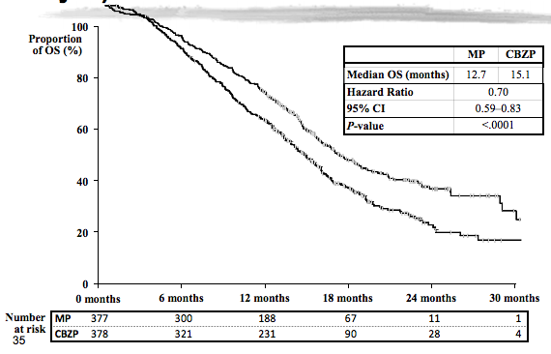
Prostate Cancer| Cabazitaxel
TROPIC trial
 | OS | PFS
Cabazitaxel and prednisolone | 15.1 months (HR 0.70) | 2.8 (HR 0.74)
Mitoxantrone and prednisolone | 12.7 months | 1.4
Notes:
TROPIC trial 755 men
All of whom had progressed on docetaxel
Cabazitaxel (25mg/m2)
Mitoxantrone (12mg/m2)
In analysis those that had been most heavilyy treated had a greater survival benefit
More toxic

Slide 66
Prostate Cancer| Cabazitaxel
Side effects:
  Neutropenia and febrile neutropenia occur at much higher rate
    TROPIC trial used secondary prophylaxis with g-CSF
  Diarrhoea

