Slide 1
Adjuvant Therapy For Breast Cancer

Slide 2
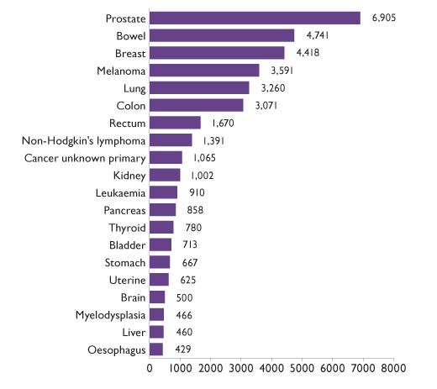
Australian Institute of Health and Welfare 2014. ACIM (Australian Cancer Incidence and Mortality) Books. Canberra. AIHW
Breast Cancer | Epidemiology- Australia
Overall is the third leading cause of cancer
Most common cause of cancer in women
Notes:
Globally breast cancer is the most frequently diagnosed cancer
Remains the most common malignancy diagnosed in women, with 1.38 million women diagnosed in 2008 (23% of all new cancer cases)
Interestingly there is an increasing incidence in developing countries, likely secondary to increased health information and obesity
In 2010 14,181 women and 127 men were diagnosed in Australia
In 2011 2914 women and 23 men died of breast cancer in Australia, with it being the second most common cause of cancer death as well as the main cause of death from any cause in women aged 40-49

Slide 3
Breast Cancer | Worldwide Incidence
Incidence rates higher in economically developed regions
  Inc. Australia, Western Europe, Nth. America
Increased Incidence in 1980-1990
  increased screening
Decline in incidence in since 2000
  HRT related
Worldwide increase in incidence
  Developing Countries
Notes:
Increased incidence in developing countries: throught to be secondary to changes in reproductive patterns, increased obesity and decreased physical activity.

Slide 4
Breast Cancer | Established Risk Factors: FIXED
Factor | Relative Risk
Gender (female vs. male) | 100
Age (<50 vs. >50) | 6.7
Endocrine Factors -Age of menarche (<10) -Age at first birth (>35) -Nulliparity -Age at menopause (>55) | 1.4-1.9 1.7 1.4 1.3
Benign Breast Disease - ADH, LCIS | 4.0 -5.0
Family History First degree relative BRCA1/ BRCA2 mutation P53 (Li- Fraumeni) PTEN (Cowden Syndrome) | 2.0 -7.0 10-30 1.5-6.0 2.0-4.0
Ethnicity (Ashkenazi Jewish) | 1.4
Therapeutic radiation | 35
Notes:
Relative risk is the ratio of the probability of an event occurring to an exposed group to the probability of the even occurring to the non-exposed group
Atypical hyperplasia and LCIS are associated with a 20-30% lifetime risk of breast cancer
BRCA 1 and BRCA2 are associated with a 50-75% lifetime risk of developing breast cancer and a 30-40% risk of 10-20% risk of developing ovarian or fallopian tube cancer
Three founder mutations are associated with breast/ ovarian cancer in the Ashkenazi Jewish family

Slide 5
Breast Cancer | Established Risk Factor: MODIFIABLE
Factor | Relative Risk
Exogenous Hormones OCP Oestrogen replacement (>10 years) Oestrogen and Progesterone | 0.9-1.0 1.1 1.4-3.0
Obesity (>30) | 2.5
Exercise (>3 hours/ week) | 0.6
Alcohol Use | 1.1-2.2
Diet | 1.0
Mammographic Density | 2.2-3.5
Notes:
Exercise decreases the risk of breast cancer by around 15%

Slide 6
Breast Cancer | Who needs Adjuvant Therapy?
All breast cancer patients need consideration of adjuvant therapy
  There are multiple possible treatment options which can be used individually or combined
    Includes not only chemotherapy but endocrine and targeted therapy
Who to treat with which agents….
  Prognostic factors
  Predictive factors
Notes:
From knowing the background of the cancer there are three additional questions:
Do they need chemotherapy?
What do we give?
Do they need additional target specific agents?
Not all women need adjuvant therapy and the decision to proceed with adjuvant management is multifactorial

Slide 7
Breast Cancer | The patient in front of you
Patient Age
Performance Status
Grade | ECOG Performance Status
0 | Fully active
1 | Restricted in physically strenuous activity but ambulatory and able to carry out work of light or sedentary nature
2 | Ambulatory and capable of all self care. Up > 50% of waking hours
3 | Capable of only limited self care, confined to bed or chair for > 50% of working hours
4 | Completely disabled. Cannot carry on any self care. Totally confined to bed or chair
Notes:
Prognostic factors:
Most significant is age
Age is an independent prognostic feature in that younger women (<50) are at higher risk of both local and systemic disease recurrence and there fore the threshold for offering CTx is reduced in this setting
and ECOG status, menopausal status
And many patients will also have a strong opinion on their choices

Slide 8
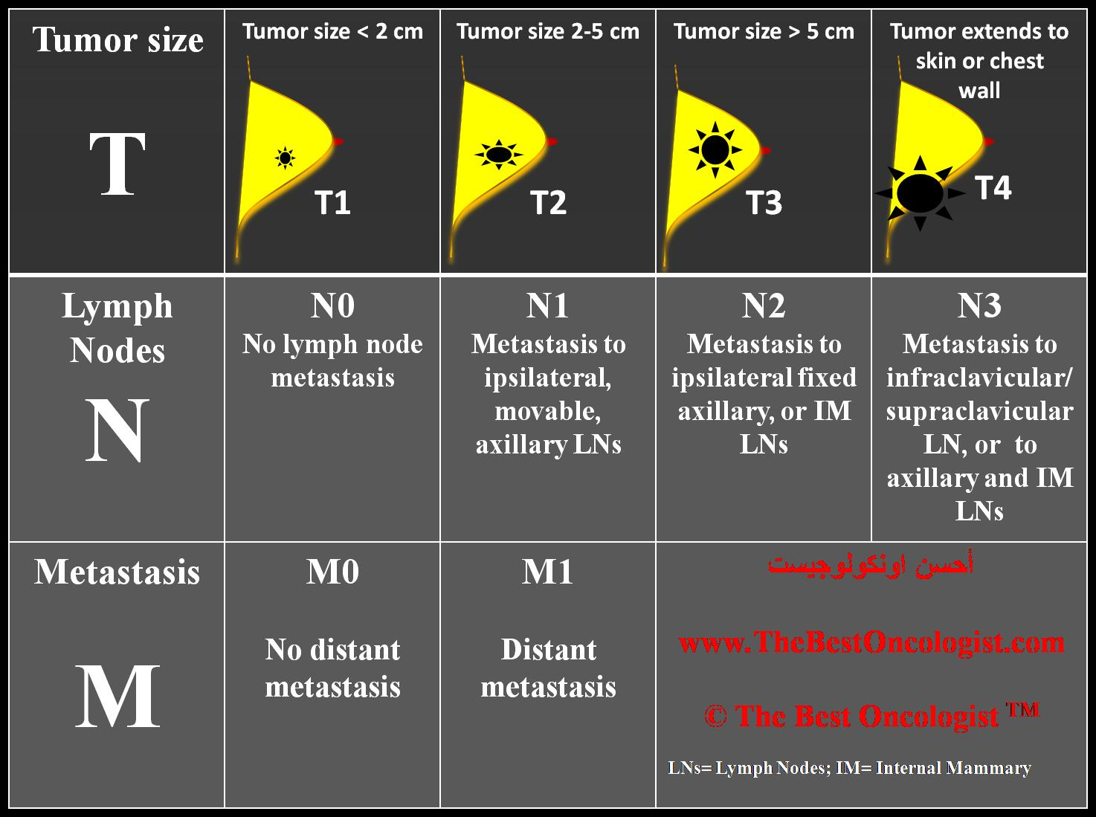
Breast Cancer | Staging: AJCC Tumour Staging

Slide 9
Breast Cancer | Staging: AJCC TNM Staging
 | PRIMARY TUMOUR
TX | Can not be assessed
T0 | Tumour not present
Tis | Carcinoma in situ
T1 | <2.0cm
T2 | >2.0cm but <5cm
T3 | >5.0cm
T4 | Any size tumour with extension through the chest wall or skin ulceration/ nodules or both
T4d | Inflammatory breast cancer
 | REGIONAL LYMPH NODES
NX | Can not be assessed
N0 | Nodes not involved
N1 | Clinical/ Pathological involvement of axillary/ internal mammary LN
N2 | Ipsilateral axillary LN or clinically apparent internal mammary LN in the absence of clinically +ve axillary LN
N3 | Ipsilateral infraclavicular, supraclavicular
 | METASTASES
M0 | No Metastatic disease
M1 | Metastatic disease
AJCC Cancer Staging Manual, 7th Edition (2010) Springer Science and Business Media LLC
Notes:
TNM staging of breast cancer is a purely anatomical criteria as a measurement of disease extent
This allows for the grading of patients into groups with reasonably similar prognostic outcomes
However breast cancer is not as straightforward as a simple anatomical classification and requires additional biological analysis of the tumour
The TNM is perhaps most useful in determining Stage 0 (* in which there is no further biological activity) and Stage 4 disease (which changes the direction of management)
Tumour size
Refers to the invasive component and the size of any surrounding DCIS dose not contribute to the risk of ipsilateral cancer recurrence
Larger tumours are associated with a shorter recurrence free survival
Multicentric disease (10-30%) is associated with a higher risk of ipsilateral recurrence
In general tumours > 0.5cm has a risk high enough to consider the addition of adjuvant treatment

Slide 10
Breast Cancer | Intrinsic Molecular Subtypes
Subtype
Luminal A | ER/PR strongly +ve, low proliferation Best overall prognosis
Luminal B | ER/PR +ve, high proliferation
Basal Like | Triple negative (ER, PR, HER2 –ve) More common in BRCA-1 Worst prognosis
HER2 rich | HER2+, ER/PR-ve
Normal
Both prognostic and predicative information
Synder R. Update of breast cancer FRACP Pt1. (2013)
Notes:
Whole gene analysis has resulted in the identification of molecular subtypes of breast caner with each subtype associated with gene expression signatures and clinical characteristics
Has become used in the last 10-15 years
Now being established as prognostic indicators in terms of local disease recurrence following surgery
Assay of multiple genes to create 5 main type or a whole gene analysis, this is NOT routine however as the management of cancer becomes increasing personalized this is likely to continue to increase
However use of routine markers can act as a surrogate marker
These are ER, PR, HER2, Ki67
Predictive value of this classification is contained in conventional factors
LUMINAL: In general luminal subtypes, which are the most common (60-70%), Luminal A tumours have a lower incidence ofp53 mutations and are associated with a lower rate of DFS, OS and local and regional disease relapse where as Luminal B cancers are often higher grade with less favorable overall prognosis
BASAL: On the other hand basal like tumours has a high propensity to be high grade with p53 mutations and a high rate of systemic and local disease relapse
PREDICTIVE value
EG.
Basal like tumours are more likely to to sensitive to DNA damaging CTX
Luminal A can likely be treated with endocrine therapy only while luminal B may benefit from the addition of CTX

Slide 11
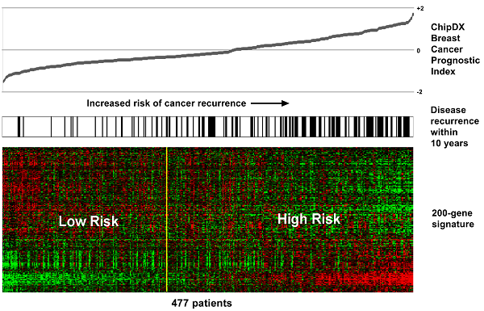
Breast Cancer | Gene Expression Signatures
Gene expression profiling
  Assessment of the risk of both local and systemic recurrence among breast cancers with a more FAVOURABLE profile
  Those with low risk are unlikely to significantly benefit from CTx
Oncotype DX ( 21 genes)
Va de Vijver et al. Supervised risk predictor of breast cancer based on intrinsic subtypes. NEJM. 2002: 347: 1999-2009
Paik et al. A multigene assay to predict recurrence of tamoxifen-treated, node-negative breast cancer. NEJM: 2004: 351: 2817-2826
Notes:
Gene profiling has done little to change the prognostic information for high risk tumours (HR –ve, HER2 +ve)
This is then used to assess the patients with a good prognosis who will NOT require adjuvant CTx
There are two commerical tests avaliable however the Dutch test requires fresh tissue where as Oncotype can be performed with paraffin-embedded tissue

Slide 12
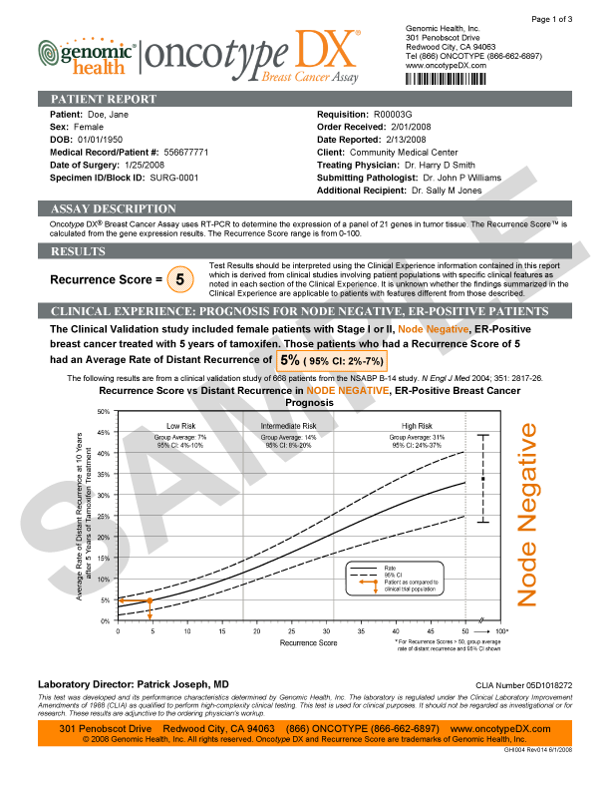
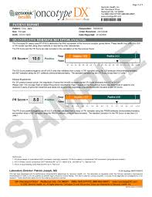
Breast Cancer | Oncotype
Notes:
Ta

Slide 13
Breast Cancer | Oncotype
Notes:
The oncotype gene recurrence score was developed from patients with node-negative, ER positive disease enrolled in the NSABP-14 clinical trial which randomly allocated patients to tamoxifen adjuvant therapy or placebo
The recurrence score is used as a continuous function and assesses residual risk of systemic recurrence in ER +ve patients treated with tamoxifen (more recently validated with AI)
Those patients with a low score do not significantly benefit from chemotherapy when given in addition to tamoxifen
More recently the test prognostic value has been validated for patients treated with Ais and combination CTx AND for the risk of local disease recurrence (ipsilateral breast, chest wall, regional nodes)
The TAILORx (trial assigning indizidualised option for treatment )

Slide 14
Breast Cancer | TAILORx Trial
Oncotype Dx recurrence score (RS)
Low risk (<11)
Intermediate risk
Endocrine therapy
Hormonal therapy
CTx + Endocrine therapy
High risk (RS> 25)
CTx +endocrine therapy
Notes:
Easter n cooperative Oncology Group and the National Cancer Institute have coordinated the Phase III TAILORx which seeking to incorporate molecular profiling into clinical decision making and thus spare women unnecessary chemotherapy if it is not required.
The researchers primary end point is to:
Determine whether adjuvant hormonal therapy is not inferior to adjuvant chemo hormonal women whose tumours fall in the intermediate risk study group
The aim of the trial is to further evaluate the role of oncotype in intermediate risk tumour types
Around 7000 women have been randomised at 900 sites in the US and Canada
Included patients were women recently diagnosed with ER +/or PR +, HER2 –ve breast cancer that was node -ve
The actual chemotherapy and endocrine therapy is at the discretion of the treating physician
The plan is to continue follow up for 20 years

Slide 15
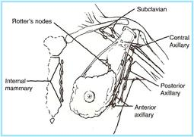
Breast Cancer | Anatomical LN Involvement
Without Systemic Treatment
1-3 LN: 25-35% recurrence rate
4-9 LN: 25-55% recurrence rate
>10 LN: >70% recurrence rate
Quiet et al. Natural History of node positive breast cancer: the curability of small cancers with a limited number of positive nodes. J Clin Oncol. 1996; 14:3105-3111
Notes:
Most important anatomical prognostic indicator in EARLY or localised disease is the presence of tumour involvement within the LNs
The number of involved LN are linearly related to the risk of systemic disease and disease free survival
1-3: prognosis is also influenced by size of tumour
>4: the prognosis more closely follows the nodal involvement
>10: at > 10 LN involved more that 70% of patients would develop systemic metastasis
Also influencing the prognosis is the size of the metastatic deposit within the lymph node, with further differentiation into micro and macro metastases

Slide 16
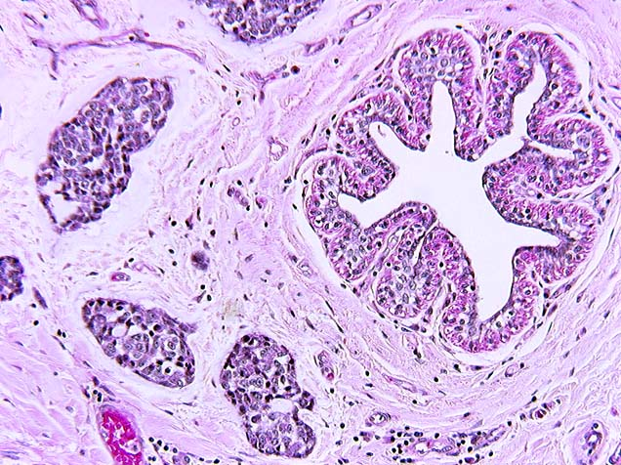
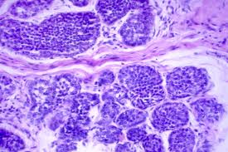
Breast Cancer | Histology
Histological Classification
  Ductal (75%)
  Lobular (10%)
  Tubular (1-4%)
  Mucinous
  Medullary
  Papillary
  Micropapillary
Notes:
The breast gives rise to multiple histological subtypes of cancer
The majority of invasive breast cancer is ductal (75%) or lobular (10%) or a combination of both histological features
As lobular cancer is more difficult to detect in mammogram there is an increased rate of multifocal and indistinct borders with a higher incidence of bilateral disease at diagnosis (but as a pure risk factor has similar outcomes)
In contrast Tubular, mucious (colloid) tumours have an excellent prognosis post surgical treatment
The histological grading system
Considers the degree of tubular formation, nucleur pleomorphism, mitotic count
Grading looks at the degree of these features and allocates: low, intermediate and high
Histological grade is an independent prognostic indicator
Also looks at lymphatic invasion and rate of proliferation which is detected by Ki67 (nuclear antigen used as a marker of proliferation)

Slide 17
Breast Cancer | Stage I and II
Local Disease Control
  Surgery
    Breast Conservation Surgery
    Mastectomy
      With sentinel lymph node biopsy in both
  Radiation
    Whole Breast Radiotherapy
      Applied to the tumour bed, over a course of 5-6 week, or in older patients this can be shortened to a 2-3 week period
      Majority of local tumour recurrences occur at or around the tumour bed or localised lymph nodes
Notes:
Focus in on a combination of local disease control (breast and regional LN) and systemic disease control
Complement each other and are not mutual exclusive
Surgery
In operable patients, the options for local disease control include mastectomy, or lumpectomy with whole breast radiotherapy
The decision to attempt a lumpectomy is influenced my the ability to gain negative surgical margins (>2mm), acceptable cosmetic results,
Mastectomy is preferred in muticentric disease, prior radiation therapy, connective tissue disease affecting the skin
Sentinel node biopsy can occur in a clinically negative axilla
If SLND is positive- 48% will have further involvement and therefore should go on and have an ALND unless they meet a strict guideline regarding not proceeding
Radiotherapy
Typically occurs post CTx
Can use either hypofractrionated or standard depending on risk profile of the tumour
Addition dose to the tumour bed has been shown to reduce the risk of local tumour recurrence, specifically among women < 50, or with high-grade invasive cancer

Slide 18
Breast Cancer | Therefore….
Things taken into account when planning adjuvant therapy
  Age
  ECOG
  Tumour size
  Tumour Histology
  Lymphatic Invasion
  Proliferative Rate
  Hormone Receptor Status
  HER2 Status
    Intrinsic Molecular Subtypes
    Gene Expression Signatures
  Patient Preference
Notes:
Made a decision regarding the risk of distant metastasis and the benefit of therapies to reduce this risk

Slide 19
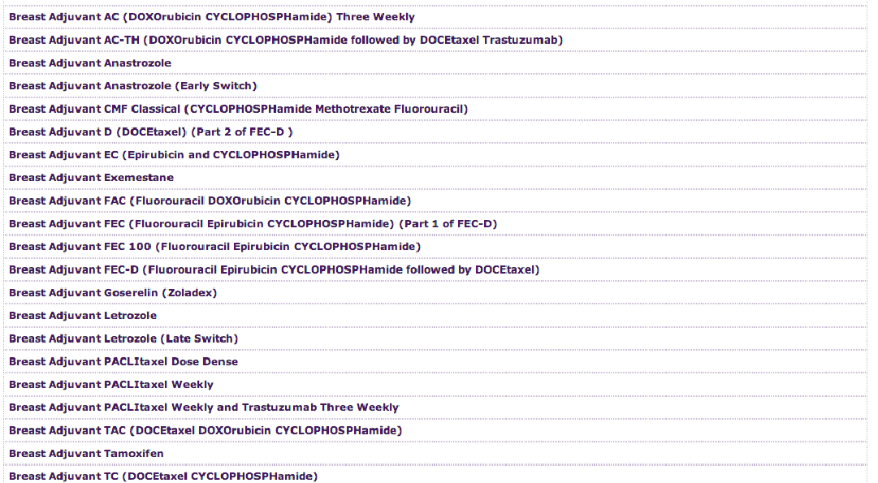
Breast Cancer | Chemotherapy
Notes:
So the hard bits is over……lets give chemotherapy…….
But then the next questions is WHICH one

Slide 20
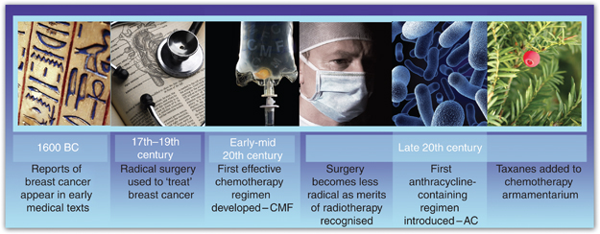
Breast Cancer | Historical Chemotherapy Timeline
Verrill M, Chemotherapy for early-stage breast cancer: a brief history. British Journal of Cancer (2009)
Notes:
The first descriptions of breast cancer where of eight cases of a large tumour or ulceration of the breast
In the seventeenth century there was an understanding of the lymphatic circulation that allowed for a link between axillary nodes and the breast
Radical Mastectomy was commenced in the nineteenth century with removal of affected breast, contralateral breast, all associated lymph nodes and the underlying pectoral muscle→ this did little to change the natural history of the disease
With the addition of chemotherapy and radiotherapy this lead the way for the development of less radical forms of mastectomy

Slide 21
Breast Cancer | Historical Chemotherapy Timeline
CMF (Cyclophosphamide, Methotrexate, 5-FU)
AC (Doxorubicin, Cyclophosphamide)
FEC (5-FU, Epirubicin, Cyclophosphamide)
AC-docetaxel, AC-paclitaxel
Dose Dense AC
FEC-T
Notes:
The first effective chemotherapy developed for breast cancer was CMF (cyclophosphamide, methotrexate and 5- fluorouacil
which was initially tested in the 1970s with a demonstration that risk of breast cancer recurrence could be decreased with the addition of adjuvant chemotherapy
This then lead the way for the development of less morbid surgical management
Anthracyclines were first considered for use in the late 1960s
the first ‘gold standard” regimen of doxorubicin and cyclophosphamide (AC) was considered in the 1990,
shown to be non-inferior to CMF but had significantly less toxicities.
Likely due to shorter treatment time and less nausea
The thought was then to increase the efficacy of CMF by substituting in a Anthracycline for methotrexate to make
FAC and FEC were then developed with either a 3 or 4 week schedule
In the 1970s the taxane (paclitaxel/ docetaxel) family of CTx drugs were developed
This in turn lead to the inclusion of a taxane into various adjuvant trials→ and the finding that AC followed by a taxane was more effective than AC alone
With time the acceleration of this cause a further increment in anti-tumour activity
With the knowledge of increased efficacy with addition of taxane to AC there the FEC regimen was also trials with an additional three cycles of docetaxel post

Slide 22
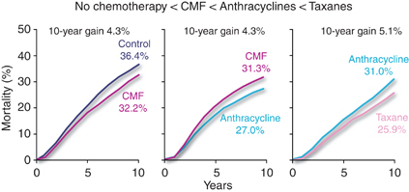
Breast Cancer | What is Gold Standard?
Nothing
CMF regimen
Anthracycline containing regimen
Anthracycline AND Taxane Containing regimen
Peto, R San Antonia Breast Cancer Symposium on behalf of the Early Breast Cancer Trialists’ Collaborative Group
Notes:
There is a large number of trials and varying opinions regarding the standard of care
This data presented by the Early Breast Cancer Trialists’ Collaborative Group (EBTCG)

Slide 23
Breast Cancer | Rationale for Adjuvant Therapy
EBCTCG meta-analysis (2011)
  Anthracycline- containing regimens
      Decreased risk of recurrence resulting in an absolute reduction of 8%
      Reduction of BC mortality to an absolute decreased of 6.5%
      Reduction in overall mortality to an absolute of 5.0%
  CMF
      Decrease in the risk of recurrence in an absolute reduction of 10.2%
      Reduction in BC mortality to an absolute decreased of 6.2%
      Reduction in overall mortality to absolute decrease of 4.7%
Notes:
The Early Breast Cancer Trialists’ Collaborative Group (meets every 5 years) and reviews data for global breast cancer trials
The two regimens were compared to no treatment at all at 10 years
CMF: cyclophosphamide, methotrexate, 5-FU

Slide 24
Breast Cancer | Adjuvant CTx: General Principles
Maintain full dose density
Women > 70 need more individualised decisions
There is no added benefit to dose escalation in adjuvant treatment
Poly-chemotherapy is preferred
Notes:
Should be administered based on actual height and weight (regardless of BMI)
Most studies did not include women > 70, therefore these decisions are based more upon individual risk/benefit ratios.
Polychemotherapy is associated with greater benefits in women younger than 50, with higher risk disease and with hormone receptor negative disease

Slide 25
Breast Cancer | High Grade Basal Disease
Accounts for 10-15% of all breast cancer
  More common in young and/or black patients
  Commonly presents as higher grade
Prognosis is more difficult
  Does not correlate as closely with tumour size or nodal involvement
Requires treatment with adjuvant CTx at a smaller tumour size
Notes:
The majority of high grade basal disease are triple –ve disease, however there are a subset of around 10% that are not clear cut
but not There is an increased efficacy of CTx in triple –ve disease
This presents a challenge as the adjuvant endocrine and and HER2 therapies have no targets and a re therefore ineffective
Therefore chemotherapy remains the mainstay of triple-negative disease
Node negative TNBC >0.5cm has a high enough risk of disease recurrence and death to warrant consideration of adjuvant CTx
This also results in a greater efficacy of CTx in TNBC where the risk of recurrence is greatest in the first 2-3 years when compared with HR +ve disease
The CTx regimens recommended for treatment are identical in both TNBC and HR +ve BC

Slide 26
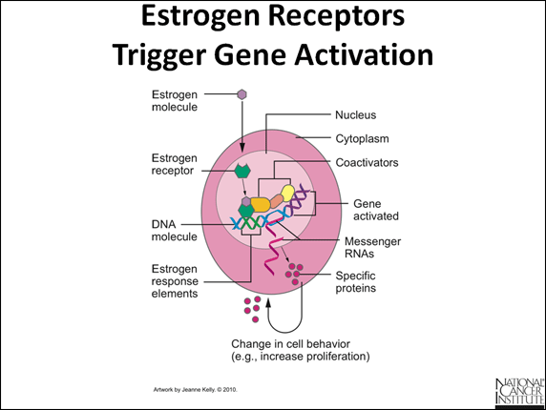
Breast Cancer | Oestrogen and Progesterone Receptors
Hormone Receptors
  Oestrogen/ Progesterone
    Regulate gene expression through interaction with hormone response elements.
Notes:
Ligand dependent transcriptional factor that regulates gene expression through interaction with its hormone elements

Slide 27
Breast Cancer | Oestrogen and Progesterone Receptors
Positive prognostic indicator
  Late disease recurrence
    ER/PR –ve:
      greatest risk < 5 years, then dramatic decline
    ER/PR +ve:
      Slower rise in recurrence and more gradual decline
Predictive indicator
  Of response to endocrine therapy
    Higher degrees of positivity indicate increased response
Notes:
Both weak prognostic indicators but strongly predictive indicators
Typically both are positive (55%) however both ER+/PR- (16%) and less commonly PR+/ER – (4%) tumours do occur, these have a response to endocrine therapy, but less so.
Independently associated with a modest superior disease free survival , decreased local recurrence rate and improved OS compared with ER/PR-ve , especially within the first 10 years
Single ER or PR +ve tumours have outcomes in between
Interestingly hormone positive tumours have a significantly different post surgical history when compared with ER/PR –ve subgroups with a tendency towards a slower rise in recurrence and a more gradual decline which makes late recurrence more common ( >10 years)

Slide 28
Breast Cancer | Hormone Receptor +ve disease
Endocrine Therapy
  Reduces the risk of systemic recurrence
  Increased overall survival
    All women regardless of age, menopausal status, nodal involvement, tumour size, HER2 status or use of chemotherapy
Therefore almost universal use across the population of HR +ve patients
Notes:
Current standard of care is the use of tamoxifen

Slide 29
Breast Cancer | Endocrine Therapy: Pre-menopausal
The diagnosis of menopause is made at the time of diagnosis
Tamoxifen for 5 years is the current standard therapy
Aromatase Inhibitors are not active for women with intact ovarian function
  Including amenorrhic women secondary to chemotherapy
Ovarian Suppression
  Ovarian ablation/ Oophorectomy
  LHRH agonist
Notes:
Endocrine therapy reduces the risk of systemic recurrences and increases overall survival in all women with hormone receptor positive breast cancer regardless or
Age
Tumour size
HEr2 status
CTx
Should therefore be used in almost ALL women with hormone receptor +ve disease
5 years of tamoxifen → reduces risk of distant recurrence by 41% and relative risk of dying by 41%
The role of ovarian suppression remains uncertain and was investigated by the 2005 EBCTCG of > 8000 women <50 with ER +ve disease who were randomised to ovraian suppresion or no further therapy,
EBCTCG metanalysis (of women <50) showed a improvement in DFS and OS (11 and 5%) with ovarian ablation, however this failed to reach SS if Ctx was given.
Metanalysis of LHRH agonist showed a risk reduction in both recurrence and death but this was of borderline significant
Can be considered in individual patients

Slide 30
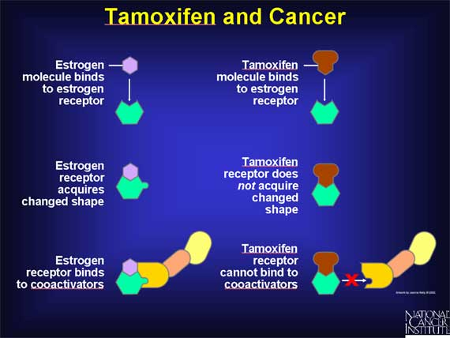
Breast Cancer | Endocrine Therapy: Tamoxifen
Notes:
Tamoxifen is a selective oestrogen receptor modulator
It is actually a pro-drug that gets metabolized by hepatic enzymes to form endoxifen its active metabolite
It has mixed agonist and antagonist activity depending on the target tissue, the difference in the agonist/ antagonist action is thought to be secondary to changes in the receptor conformation that follow binding of the oestrogen receptor to the SERM
Side effect profile,
Increased rates of uterine cancer, stroke (not SS)
Hot flushes, vaginal dryness, sexual dysfunction, menstrual irregularities)

Slide 31
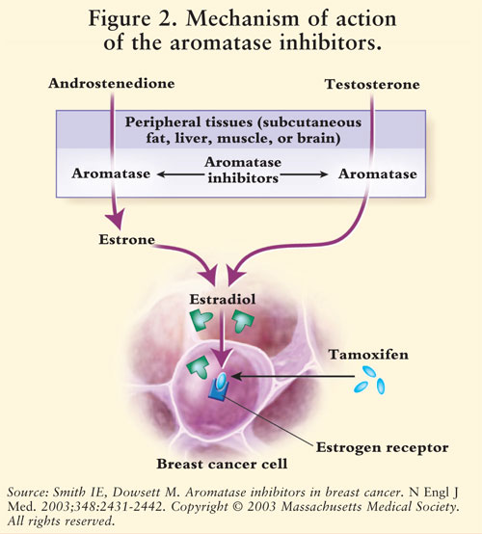
Breast Cancer | Aromatase Inhibitors
Suppress plasma oestrogen levels by inhibiting or inactivating aromatase
Notes:
SE: increased osteroporosis, myalgias, no uterine cancer or VTE complications

Slide 32
Breast Cancer | Postmenopausal HR+ve
  Anastrozole
  Letrozole
  Exemestane (steroidal inhibitor)
Comparable in efficacy
Similar SE profile
  Arthralgias, myalgias, reduction in bone density
Notes:
In post menopausal women there is a second option of endocrine therapy with the use of an AI
There is minimal difference between the three available AI with the exclusion exemestane which is a steroidal inhibitor. Despite this difference:
National Cancer Institute of Canada Clinical Trials Group randomised 7500 women to exemestane or anastrozole with no significant change in event free or overall survival at 4 years
The question of which is the most appropriate is then raised:

Slide 33
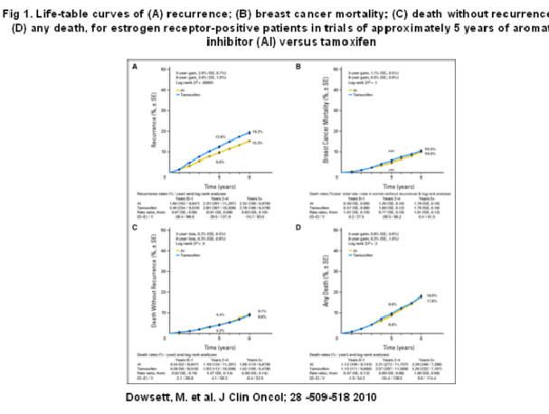
Breast Cancer | Tamoxifen or AI
Notes:
In postmenopausal w
Meta-analysis of Breast Cancer Outcome in Adjuvant Trials of AI vs. Tamoxifen
Looked at two questions:
1. Comparing AI to Tamoxifen for 5 years therapy
Comparing 5 years of tamoxifen to AI the first graph shows a decrease 4% absolute recurrence using AI cf Tamoxifen at 8 years
Does not translate to a survival advantage as outline in D, however this trial is only out to 8 years and due to the natural history of late relapses in hormone +ve BC this may become more apparent with longer follow up

Slide 34
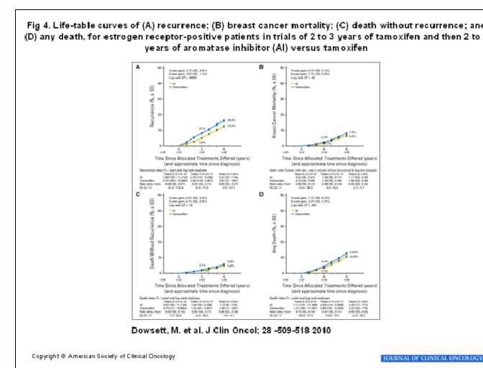
Breast Cancer | Tamoxifen then AI
Notes:
Second question: some tamoxifen followed by AI vs. 5 years of tamoxifen
Again shows some decrease in recurrence
No change in mortality
General consensus is that there is a modest improvement in OS and that as a first line postmenopausal women should receive either: 5 years of AI or 2-3 years of tamoxifen then switch to an AI, as outline above.

Slide 35
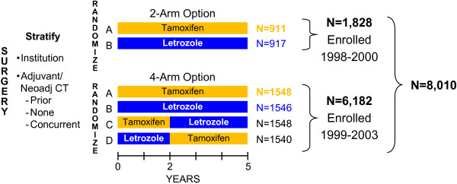
Breast Cancer | Big 1-98 trial
 | DFS | OS
Letrozole alone | 78.6% | 87.5%
Letrozole2/ Tamoxifen 3 | 77.8% | 87.7%
Tamoxifen2 / Letrozole 3 | 77.3% | 85.9%
Notes:
BIG- 198 Randomised, double blind, phase III trial comparing Letrozole and tamoxifen as adjuvant endocrine therapy for postmenopausal women with hormone receptor +ve early breast cancer. Regan et al
8000 women enrolled from 1998- 2003: postmenopausal with early HR +ve breast cancer
4 arm trial comparing 5 years of monotherapy with tamoxifen or with Letrozole or with sequence of 2 years of one followed by three years of the other
Main conclusion from the trial was that the use of an AI as a single agent for 5 years is as effective as the “switch” therapies

Slide 36
Breast Cancer | Adjuvant Endocrine Therapy
Study | Endocrine therapy and duration | Relative risk of recurrence | Relative Risk of mortality
EBCTC | Tamoxifen (5 years) | 0.61 | 0.70
ATAC | Anastrozole vs. Tamoxifen (5yr) | 0.90 | 1.00
BIG 1-98 | Letrozole vs. Tamoxifen (5yr) | 0.88 | 0.81
Sequential Therapy
BIG 1-98 | Tamoxifen/ Letrozole vs. letrozole | 1.05 | 1.13
BIG 1-98 | Letrozole/ Tamoxifen vs. Letrozole | 0.96 | 0.9
Extended Therapy
NCIC CTG MA. 17 | Tamoxifen (5 yrs) then Letrozole (5 yrs) | 0.68 | 0.98
Notes:
5 years of tamoxifen reduces the relative risk of distant recurrence by approx. 41% and reduces the relative risk of dying by 34%
Two strategies have been trialled-
1. 5 yrs AI vs. Tamoxifen (fewer relapses with AI but NO mortality difference)
Other benefits to AI-> main risk is arthralgia, OP and worsening hormone therapy, tamoxifen-> risk of endometrial cancer/ DVT
Staggering 2-3 year
Similar disease free, but also related to a smaller
Early Breast Cancer Trialist Collaborative Group: effects of chemotherapy and hormonal therapy for early breast cancer on recurrence and 12 year survival: an overview of the randomised trials, showed a 13% absolute reduction in breast cancer recurrence at 15 years compared with placebo and a 9% decreased risk of BC mortality
LONGER use of tamoxifen has not been associated with greater efficacy (and associated with increase in uterine and DVT risk)
TREND:

Slide 37
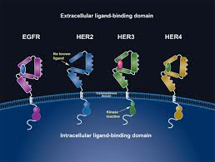
Breast Cancer | HER-2
Member of the epidermal growth factor receptor tyrosine kinase family
  EGFR-1, HER2, HER3, HER4
Notes:
Human Epidermal Growth Receptor is a member of the Epithelial growth factor family, this also includes EGFR.
Discovered the family of receptors in early 1990s
Activation of these receptors results in a chain or events which then stimulated cellular growth, cell survival, migration and angiogenesis

Slide 38
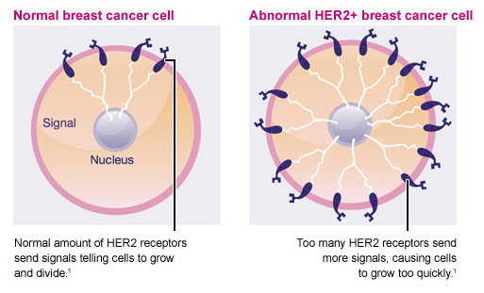
Breast Cancer | HER2 Overamplification
Notes:
18-20 % of primary invasive breast cancers have amplification or overexpression of the human epidermal growth factor 2
HER 2 receptors, a receptor on the surface of the cell
Work by activation and downstream effect→ phosphorylation and activation of nucleus→ cancer cell proliferation, inhibition of apoptosis, angiogenesis (development of tumour blood vessels), invasion and metastasis
Therefore with overexpression of Her2 in breast cancer cells
Increases from tens of thousands of receptors to millions of receptors.
Therefore at diagnosis all new breast cancers are tested for overexpression
They are then eligible for HER2 directed therapy if positive
IHC stain of 3+ which is a uniform intense membrane staining for HER2 in 10% of more of tumour cells
HER2/ chromosome enumeration probe florescent in situ hybridization (FISH) amplification

Slide 39
Breast Cancer | HER2 Overamplification
Overexpression of the HER2 protein is a consequence of gene amplification
  Occurs in 20% of BC
Strong predictive indicator
  Increased efficacy of certain CTx agents
  Increased resistance to endocrine therapy
Modest prognostic indicator
  Independent of other prognostic indicators
Notes:
Predicative indicator: how well a tumour will respond to certain treatments
Increased efficacy in Anthracycline and taxanes
Prognostic indicator: correlation with outcome
It is correlated also with a highly proliferative subtype of breast cancer with high grade histology and LN involvement
Interestingly the degree of HER2 positivity does not correlate with prognosis of increased response to anti-HER2 therapy

Slide 40
Breast Cancer | Trastuzumab
  Trastuzumab (Herceptin)
    Adjuvant: survival advantage
    IV delivery
      ? Role for s/c in future
    Side effect profile
      Modify cardiac muscles response to stress
      5% of patients experience asymptomatic decrease in EF
      Increased risk with advanced age, HTN, poor initial EF
Notes:
Multiple drugs available, new drugs in development
However Trastuzumab is the only HER-directed therapy to have proven survival benefit when administered with CTx as an adjuvant therapy
Pertuzumab (newer agent)
Targeted agents
Antibodies
High specific, parenteral, longer half-life (6-10 weeks), fewer side effects, don’t cross BBB
Increased risk of cerebral metastases (lives long enough to get them)
Side effects
Her2 appears to be involved in remodeling and repair of the cardiac muscle therefore there can be significant damage by herceptin, which can be reversed with cessation of the drug
For this reason they need to have a good cardiac function and ongoing clinical monitoring of this
Current pbs guidelines indicate trastuzumab for 52 weeks, initially concurrently and later as an ongoing maintenance

Slide 41
Breast Cancer | Seminal Adjuvant Trastuzumab Trials
Trial | Eligibility Requirements | Treatment | HR for Disease Free Survival
NSABP B-31 | Node +ve disease | AC-T vs AC-TH | 0.48
NCCTG N9831 | Node +ve or high risk node –ve | AC-T vs. AC-TH (concurrent) | 0.48
 |  | AC-T vs. AC-T-H | 0.86
BCIRG 006 | Node +ve or high risk node –ve | AC-D vs. AC-DH | 0.61
FinHER | Node +ve or high risk node –ve | D or V +FEC vs. D or V+ FEC + H
FNCLCC-PACS 04 | Node +ve | FEC or ED vs. FEC of ED + H | 0.86
Notes:
To sum up this slide:
2012 metaanalysis showed that there was an
Improved disease free survival independent of timing or length of trastuzumab but a benefit in overall survival was noted only with a concurrent Ctx/ Trastuzumab not sequential therapy
First three trials (>100000 patients), with a very good HR in these patients
First two: American
Third group: involved Australia
EACH trial limited eligbility to women with node +ve or node –ve with high risk disease, however pre-existing data from prior to the trastuzumab indicate that HER 2 positive tumours have a higher risk of recurrence compared with similar sized HER2 –ve tumours
Therefore the adjuvant benefit o trastuzumab to tumours <1cm has not been directly established in trials but it is widely believed that this should lower the recurrence risk
National Comprehensive Cancer Networks guidelines echo this indicating anti-HER2 therapy in tumours > 0.5cm

Slide 42
Breast Cancer | New Therapies
HER2 is a tyrosine kinase receptor that activates downstream oncogenic signaling pathways
HER2/HER3 Dimers may provide an escape mechanism for trastuzumab
  Therefore it has been postulated that a combination of HER2 receptor targets may have synergistic effects

Slide 43
Breast Cancer | Other HER2 receptor based therapy
  Pertuzumab
    Shows survival benefit in neo-adjuvant and metastatic setting
    NCCN guidelines 2014 indicate that it can be incorporated into adjuvant treatment alongside CTx and trastuzumab
      Adjuvant trials ongoing
Notes:
Recent data show

Slide 44
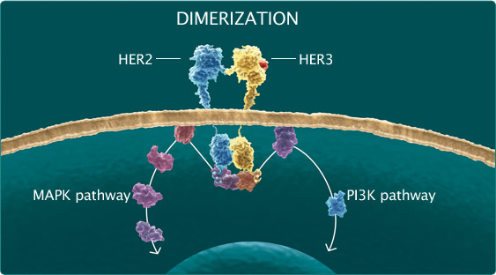
Breast Cancer | Other HER2 receptor based therapy
TRASTUZUMAB | PERTUZUMAB
Trastuzumab continually suppresses HER2 activity | Inhibits HER formation of dimer pairs
Flags cells for destruction by the immune system | Suppresses multiple HER signalling pathways
Does not inhibit HER2 dimerization | Flags cell for destruction by immune system
Notes:
The addition of pertuzumab to combinations of chemotherapy and trastuzumab is designed to overcome trastuzumab resistance caused by the formation of HER2: HER3 herterodimers
The two drugs work synergistically by binding to separate locations on the HER complex
Two trials have been performed (randomised phase II trials), both in the neo-adjuvant setting.

Slide 45
Breast Cancer | Neo-Sphere trial
Trial Arm | Complete Pathological Response | ER/PR-ve
A (107) | 29.0% (31 0f 107) | 36.8%
B (107) | 45.8% (49 of 107) | 63.2%
C (107) | 16.8% (18 of 107) | 29.1%
D (96) | 24.0% (24 of 96) | 30.0%
Improvement in pCR with use of dual HER2 blocking therapy and CTx
Increased efficacy in the patients with ER/PR –ve disease
Notes:
There was a significant increase in the complete pathological response rate post the combination of dual blockade AND docetaxel but perhaps more interestingly there was also a very significant response rate in arm C which used only trastuzumab and pertuzumab,
Common adverse effects were those of febrile neutropenia and leucopenia with the number of serious events very similar in groups A,B,D and lower in C
This needs to be taken into context that this trial adopted an unconvential approach of treating patients with chemotherapy both before and after surgery
The Tryphaena trials also looked at neoadjuvant combination of trasutzumab and pertuzumab with 223 women ALL receiving dual HER2 therapy with one of three CTx regimens: FEC-D, FEC alone, or carboplatin, docetaxel. All three arms had similar PCR rates of (62, 57, 66 respectively)

Slide 46
THANK YOU

