Slide 1
Adjuvant chemotherapy in Rectal Cancer?

Slide 2
Overview
What is the evidence for adjuvant chemotherapy?
Do patients achieving a pathological complete response need chemotherapy?
How do we incorporate Oxaliplatin following the recent data from ASCO 2014?

Slide 3
Case
  62 y.o. man with no significant PHx
  Recently diagnosed with T3 mid rectal cancer
  Discussed in MDM
Recommended treatment
  Neo-adjuvant long course chemoRT with infusional 5FU
  Surgery 6-8 weeks following completion of RT
  Post-op adjuvant bolus 5FU for 20 weeks

Slide 4
Why Radiotherapy?

Slide 5
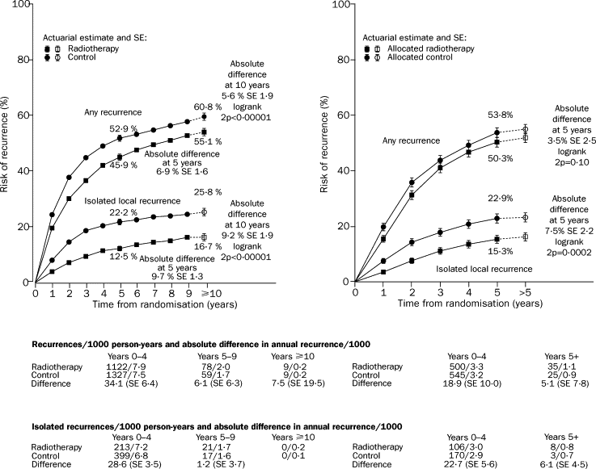
Pre Operative RT | Post Operative RT
Lancet 2001; 358:1291-304.

Slide 6
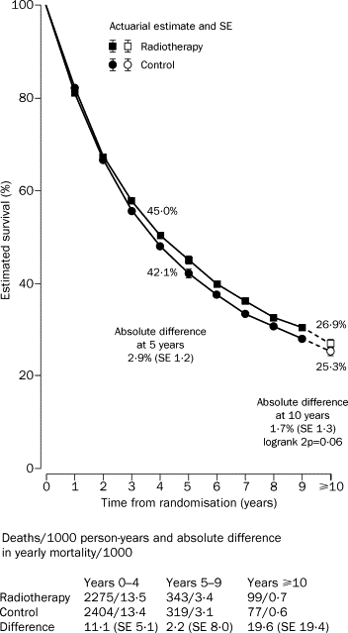
Meta-analysis: (Neo) Adjuvant RT and Overall survival.

Slide 7
Pre-op vs Post-op ChemoRT
n LR OS
Swedish¹ 471 12% vs 21% p=0.02 No Difference
CAO/ARO/AIO-94² 823 6% vs 13% p=0.006 76% vs 74% p=0.80
NSABP R-03³ 267 10% vs 10% p=0.7 74% vs 65% p=0.065
1) Ann Surg. 1990 Feb;211(2):187-95
2)Sauer et al NEJM 2004 Oct 21
3)Roh et al JCO 2009 Nov 1

Slide 8
Radiotherapy Summary
RT (pre or post-op) significantly reduces local recurrence
  Even if TME (Dutch study)
RT has little or no impact on O.S.
  And no impact on distant recurrence
Pre-operative RT preferred to Post-op RT

Slide 9
Adjuvant Chemotherapy in Rectal Cancer
2 Cochrane Systematic reviews
  ChemoRT vs RT¹
  Post-operative adjuvant chemotherapy vs observation²
  ¹ McCarthy K et al Cochrane Database Syst Rev 2012 Dec 12
  ² Petersen SH et al Cochrane Database Syst Rev 2012 Mar 14

Slide 10
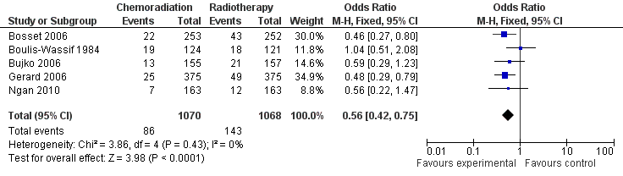
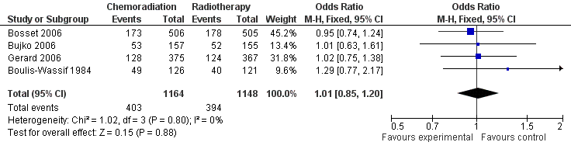
Chemo RT vs RT
LR
OS

Slide 11
What is the role of adjuvant chemotherapy following neoadjuvant chemoRT and surgery?

Slide 12
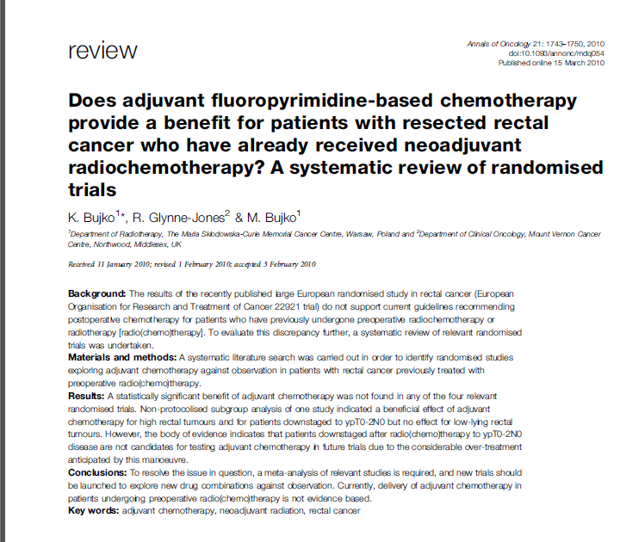
Main Title| Slide title

Slide 13
4 relevant studies identified
EORTC 22921
Italian study
QUASAR
Chinese study

Slide 14
EORTC 22921
T3-4 Rectal cancer, < 15cm from anal verge, < 81 yrs old.
2 X 2 factorial design
  Pre op RT vs Pre Op Chemo RT
  Post op 4 cycles of 5FU vs Observation
1011 pt’s randomized
Adjuvant chemo showed a trend to better OS. HR 0.85 (0.68-1.04, P=0.12)
  Suggestion of improvement in ypT0-2
  HR 0.97 (0.70-1.20) if had pre-op chemoRT
  Collette et al JCO Oct 2007
  Bosset et al Lancet Jan 2014

Slide 15
Italian Study
635 T3-4 rectal cancer pt’s under 75 yrs
All pt’s had pre-op ChemoRT (bolus 5FU)
Randomized to post op 6 cycles of “Mayo” 5FU/FA vs observation.
5 yr O.S. 70% vs 68% N.S.
  For ypT0-2 80% vs 80%
Cionini L et, al. Eur J Cancer 2001; 37:S300 (Abstr)
Cionini L, et al. Radiother Oncol 2010; 96 (1 suppl); S113

Slide 16
QUASAR
2291 colon cancers, 948 rectal cancers
Mostly stage 2
Randomized to 6 months of post-op bolus 5FU or observation.
Only 203 patients had pre op RT
For all rectal cancer pt’s
  O.S. was 78% vs 74%
  HR 0.77(0.54-1.00), p=0.05

Slide 17
What about path CR’s?
Meta-analysis of pathCR vs Non- pathCR.
1913 pt’s, 300(15.6%) pathCR
Median Fup 23-46 months
LR – 0.7% vs 2.6% OR 0.45 p=0.03
DR – 5.3% vs 24.1% OR 0.15 p=0.0001
OS 92.3% vs 73.4% p=0.002
Zorcolo L et al. Ann Surg Oncol 2012 Sept

Slide 18
Systemic review of the literature
  16 studies
  1263 cases of path CR’s after neoadj CRT
  Median Fup 55 months
LR 0.7%
DR 8.7%
5 yr O.S.- 90.2%
Martin ST et al. Br J Surg 2012 July

Slide 19
What about our Patients?
Audit of all patients who received a path CR following neo-adjuvant (chemo)RT for rectal cancer at WBRC.
Neo-adj Rx given between 1999-2012.
Hamid et al ASCO 2014

Slide 20
Results
407 patients were identified
69 exclusions due to:
  Metastatic disease at diagnosis (32)
  No surgery (10) or surgery after 2012 (10)
  Retreatment of locally recurrent disease (9)
  Non-adenocarcinoma histology (4)
  Unknown pathology (4)
338 patients included who underwent pre-operative treatment for LARC

Slide 21
Results
51 patients (15.1%) achieved pCR (ypT0N0)
49 long-course CRT; 2 patients short-course RT
  49 of 298 long course (16.4%), 2 out of 40 short course (5%)
Median follow-up of survivors was 58 months.
Pre-operative staging of pCR patients:
  T2 (14%)
  T3 (82%)
  T4 (4%)

Slide 22
Results
62% of pCR patients received post-operative 5-FU chemotherapy
Patients receiving post-operative chemotherapy were younger (54 vs 71 years; p<0.001) however there was no difference in ECOG performance status (p=0.43)
Recurrences
  Nil local
  2 distant recurrence - one patient with synchronous sigmoid carcinoma at resection

Slide 23
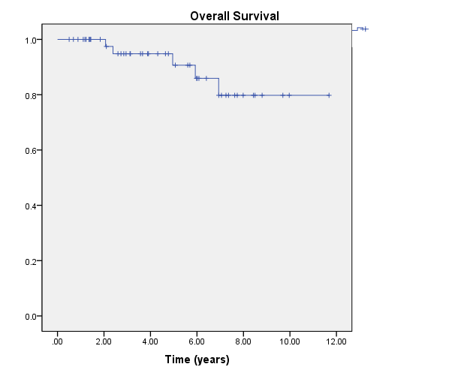
Results
5-years OS was 91%
1 patient died from metastatic rectal cancer; 4 died from non-malignant causes

Slide 24
Results

Slide 25
Oxaliplatin?

Slide 38
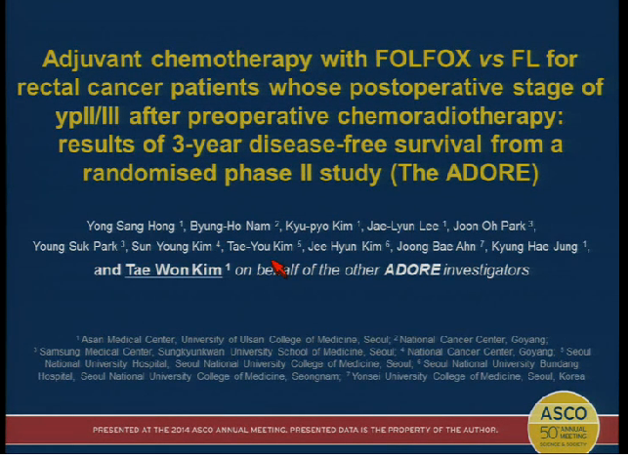

Slide 39
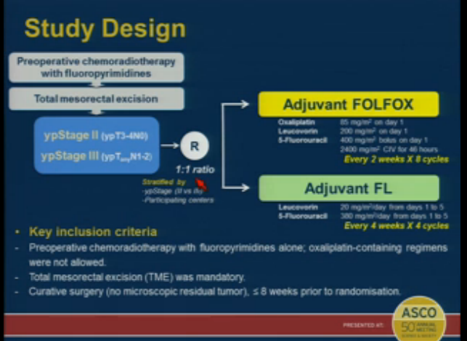

Slide 41
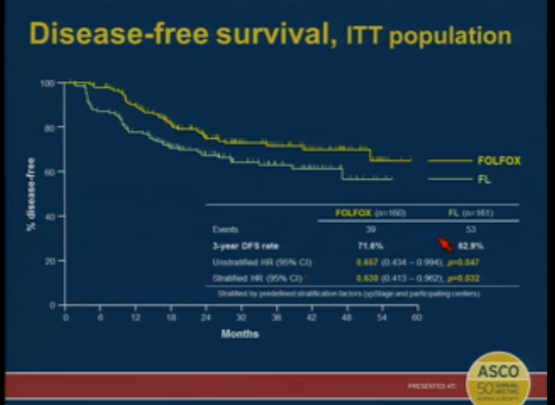

Slide 42
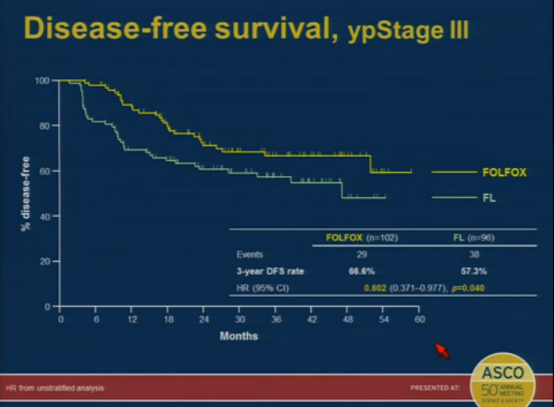

Slide 43
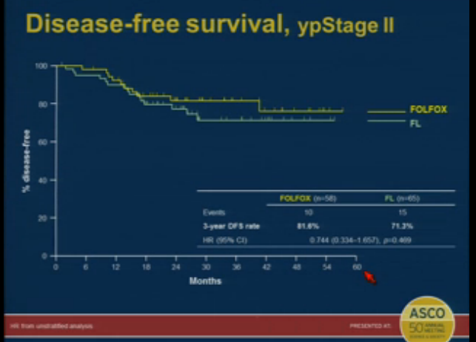

Slide 44
No role for neoadj Oxaliplatin when giving pre-op (long course) chemo RT
  Infusional 5FU remains standard of care.
? Role for adj (post op) oxali
  No O.S. improvement
  I would consider treating fit pt’s who are ypN+ve
  Folfox preferred over Xelox
Adjuvant chemotherapy following a path CR to long course chemoRT may be unnecessary.

