Slide 1
Genomic Medicine
Rebecca Tay
Oncology Registrar

Slide 2
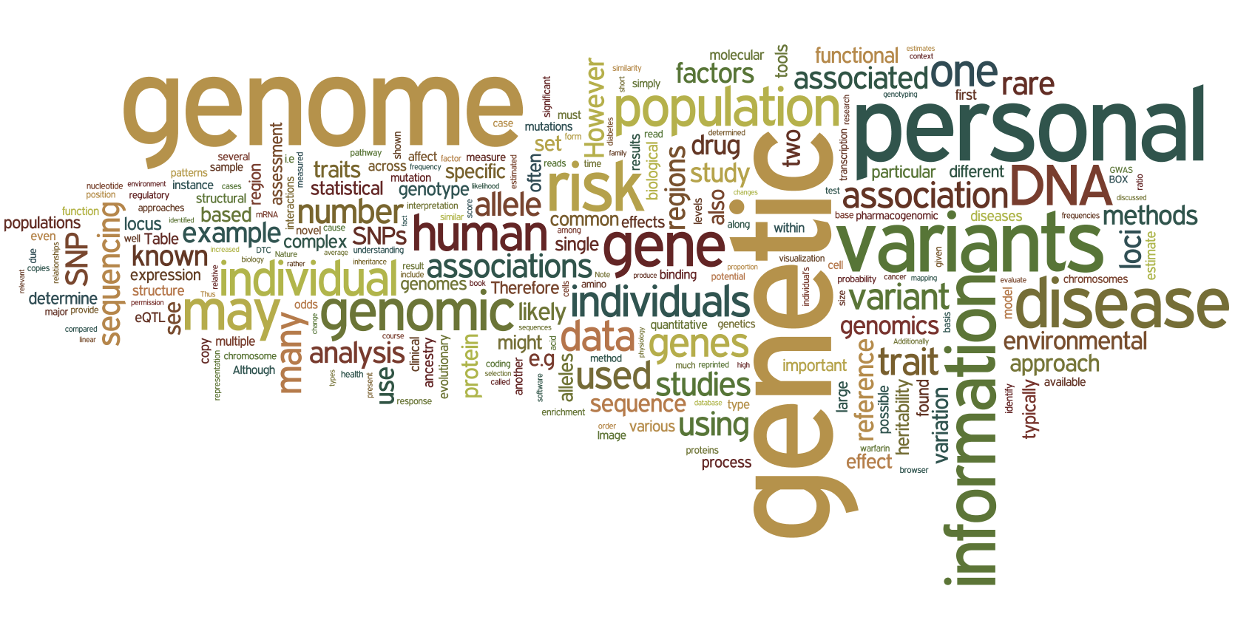
What is Genomic Medicine?
personalised, precision or stratified medicine
Notes:
Genomic medicine, personalised medicine, precision medicine, stratified medicine
Genomics is the use of an individuals genetic profile to guide preventing, diagnosing and treating disease
This is done by sequencing and analysing DNA
In this presentation, I will be covering some genetics principles followed by examples of how we incorporate genomic medicine into everyday oncology practice

Slide 3
Why is Genomic Medicine important?
Improves medical decision making
Able to recommend therapy tailored to the patient rather than the general population
Avoid treatments that have low efficacy or may cause harm
Optimise disease prevention strategies
Enhance patient satisfaction with the treatment process, improved tolerance of therapy, better compliance

Slide 4

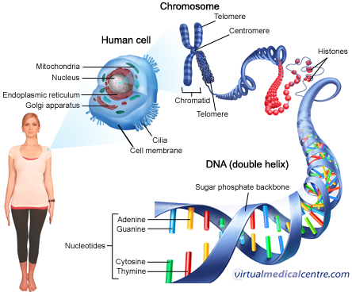
DNA – the building blocks of a human
23 pairs of chromosomes
Notes:
We are all made up of trillions of cells
Cells provide structure, take in nutrients from food, covert these nutrients to energy and differentiate to carry out specific functions
The cell nucleus is ‘command centre’ of the cell, housing DNA
DNA is the structure that contains our genetic code
It is made up of 4 chemical bases: adenine (A), guanine (G), cytosine (C), and thymine (T)
DNA bases pair up with each other, A with T and C with G, to form units called base pairs.
Each base is attached to a sugar molecule and a phosphate molecule
Together, a base, sugar, and phosphate are called a nucleotide
Nucleotides are arranged in two long strands that form a spiral called a double helix
When unraveled, the base pairs can be read
Human DNA consists of about 3 billion bases
>99% of bases are the same in all humans
The order, or sequence, of these bases determines the information available for building and maintaining an organism
An important property of DNA is that it can replicate, or make copies of itself. Each strand of DNA in the double helix can serve as a pattern for duplicating the sequence of bases. This is critical when cells divide because each new cell needs to have an exact copy of the DNA present in the old cell
gene is a length of DNA that codes for a specific protein

Slide 5
The Human Genome Project
Publically funded initiative to determine the entire human DNA sequence
  1999 to 2003
  20 500 individual genes found
  >99% of bases are the same in all humans
Able to map the genetic origins and identify mutations linked to disease

Slide 6
Types of genetic testing
Single specific gene tests
  BRCA1/2
Gene panels
  Sequence multiple genes focused on conditions with high genetic variability
Whole genome sequencing (Next Generation Sequencing)

Slide 7
Genomics in Oncology
1. Identifying risk of developing cancer
  Breast cancer
2. Tailoring treatment to a specific patient
  Lung cancer
3. Predicting response to treatment
  Colon cancer

Slide 8

Identifying risk of developing cancer

Slide 9
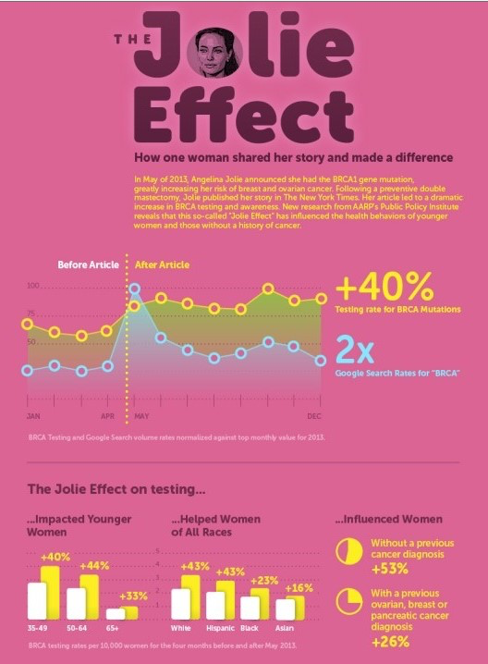

Slide 10
Genomics in Oncology – Identifying risk
BRCA 1/2 are tumour suppressor genes
Autosomal dominant inheritance pattern
 | BRCA 1 | BRCA 2
Breast cancer risk | 55-70% | 45-70%
Ovarian cancer risk | 40% | 15%
Prostate cancer | - | 30%
Pancreatic cancer | 1% | 5%
Uveal melanoma

Slide 11
Who gets referred for BRCA testing?
Breast cancer diagnosis < 40 years old
Triple negative breast cancer < 60 years old
Male breast cancer
Ovarian/fallopian tube/primary peritoneal cancers
Ashkenazi Jewish
Family history
  Breast cancer: 2 first degree relatives (1 dx <50 yo) or 3 first and second degree relatives
  Ovarian cancer: 2 first or second degree relatives
  Male breast cancer

Slide 12
Screening protocols for BRCA 1/2 mutation carriers
Breast screening
  Breast exam every 6 – 12 months
  Annual breast MRI 25 - 29yo
  Annual MMG + breast MRI 30 – 75yo
Risk reducing surgery
  Mastectomy >90% risk reduction
  BSO >70% risk reduction

Slide 13
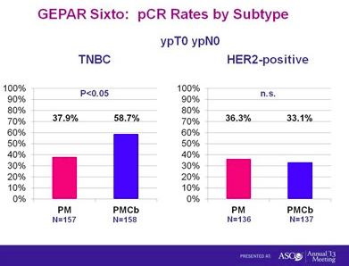
Treatments for BRCA mutation carriers
Breast cancer
  Contralateral prophylactic mastectomy
  Risk reducing BSO
  Platinum chemotherapy
    BRCA associated cancers are more platinum sensitive
    GeparSixto. J Clin Oncol 2014

Slide 14
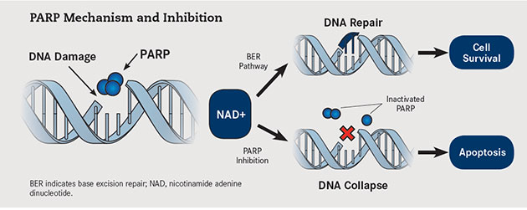
Treatments for BRCA mutation carriers
PARP inhibitors block the repair of DNA single-stand breaks
For tumours associated with BRCA mutations, this results in death of tumour due to inefficiency cell repair mechanisms
Notes:
PARP inhibitors block the repair of DNA single-stand breaks
For tumours associated with BRCA mutations, this results in death of tumour due to inefficiency cell repair mechanisms

Slide 15
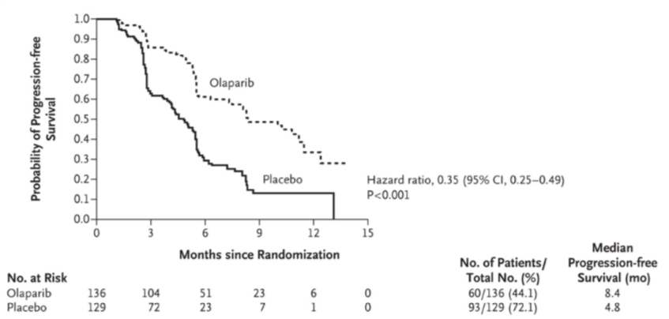
Treatments for BRCA mutation carriers
Study 19: Ph 2 Olaparib vs placebo in BRCA mutants
n=300 with platinum-sensitive HG epithelial ovarian cancer
N Engl J Med. 2012;366(15):1382
Notes:
PARP inhibitors block the repair of DNA single-stand breaks
For tumours associated with BRCA mutations, this results in death of tumour due to inefficiency cell repair mechanisms

Slide 16
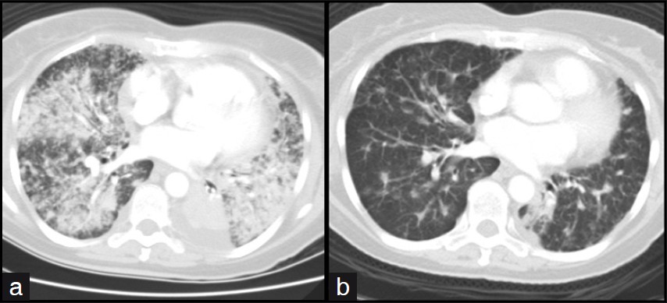
Tailoring treatment to a specific patient
Molecular testing in lung cancer

Slide 17
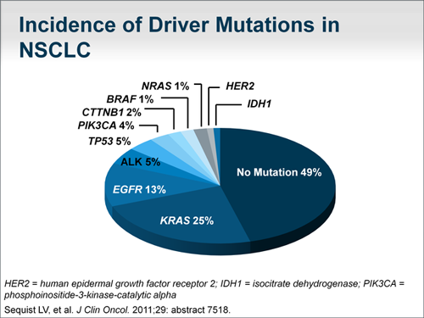
Genomics in Oncology – Tailoring treatment
Mutations can occur in cancer cells within genes that encode for proteins critical to cell growth and survival

Slide 18
Genomics in Oncology – testing for driver mutations
Testing for driver mutations at diagnosis
Need adequate tissue from the primary or secondary tumour to sequence DNA
  Gene sequencing eg: NextGen “lung panel”
    EGFR (exons 18-21), KRAS (exon 2-3)

Slide 19
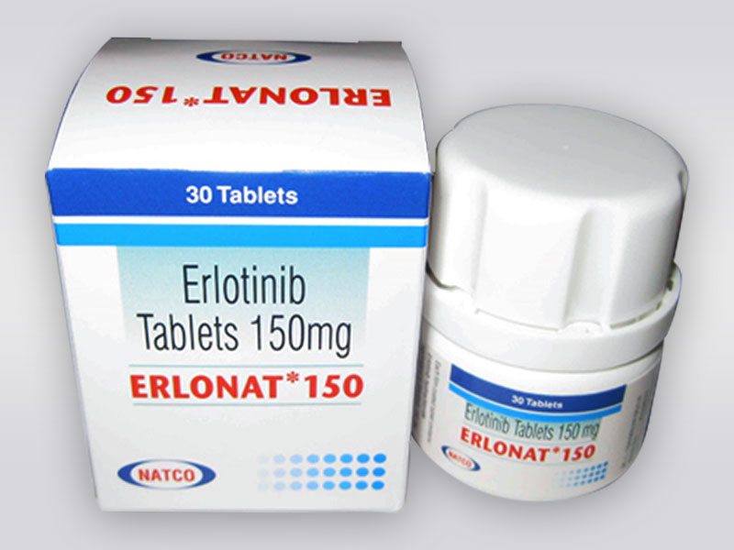
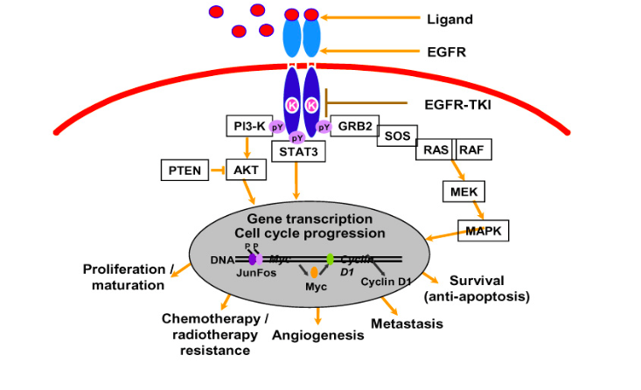
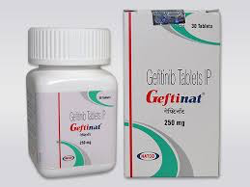
Genomics in Oncology – Tailoring treatment
Mutations in the epidermal growth factor receptor (EGFR) tyrosine kinase cause activation and uncontrolled cell growth

Slide 20
Genomics in Oncology – Targeting treatment
Driver mutation |  | Treatment
EGFR | Exon 19 del L858R T790M Exon 20 ins | Gefitinib/Erlotinib Gefitinib/Erlotinib Resistance – AZD929 Resistant
ALK | EML4-ALK | Crizotinib
KRAS |  | None, but poor prognostic factor

Slide 21
Genomics in Oncology – EGFR mutation
15% of lung adenocarcinomas
Young, asian, female, never smokers more likely to harbour EGFR mutation: >60%
Response to EGFR-TKI treatment: 70-80%

Slide 22
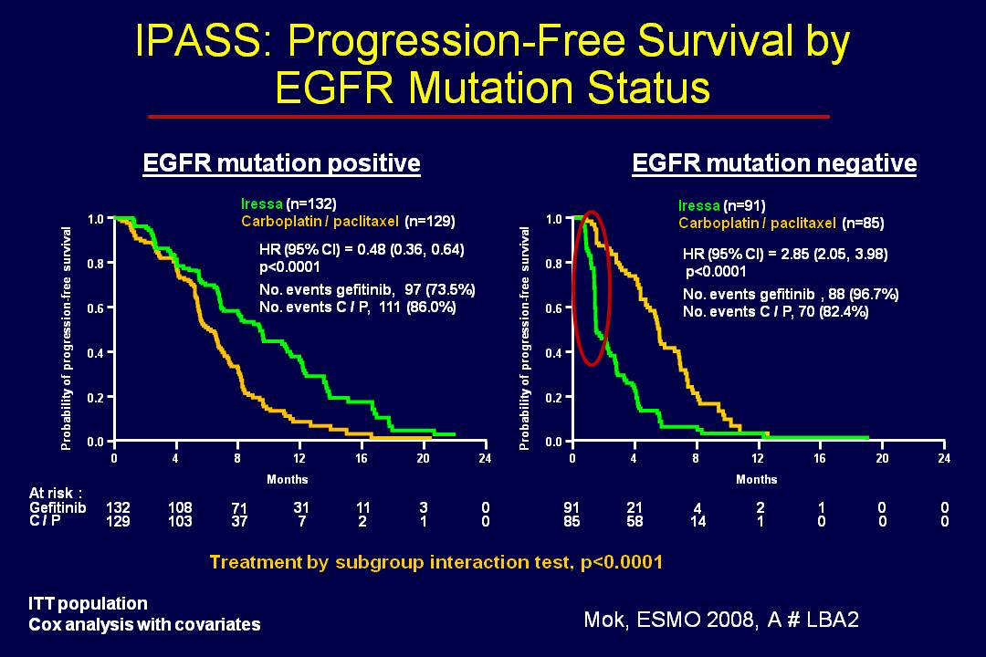
Genomics in Oncology – Tailoring treatment

Slide 23
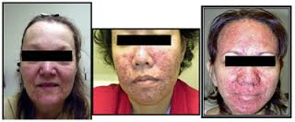
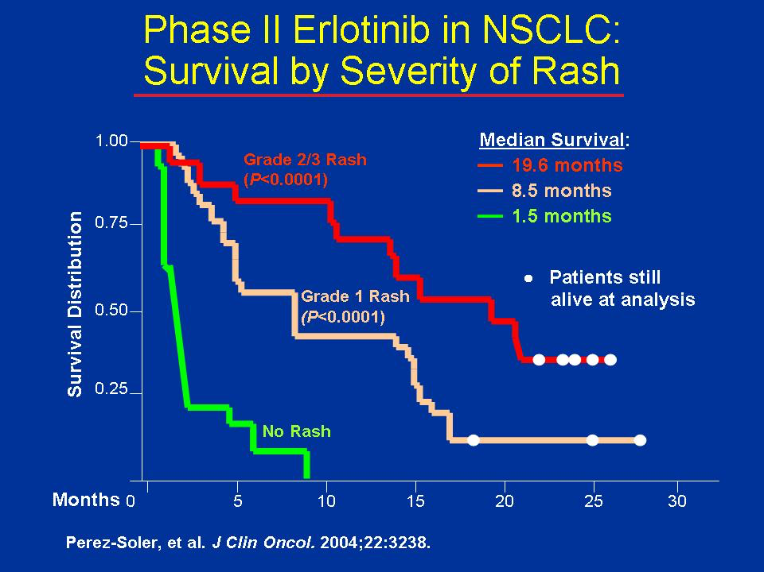
Genomics in Oncology – Tailoring treatment

Slide 24
Predicting response to treatment
Choosing the right treatment in colon cancer

Slide 25
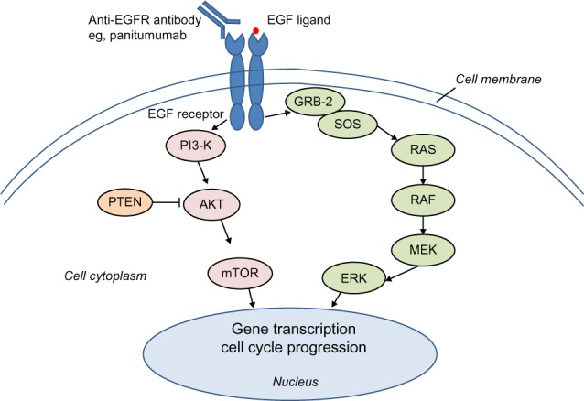
Mutations can predict response or lack of response to treatment
Screening for RAS mutations will identify patients who may respond to certain treatments in mCRC

Slide 26
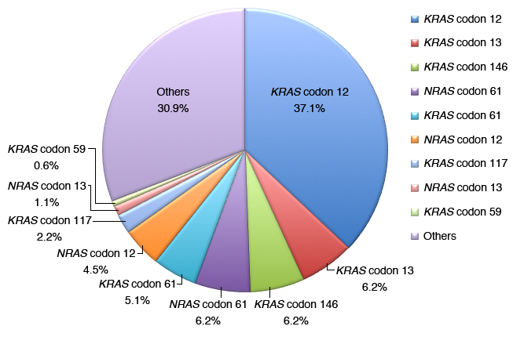

Slide 27
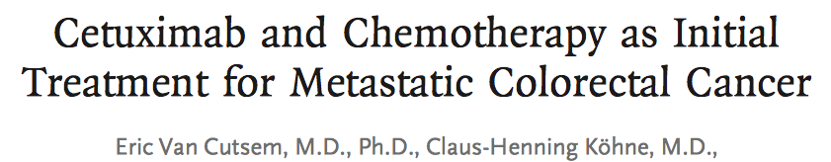
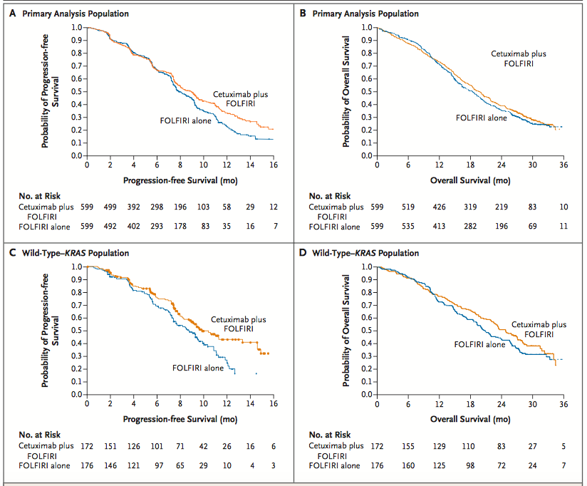

Slide 28
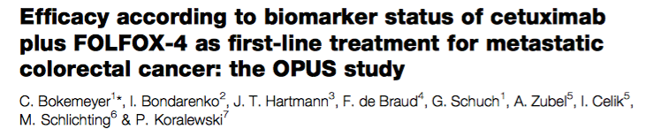
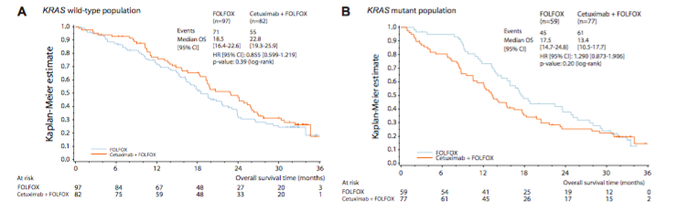

Slide 29
Future applications of Genomic Medicine

Slide 30
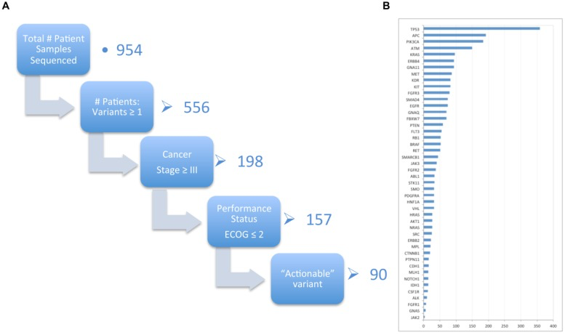
Genomics in the future
Cancer 2015: A Prospective, Population-Based Cancer Cohort-Phase 1: Feasibility of Genomics-Guided Precision Medicine in the Clinic
Notes:
The Cancer 2015 project is an example of how genomics can be incorporated into routine cancer care at the point of diagnosis to personalise a patient's treatment strategy
In this phase I study, cancer tumour DNA was screened for specific mutations
58% had at least one somatic variant identified
Approximated 10% of patients screened had mutations that could be treated with currently available targeted agents
Saving patients from up front chemotherapy
Able to identified treatments for rarer cancer types

