Slide 1



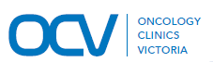
Bone Health
Secondary Breast Cancer
Dr Yoland Antill
Cabrini Health
Frankston Hospital
Frankston Hospital

Slide 2
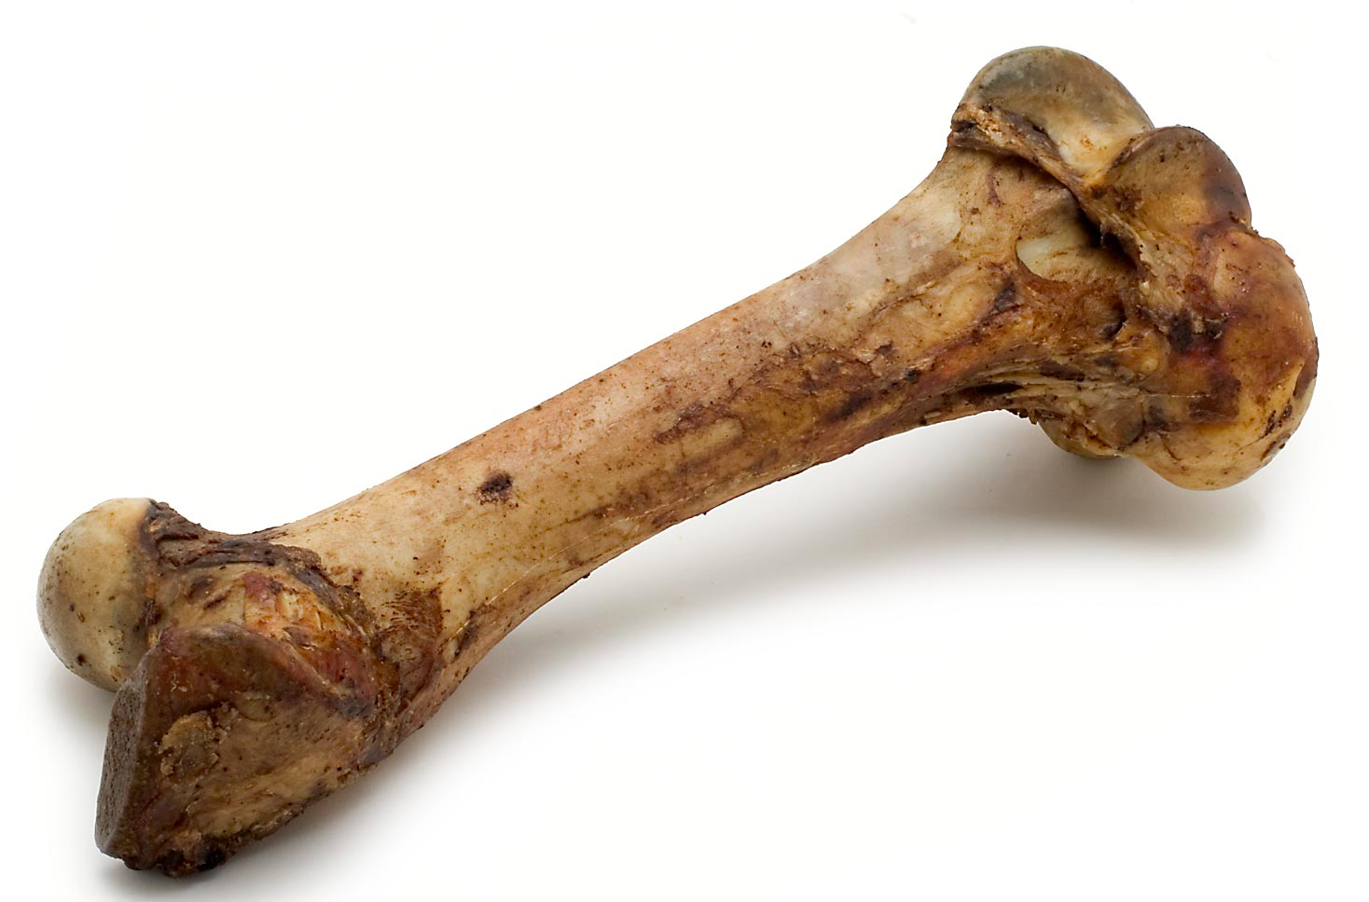
Bones and bone regeneration
Frankston Hospital

Slide 3
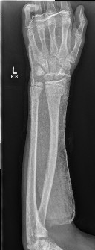
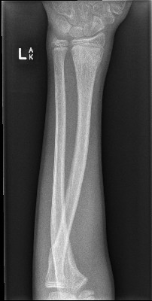
SEVEN WEEKS
Frankston Hospital

Slide 4
SEVEN WEEKS
WATCHING TWO BOYS
REMODEL FIVE BONES
OVER ONE
SUMMER HOLIDAY
Frankston Hospital

Slide 5
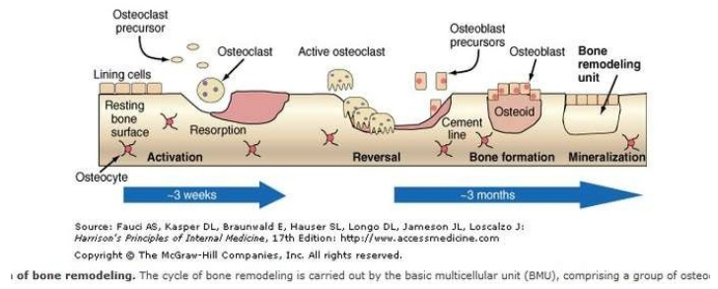
Bone Modeling
Frankston Hospital

Slide 6
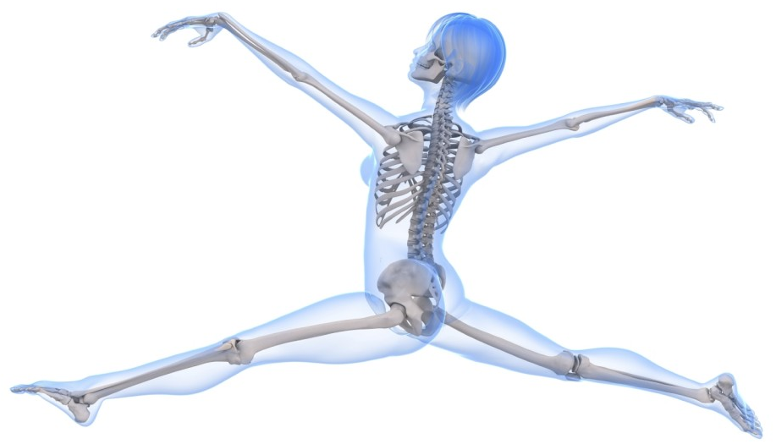
Factors effecting bone health
AGE
FEMALE
RACE
PRE-EXISTING DISEASE
NUTRITION
SMOKING
EXCERCISE
BREAST CANCER
TREATMENTS
BONE METASTASES
Frankston Hospital

Slide 7
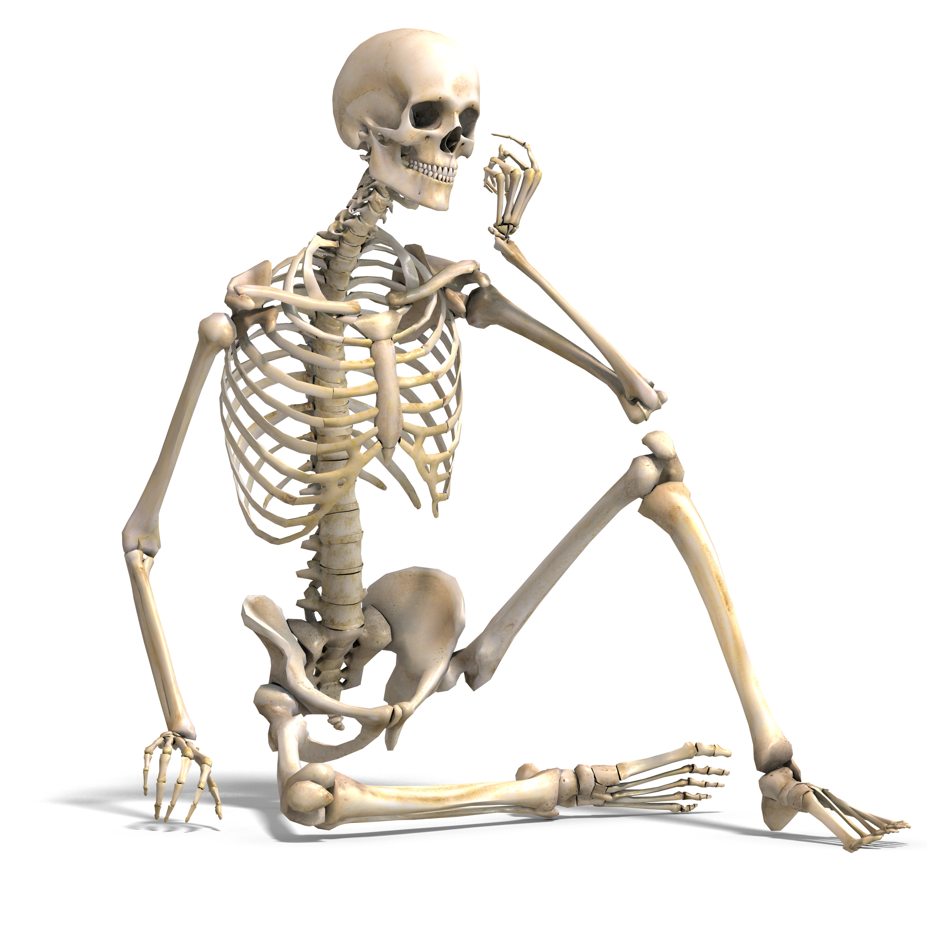
Bone Health and Breast Cancer
Women 100 x risk of men
3:4 cases occur >55yrs
Women lose 2-3% bone mass per yr for the first 5 yrs post onset menopause then 1%/ yr thereafter
2 of 3 women will have an osteoporotic fracture in their lifetime
Less than half eat recommended daily calcium intake.
38% adult Australians partake in recommended exercise regimens
  37% breast cancer pts post Dx
Frankston Hospital

Slide 8
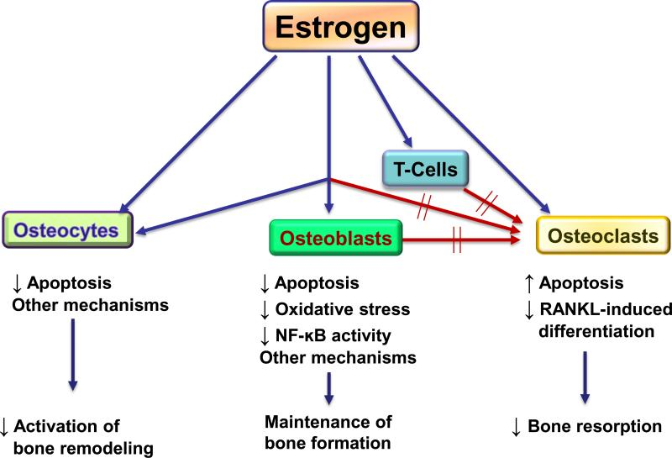

Slide 9
Chemotherapy effect
Cyclophosphamide and paclitaxel directly stimulates osteoclasts
Can effect ovarian function
Use of steroids stimulates osteoclast activity
PPIs reduce effective calcium absorption
Poor dietary intake of calcium and Vit D
Frankston Hospital

Slide 10
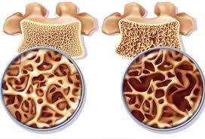
Osteoporosis/ bone thinning
Frankston Hospital

Slide 11
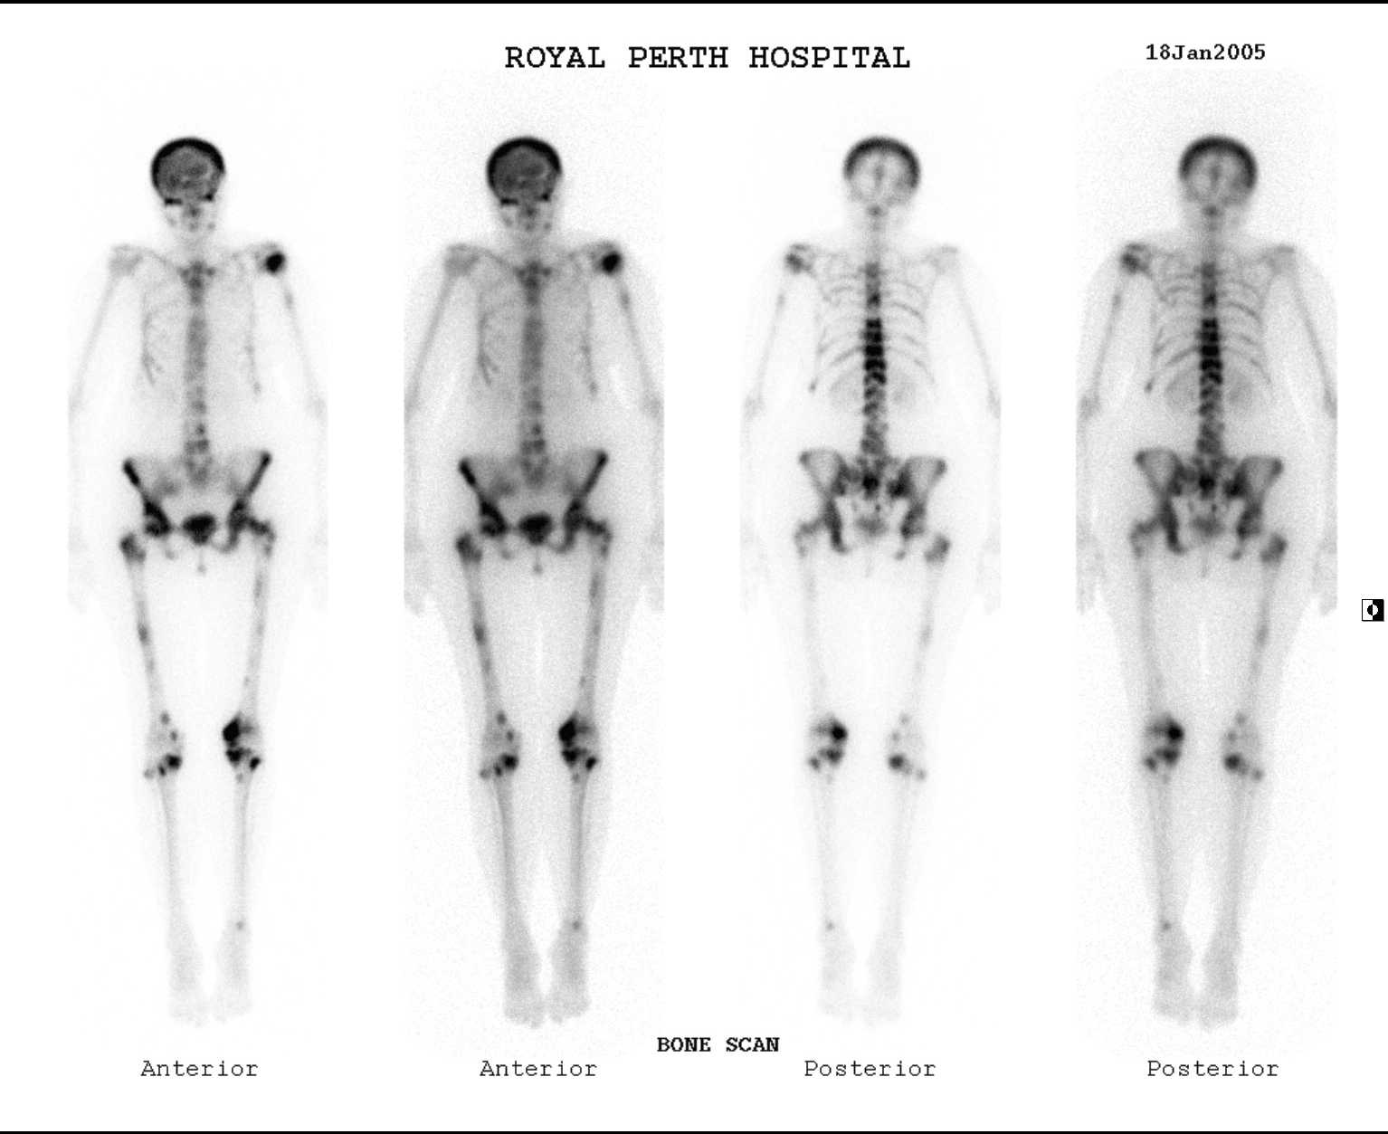
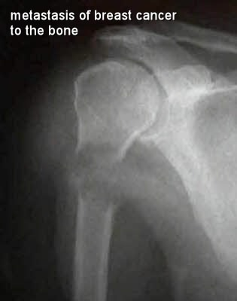
70% of patients with secondary breast cancer will have bone metastases
Frankston Hospital

Slide 12
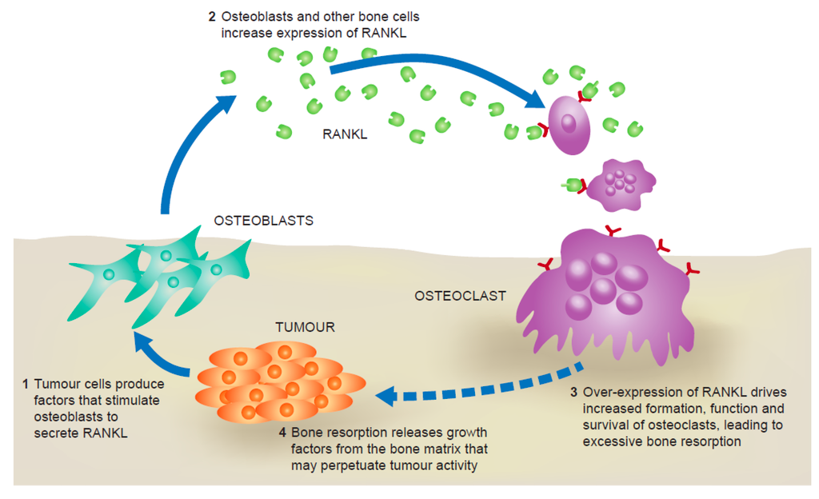
70% of patients with secondary breast cancer will have bone metastases
Frankston Hospital

Slide 13
Bone involvement with metastases
Skeletal Related Events
  Pathological fracture
  Radiation to bone
  Surgery to bone
  Spinal cord compression
  Hypercalcaemia
All SREs increase the risk for…
  Pain
  Impaired mobility
  Decreased quality of life
Frankston Hospital

Slide 14
Management of bone metastases
Breast Cancer Treatments
Denosumab/ bisphosphonates
Pain relief
  Paracetamol / NSAIDS
  Opiates
  TENS, heat packs
Frankston Hospital

Slide 15
Bisphosphonates
Inhibit osteoclast survival
Promote osteoclast apoptosis
  Decrease bone turn over
  Decreases tumour mediated bone resorption
Four available bisphosphonates for use
  Clodronate: oral
  Pamidronate: IV
  Ibandonate: oral 50mg daily or IV 6mg q28 days
  Zolendronic Acid: IV 4mg q28 days
Frankston Hospital

Slide 16
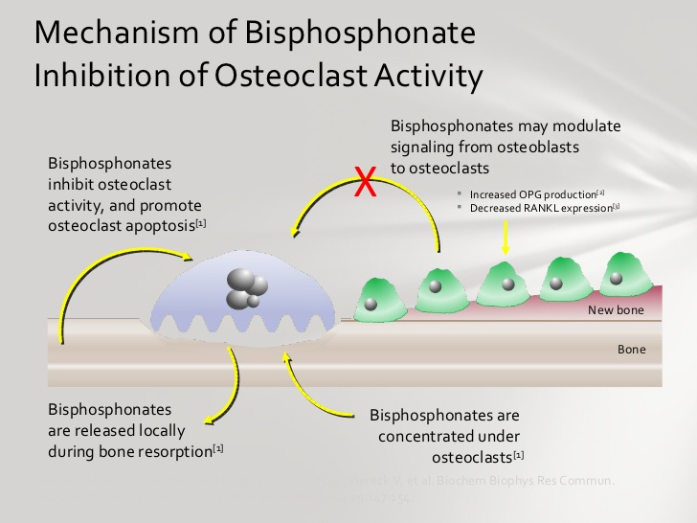
Frankston Hospital

Slide 17
Bisphosphonates: adverse events
Nephrotoxicity
  Pts with CRF at greater risk; not recommended if creatinine clearance <30mls/min
Hypocalcaemia
  Rapid onset and therefore ideal for treatment of hypercalcaemia
  5% of patients; Ca and Vit D supplements prevent
Acute phase reactions
  Most common with first infusion
Frankston Hospital

Slide 18
Bisphosphonates: adverse events
Acute phase reactions
  Usually subside after 72 hrs
Osteonecrosis of the jaw
  1-2.5% (up to 10% in pts with multiple risk factors)
  Risk factors: high potency BPs, concurrent chemo, dental disease with Hx invasive procedures
Atypical fragility fractures
Frankston Hospital

Slide 19
Denosumab
Fully humanised monoclonal Ab that binds to RANKL
  surface of osteoclast and osteoclast precursors
  RANK-RANKL interaction is the key mediator of osteoclastic activation
  Decreased cancer induced bone destruction
  Also found on mammary cells and may have a direct inhibitory function in breast tumorigenesis
Dose is 120mg subcut q28 days
Frankston Hospital

Slide 20
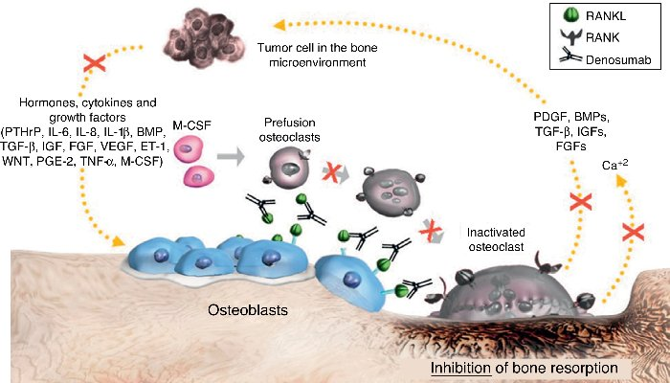
Denosumab action
Frankston Hospital

Slide 21
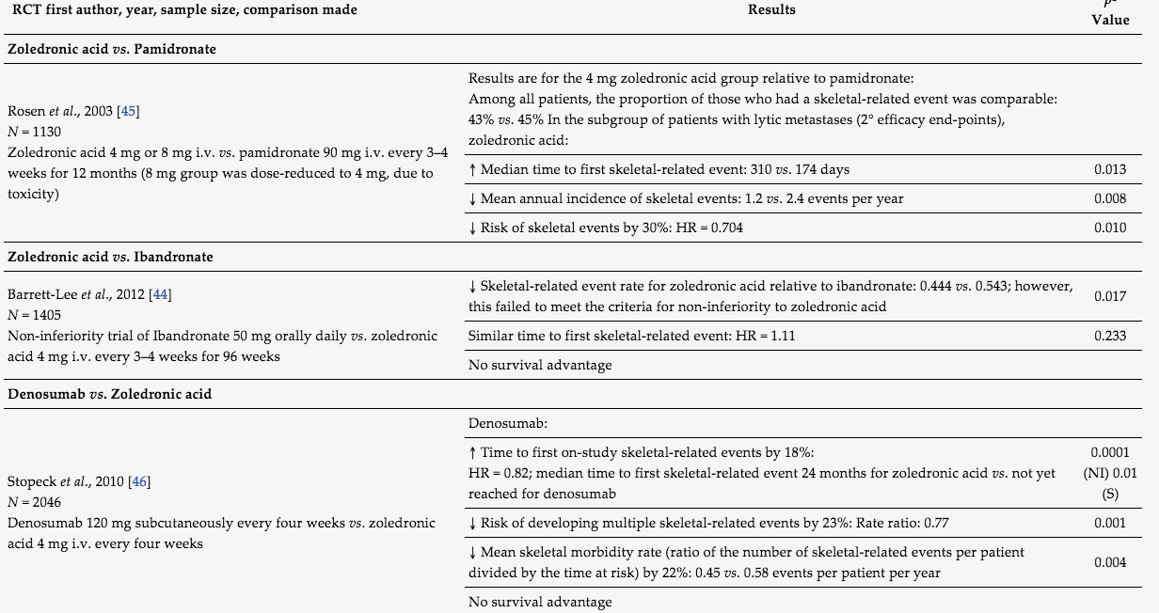
Prevention of SREs: Comparing agents

Slide 22
Denosumab: adverse events
Hypocalcaemia
  9.5% of patients
  Have been known deaths but mostly G2
  Lasting med of 3 weeks
  Ca and Vit D supplements mandatory
  pts education on symptoms of hypocalcaemia
Acute phase reactions
  Headaches, nausea, fatigue, back pain
Frankston Hospital

Slide 23
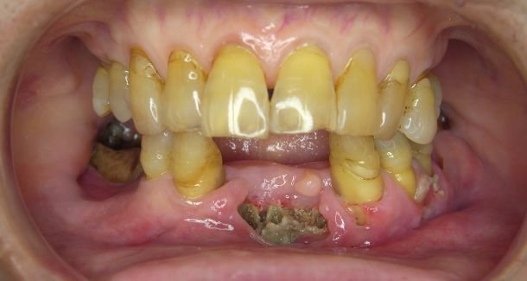
Denosumab: adverse events
Osteonecrosis of the jaw
  No greater rate than for BPs
  Similar risk factors
Atypical fractures
  Femur
  tibia
Frankston Hospital

Slide 24


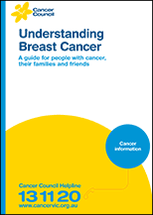
Patient Education
Frankston Hospital

Slide 25
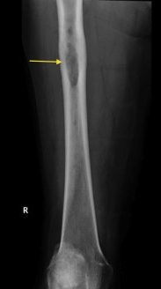
Orthopedic Intervention
Acute impending spinal cord compression
Management of pain
Prevention of pathological fracture
  Pain
  Metastasis eroding the cortex
  Large expansile metastasis
Management of fracture
Followed by radiation
Frankston Hospital

Slide 26
Radiation Therapy
Palliation of pain associated with bone metastasis
Following surgical stabilization intervention
  Remember that some chemotherapies are radio-sensitisers and may need to be stopped
Definitive treatment of solitary metastasis
Frankston Hospital

