Slide 1

Adjuvant Chemotherapy in Early Colorectal cancer
Siew Wei Wong

Slide 2
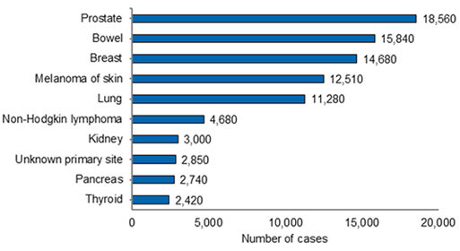
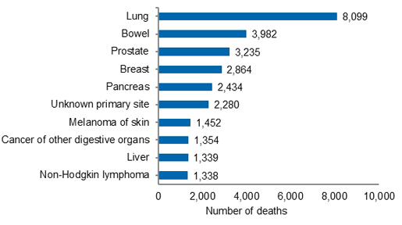

Colon Cancer | Epidemiology- Australia
Most common cancers 2012
Cancer related deaths 2010
14,410 new cases diagnosed in 2010
More common in Men 1:17 M, 1:26 F
Australian Institute of Health and Welfare

Slide 3
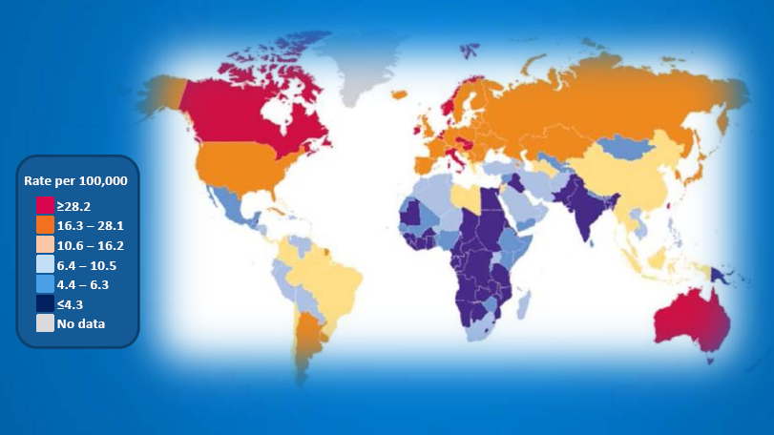

Colon Cancer | Incidence
Role of diet and lifestyle?!
Women
Men
(American Cancer Society 2011, Merck-Serono)

Slide 4
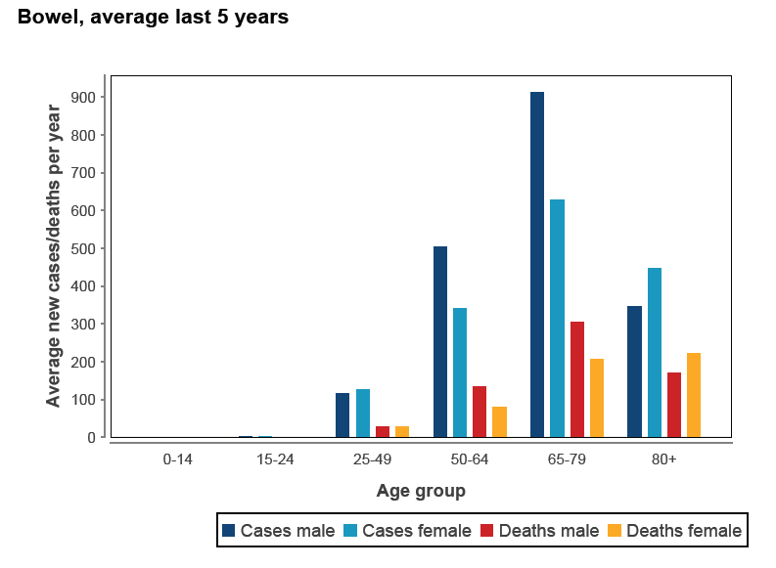
Disease of the elderly
Notes:
65% CASES SPORADIC. 5% LIFETIME RISK IN GENERAL POPULATION.

Slide 5
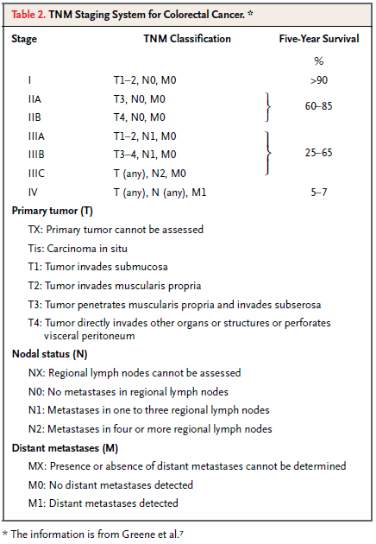
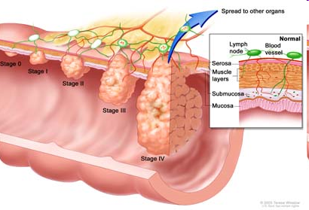

Slide 6
Adjuvant Chemo in Stage III

Slide 7
Adjuvant 5FU improves outcomes in SIII
Adjuvant therapy for colon cancer reduces risk of disease recurrence and death^{1–3}
  5-FU-based chemotherapy is superior to observation alone^{3,4}
Best arm always contained leucovorin^{5,6}
  LV forms stable complex with TS, thus permits prolonged inhibition of this enzyme by 5-FU
No advantage with 12 versus 6 months’ therapy^{3,7}
Roswell Park is less toxic cw Mayo (esp diarrhoea)
  No trial compared deGramont infusional protocol with Roswell Park
6 months’ bolus 5-FU/LV became standard of care^{1–9}
¹Buyse M et al. JAMA 1988;259:3571–8; ²Laurie JA et al. J Clin Oncol. 1989;7:1447–56
³Moertel CG et al. Ann Intern Med 1995;122:321–6; ⁴O’Connell MJ et al. N Engl J Med 1994;331:502–7
⁵Wolmark N et al. J Clin Oncol 1999;17:3553–59
⁶Haller DG et al. Proc Am Soc Clin Oncol 1998;17:256a (Abst 982)
⁷Porschen R et al. J Clin Oncol 2001;19:1787–94; ⁸IMPACT. Lancet 1995;345:939–44
⁹QUASAR Collaborative Group. Lancet. 2000;355:1588–96
Notes:
Clinical trials have demonstrated that 5-FU-based adjuvant chemotherapy improves outcomes for patients with resected colon cancer compared with surgery alone.
Adjuvant chemotherapy reduces the risk of both disease recurrence and death [1–3].
5-FU-based chemotherapy is superior to observation alone: in one trial 5-FU plus levamisole reduced recurrence rate by 40% (p<0.0001) and the death rate by 33% (p=0.0007), whereas levamisole alone reduced recurrence by only 2% and death by only 6% [3]. The first trial to establish Mayo Clinic regimen over observation only was the INT0085 study [4]. This trial showed improvements at 5 years in both relapse-free survival (RFS) (16% absolute difference, p=0.004) and overall survival (11% absolute difference, p=0.02) with addition of 5-FU/LV to curative resection.
A series of further trials (including thousands of patients) led to the conclusions that
the best arm always contained leucovorin (LV) [5,6]
12 months’ treatment is no more effective than 6 months’ therapy; a survival benefit with 12-months’ 5-FU/LV has not been demonstrated [3,7].
As a result of this large body of evidence, 6-months’ treatment with 5-FU/LV became the standard of care for the adjuvant treatment of colon cancer [1–9].
1. Buyse M et al. JAMA 1988;259:3571–8.
2. Laurie JA et al. J Clin Oncol 1989;7:1447–56.
3. Moertel CG et al. Ann Intern Med 1995;122:321–6.
4. O’Connell MJ et al. J Clin Oncol 1997;15:246–50.
5. Wolmark N et al. J Clin Oncol 1999;17:3553–59.
6. Haller DG et al. Proc Am Soc Clin Oncol 1998;17:256a (Abst 982).
7. Porschen R et al. J Clin Oncol 2001;19:1787–94.
8. IMPACT. Lancet 1995;345:939–44.
9. QUASAR Collaborative Group. Lancet 2000;355:1588–96.
1988 NSABP C01- Wolmark: MOF superior to observation or BCG
1993 NSABP C03 – Wolmark: 5FU/high dose LV better than MOF
1994 NCCTG O’Connell: Mayo 5FU/low dose LV better than observation
1995 NCCTG Moertel: 5FU/Levamisole v placebo
1995 IMPACT Zaniboni: 5FU/high dose LV vs observation. 22% RRR
1998 INT0089 Haller: 6 mths as good as 12 mths, low dose LV as good as HD LV
1999 NSABP-C04 Wolmark: Leucovorin arm better than Levamisole
2001: adjCCA-01 Porschen: Leucovorin arms are better levamisole

Slide 8
Roswell Park efficacy equivalent to Mayo Clinic regimen in stage III
Regimen | n | 3-year DFS* | 5-year DFS | p value | 5-year OS | p value
Mayo Clinic | 741 | 63 | 55 | 0.78 | 59 | 0.61
Roswell Park | 769 | 63 | 55 |  | 59
*Stage III only, derived from KM curves
Haller et al JCO 2005

Slide 9
MOSAIC trial design
12 cycles of
FOLFOX4
n=2 246
Stage II / III plus
complete resection of
1º tumor
18–75 years
ECOG PS ≤2
12 cycles of
LV5FU2
Endpoints
  primary: disease-free survival (DFS)
  secondary: safety and overall survival (OS)
André T et al. N Engl J Med 2004;350:2343–51
Notes:
In the first-line treatment of metastatic colorectal cancer (MCRC), addition of oxaliplatin to 5-FU/LV improves response rates and time to disease progression (TTP) compared with 5-FU/LV [1,2]. In a similar setting, oxaliplatin plus infused 5-FU/LV (FOLFOX) provides a survival benefit compared with bolus 5-FU/LV plus irinotecan (IFL regimen) [3].
These data provided the rationale for evaluating FOLFOX as adjuvant treatment for colon cancer.
The large international MOSAIC trial evaluated the following regimens as adjuvant treatment for patients with stage II or III colon cancer [4]:
12 cycles of FOLFOX4 (oxaliplatin 85mg/m2 day 1, leucovorin 200mg/m2 plus i.v. bolus 5-FU 400mg/m2 and a continuous 22-hour infusion of 5-FU 600mg/m2 on day 1 and 2 every two weeks) original deGramont protocol
versus 12 cycles of LV5FU2 (leucovorin 200mg/m2 plus i.v. bolus 5-FU 400mg/m2 and a continuous 22-hour infusion of 5-FU 600mg/m2 on day 1 and 2 every two weeks).
The primary endpoint was disease-free survival. Secondary endpoints included evaluation of safety and overall survival.
1. de Gramont A et al. J Clin Oncol 2000;18:2938–47.
2. Giacchetti S et al. J Clin Oncol 2003;18:136–47, 2000.
3. Goldberg RM et al. J Clin Oncol 2004; 22:23–30.
4. de Gramont A et al. Proc Am Soc Clin Oncol 2003;22:253 (Abst 1015).

Slide 10
MOSAIC: Stage II + III
Disease-free Survival
1.0
0.9
0.8
6.6%
0.7
0.6
Events
FOLFOX4 279/1123 (24.8%)
LV5FU2 345/1123 (30.7%)
HR [95% CI]: 0.77 [0.65 – 0.90]
0.5
DFS probability
0.4
0.3
0.2
0.1
0.0
0
6
12
18
24
30
36
42
48
54
60
66
Data cut-off: January 16, 2005
Months

Slide 11
MOSAIC: Disease-free Survival
Stage II and Stage III Patients
1.0
0.9
3.5%
0.8
0.7
8.6%
0.6
0.5
DFS probability
FOLFOX4 – Stage II
LV5FU2 – Stage II
FOLFOX4 – Stage III
LV5FU2 – Stage III
0.4
0.3
HR [95% CI]:
0.82 [0.60 – 1.13] Stage II
0.75 [0.62 – 0.89] Stage III
0.2
0.1
0.0
0
6
12
18
24
30
36
42
48
54
60
66
Data cut-off: January 16, 2005
Months

Slide 12
Disease-free Survival in
Stage III Patients: N1 & N2
1.0
0.9
0.8
0.7
7.2%
0.6
0.5
11.5%
DFS probability
0.4
FOLFOX4 – N1
LV5FU2 – N1
FOLFOX4 – N2
LV5FU2 – N2
0.3
HR: 0.76
0.2
HR: 0.72
0.1
0.0
0
6
12
18
24
30
36
42
48
54
60
66
Data cut-off: January 16, 2005
Months

Slide 13
MOSAIC: Overall Survival
1.0
0.9
0.8
2.1%
0.7
0.6
FOLFOX4
LV5FU2
HR [95% CI]: 0.91 [0.75 – 1.11]
0.5
OS probability
0.4
0.3
0.2
0.1
Difference is 3.2% for stage 3, HR = 0.88
0.0
0
6
12
18
24
30
36
42
48
54
60
66
Data cut-off: January 16, 2005
Months
Notes:
Oxaliplatin is the only platinum with activity in CRC

Slide 14
Residual sensory neuropathy ( all grades) with FOLFOX over time
Patients (%)
No. at risk 1106 1092 1058 1018 967
Notes:
The major dose-limiting toxicity of oxaliplatin is a cumulative sensory neurotoxicity, similar to that observed with other platin compounds. With prolonged treatment, patients may experience superficial and deep sensory loss, sensory ataxia, and functional impairment.
Follow up in the MOSAIC trial has confirmed that the oxaliplatin-induced neuropathy is largely reversible [1]. However, at 1 year follow up, 30% of patients were still experiencing paresthesias.
Therefore, the improved outcomes with FOLFOX are afforded at a cost of long-term neuropathy and functional impairment in approximately one-third of patients.
When offering adjuvant treatment to patients, it must be considered whether the risk of long-term paresthesias can be justified.
1. André T et al. N Engl J Med 2004;350:2343–51.

Slide 15
NSABP C-07 Trial (FLOX vs. FULV)
FU
B
Rest
500
LV
500
2hr
R
x3
FU
500
Rest
LV
500
OHP
85
2hr
Week 1 2 3 4 5 6 7 8
Yothers G et al. JCO 2011;29(28):3768
Notes:
2407 pts with stage 2 (29%) and 3 disease.
RPMI 3 cycles vs RPMI with Ox 85mg/m1 in W1,3,5

Slide 16
NSABP C-07 Trial (FLOX vs. FULV)
3 year Disease-Free Survival
Ev # 3yr DFS
FLOX 272 76.5%
FULV 332 71.6%
p < 0.004
HR: 0.79 [0.67 – 0.93]
21 % risk reduction

Slide 17
Gr 3 Neurotoxicity (%)

Slide 18
NSABP C-07: 5-yr followup
Improved DFS 69% vs 64%
No difference in OS 80% vs 78%
Toxic:
  1.2% deaths in both arms
  5 deaths in FLOX grp due to enteropathy
  Increased diarrhoea, vomiting and neuropathy
FLOX is more toxic and inferior c/w FOLFOX4 consistent with TREE result in the metastatic setting.

Slide 19
?Optimal duration of chemo
SCOT: 3m vs 6m FOLFOX
Current trial looking at possibility of shortening duration of chemotherapy to 3 m to minimise neurotox

Slide 20
CALGB 89803: IFL as adjuvant treatment for stage III colon cancer
5-FU/LV (Roswell Park regimen)
(32 weeks)
Stage III resected
CRC
(n=1264)
IFL
Irinotecan 125mg/m²
LV 20mg/m², 5-FU 500mg/m²
weekly x 4, every 6 weeks
(30 weeks)
Saltz L et al. J Clin Oncol Proc ASCO 2004;22:14S (Abst 3500)
Notes:
This phase III randomized study evaluated whether IFL was superior to weekly bolus 5-FU/LV (Roswell Park regimen) after curative resection for stage III colon cancer.
Eligible patients had TxN1-2M0 disease and no prior chemotherapy.
Patients received
IFL: irinotecan 125mg/m² (90-minute infusion) followed by leucovorin 20mg/m² i.v. bolus and then 5-FU 500mg/m² i.v. bolus, administered for 4 weeks, followed by a 2-week break, for 5 cycles (30 weeks total)
Roswell Park regimen: leucovorin 500mg/m² i.v. over 2 hours plus 5-FU 500mg/m², 1 hour after the start of leucovorin, administered for 6 weeks, followed by a 2-week break, for 4 cycles (32 weeks total).
A total of 1264 patients were randomized between April, 1999 and April, 2001.
Saltz L et al. J Clin Oncol Proc ASCO 2004;22:14S (Abst 3500).

Slide 21
CALGB 89803: DFS not improved with
IFL in stage III colon cancer
Proportion disease free
1.0
0.8
0.6
0.4
0.2
0.0
5-FU/LV (Roswell Park regimen)
IFL
p=0.80
0 12 24 36 48 60
Months
Saltz L et al. J Clin Oncol Proc ASCO 2004;22:14S (Abst 3500)
Notes:
Median follow up is 2.6 years, and 67% of total expected deaths and 85% of total expected failures have occurred.
IFL shows no improvement over 5-FU/LV in terms of either overall survival (p=0.88) or DFS (p=0.84); futility boundaries for both of these endpoints have been exceeded
so far 18 deaths have occurred on the IFL arm during treatment versus 6 deaths on the 5-FU/LV arm (p=0.008).
In stage III colon cancer, IFL, as compared to 5-FU/LV, is associated with a greater degree of neutropenia, neutropenic fever, and death on treatment, with no associated clinical benefit.
Weekly bolus IFL should therefore not be used in the management of stage III colon cancer.
Saltz L et al. J Clin Oncol Proc ASCO 2004;22:14S (Abst 3500).

Slide 22
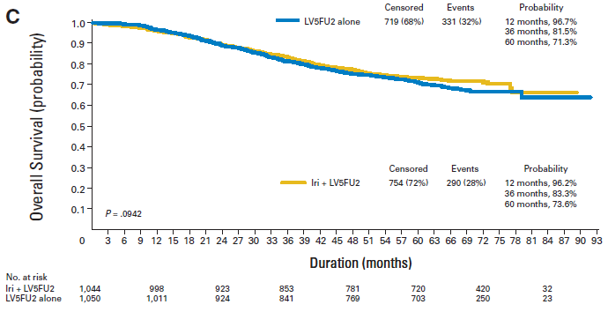
PETACC-3
PETACC 3
Notes:
3278 pts (stage II and III)
FOLFIRI (Iri 180mg/m2 D1) vs infusional 5FU degramont
No improvement of DFS or OS at 5 yrs

Slide 23
X-ACT trial in adjuvant treatment of Dukes’ C colon cancer
Capecitabine
1 250mg/m² twice daily,
d1–14, q21d
n = 1 004
Recruitment
1998–2001
Chemo-naïve
Dukes’ C,
resection ≤8 weeks
1° endpoint: disease-free survival (DFS)
2° endpoints
  relapse-free survival (RFS)
  overall survival
  tolerability (NCIC CTG)
  pharmacoeconomics
  QoL
24 weeks
Bolus 5-FU/LV
5-FU 425mg/m² plus
LV 20mg/m², d1–5, q28d
n = 983
NEJM 2005;352:2696-704
Notes:
X-ACT designed to show equivalence of Cape vs 5U.
Capecitabine is firmly established as first-line treatment for MCRC
Can it replace 5-FU in the adjuvant setting?
Potential benefits
convenient oral therapy
improved tolerability
cost savings
X-ACT trial

Slide 24
Primary endpoint met and trend to superior DFS (ITT)
1.0
0.8
0.6
0.4
3-year
Capecitabine (n=1 004) 64.2%
5-FU/LV (n=983) 60.6%
Confirmed by per protocol analysis, HR 0.89 (95% CI 0.76-1.04)
HR = 0.87 (95% CI: 0.75–1.00)
p=0.0528
Estimated probability
0 1 2 3 4 5 6
Years

Slide 25
Superior relapse-free survival (ITT)
1.0
0.8
0.6
0.4
3-year
Capecitabine (n=1 004) 65.5%
5-FU/LV (n=983) 61.9%
HR = 0.86 (95% CI: 0.74–0.99)
p=0.0407
Estimated probability
0 1 2 3 4 5 6
Years

Slide 26
Trend to improved overall survival (ITT)
1.0
0.8
0.6
0.4
3-year
Capecitabine (n=1 004) 81.3%
5-FU/LV (n=983) 77.6%
Estimated probability
HR = 0.84 (95% CI: 0.69–1.01)
p=0.0706
0 1 2 3 4 5 6
Years

Slide 27
Improved safety profile versus bolus 5-FU/LV (all grades)
Patients (%)
Treatment-related AEs
100
80
60
40
20
0
Capecitabine (n=993)
Bolus 5-FU/LV (n=974)
*
*
*
*
*
*
Diarrhea Stomatitis Hand-foot Neutropenia† Nausea/ Alopecia syndrome vomiting
*p<0.001
†Laboratory value
Scheithauer W et al. Ann Oncol 2003;14:1735–43

Slide 28
Capecitabine: less patient hours wasted travelling to, waiting for, and receiving treatment
Mean number of hours
per patient
125
100
75
50
25
0
Xeloda (n=995)
5-FU/LV (n=974)
AE treatment Drug administration Total
McKendrick JJ et al. Proc Am Soc Clin Oncol 2004;23:265 (Abst 3578; poster update)
Notes:
Time spent receiving chemotherapy is reduced for patients receiving Xeloda [1].
Patients’ time is a scarce resource
treatment requiring less patient time is preferred, when all other factors are equal.
Time costs include:
travel time to/from clinic
waiting time
time seeing the physician/receiving treatment.
Assumed that the typical time for:
an adverse event treatment = 1.5 hours
a Xeloda study visit = 2 hours (30 minutes with physician)
a 5-FU/LV infusion = 4 hours (including 2.5 hours receiving infusion).
Replacement of 5-FU/LV with Xeloda reduces the time each patient spends travelling to, waiting for and receiving chemotherapy by at least 100 hours [1].
1. McKendrick JJ et al. Proc Am Soc Clin Oncol 2004;23:265 (Abst 3578; poster update).

Slide 29
Capecitabine combinations: a new era in adjuvant treatment
XELOXA (NO16968) trial: CAPOX vs 5FU/LV in S3 CRC.
  7-yr DFS 63% vs 56%
  7-yr OS 73% vs 67%
  Less neutropenia stomatitis or alopecia but more neurotoxicity, HFS, thrombocytopenia, diarhoea
Schmoll HJ JCO 2012;30(suppl4):abst388

Slide 30
Targeted therapies: adjuvant Bevacizumab

Slide 31
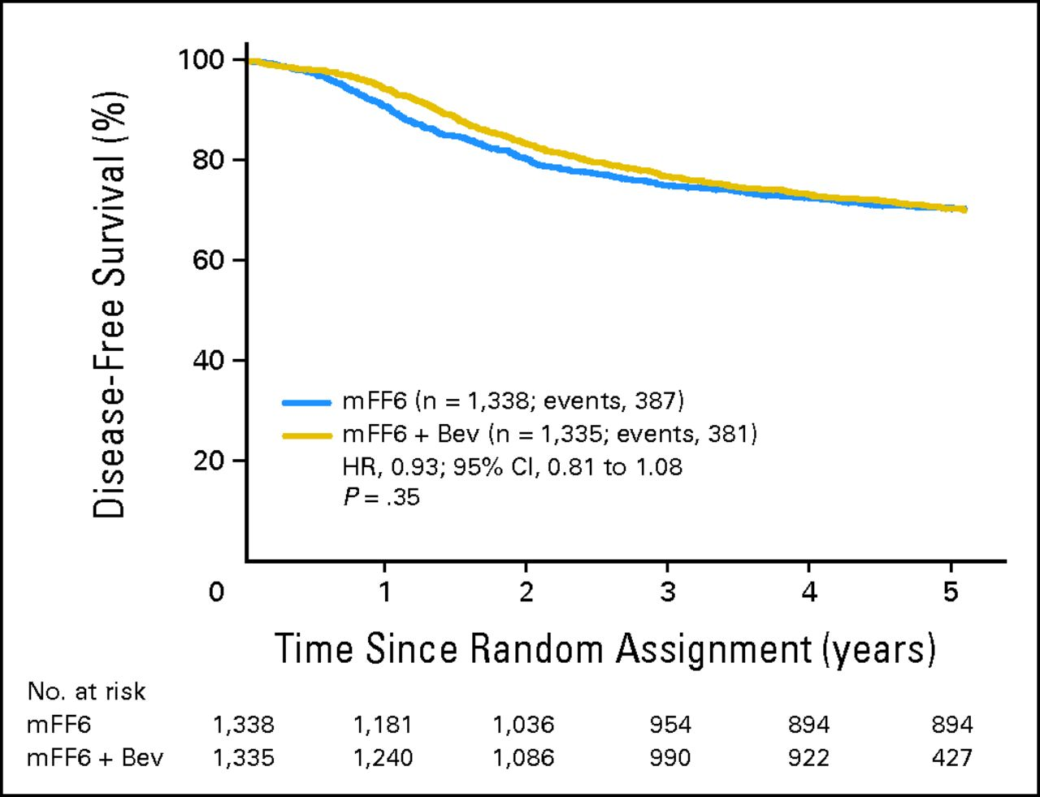
NSABP C-08 DFS
Allegra CJ et al. JCO 2013;31(3):359
Notes:
2672 pts with S2 (25%) and 3 CRC
Primary endpoint – DFS
mFOLFOX6 vs mFOLFOX6+Bev. Bevacizumab given for 12 months
Median follow-up 36 months
HR (FF6+B vs. mFF6) – 0.89 (0.76-1.04) p=0.15
No significant prolongation in DFS
Indication that Bev decreased DFS during its administration (ie in the first year)

Slide 32
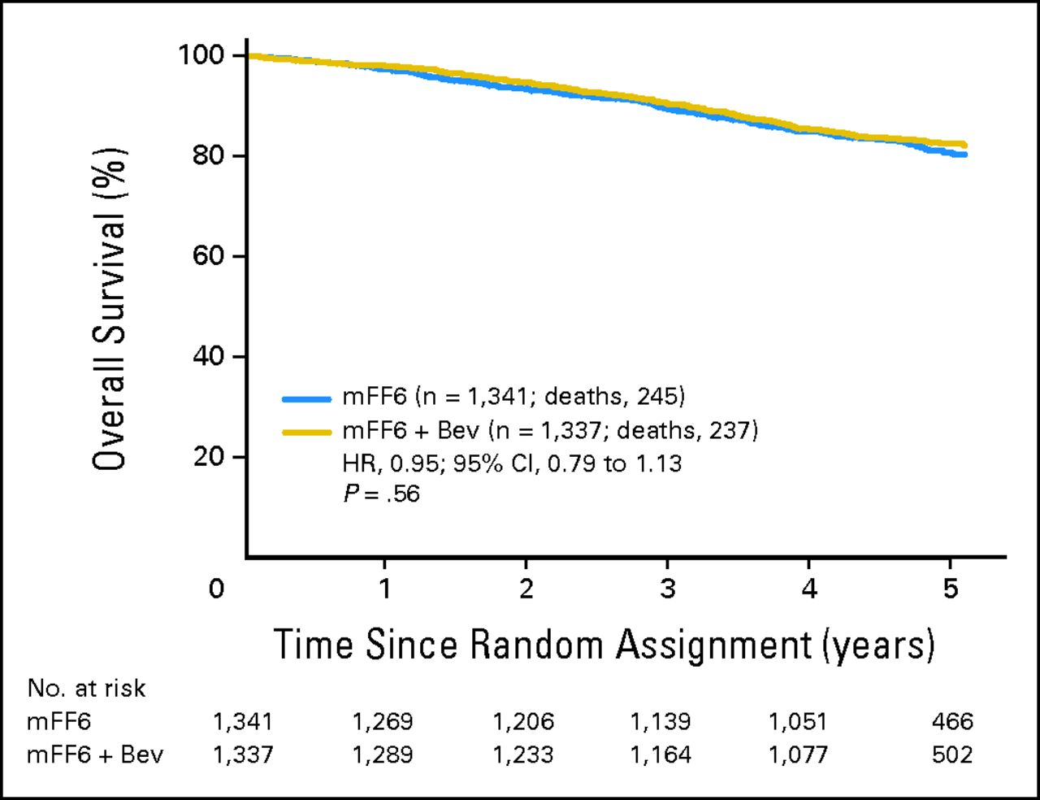
NSABP C-08 OS
Notes:
Overall survival for all patients treated with modified fluorouracil, leucovorin, and oxaliplatin (mFF6) alone for 6 months or mFF6 for 6 months plus bevacizumab for 12 months, (mFF6 + Bev). HR, hazard ratio.

Slide 33
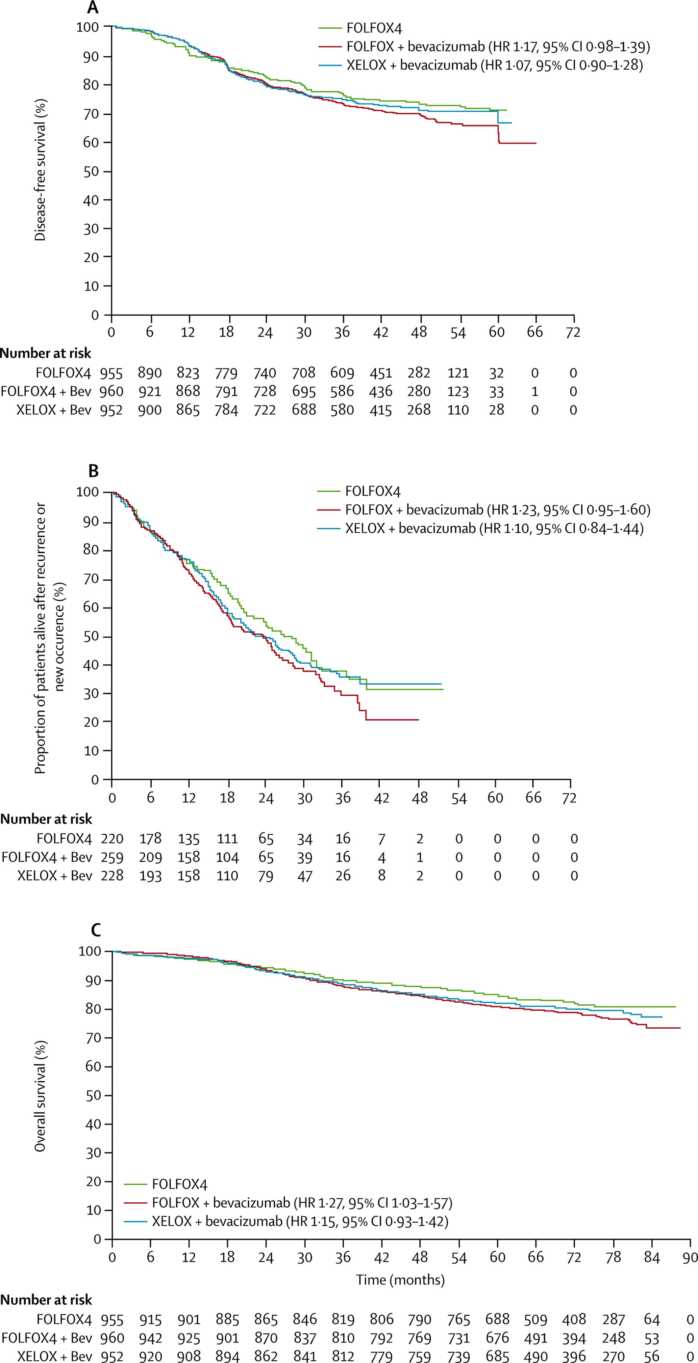
AVANT DFS
De Gramont A et al. Lancet Oncol 2012;13(12):1225
Notes:
European trial of FOLFOX4 v FOLFOX4/Bev vs XELOX/Bev
3451 High risk S2 or S3 pts

Slide 34
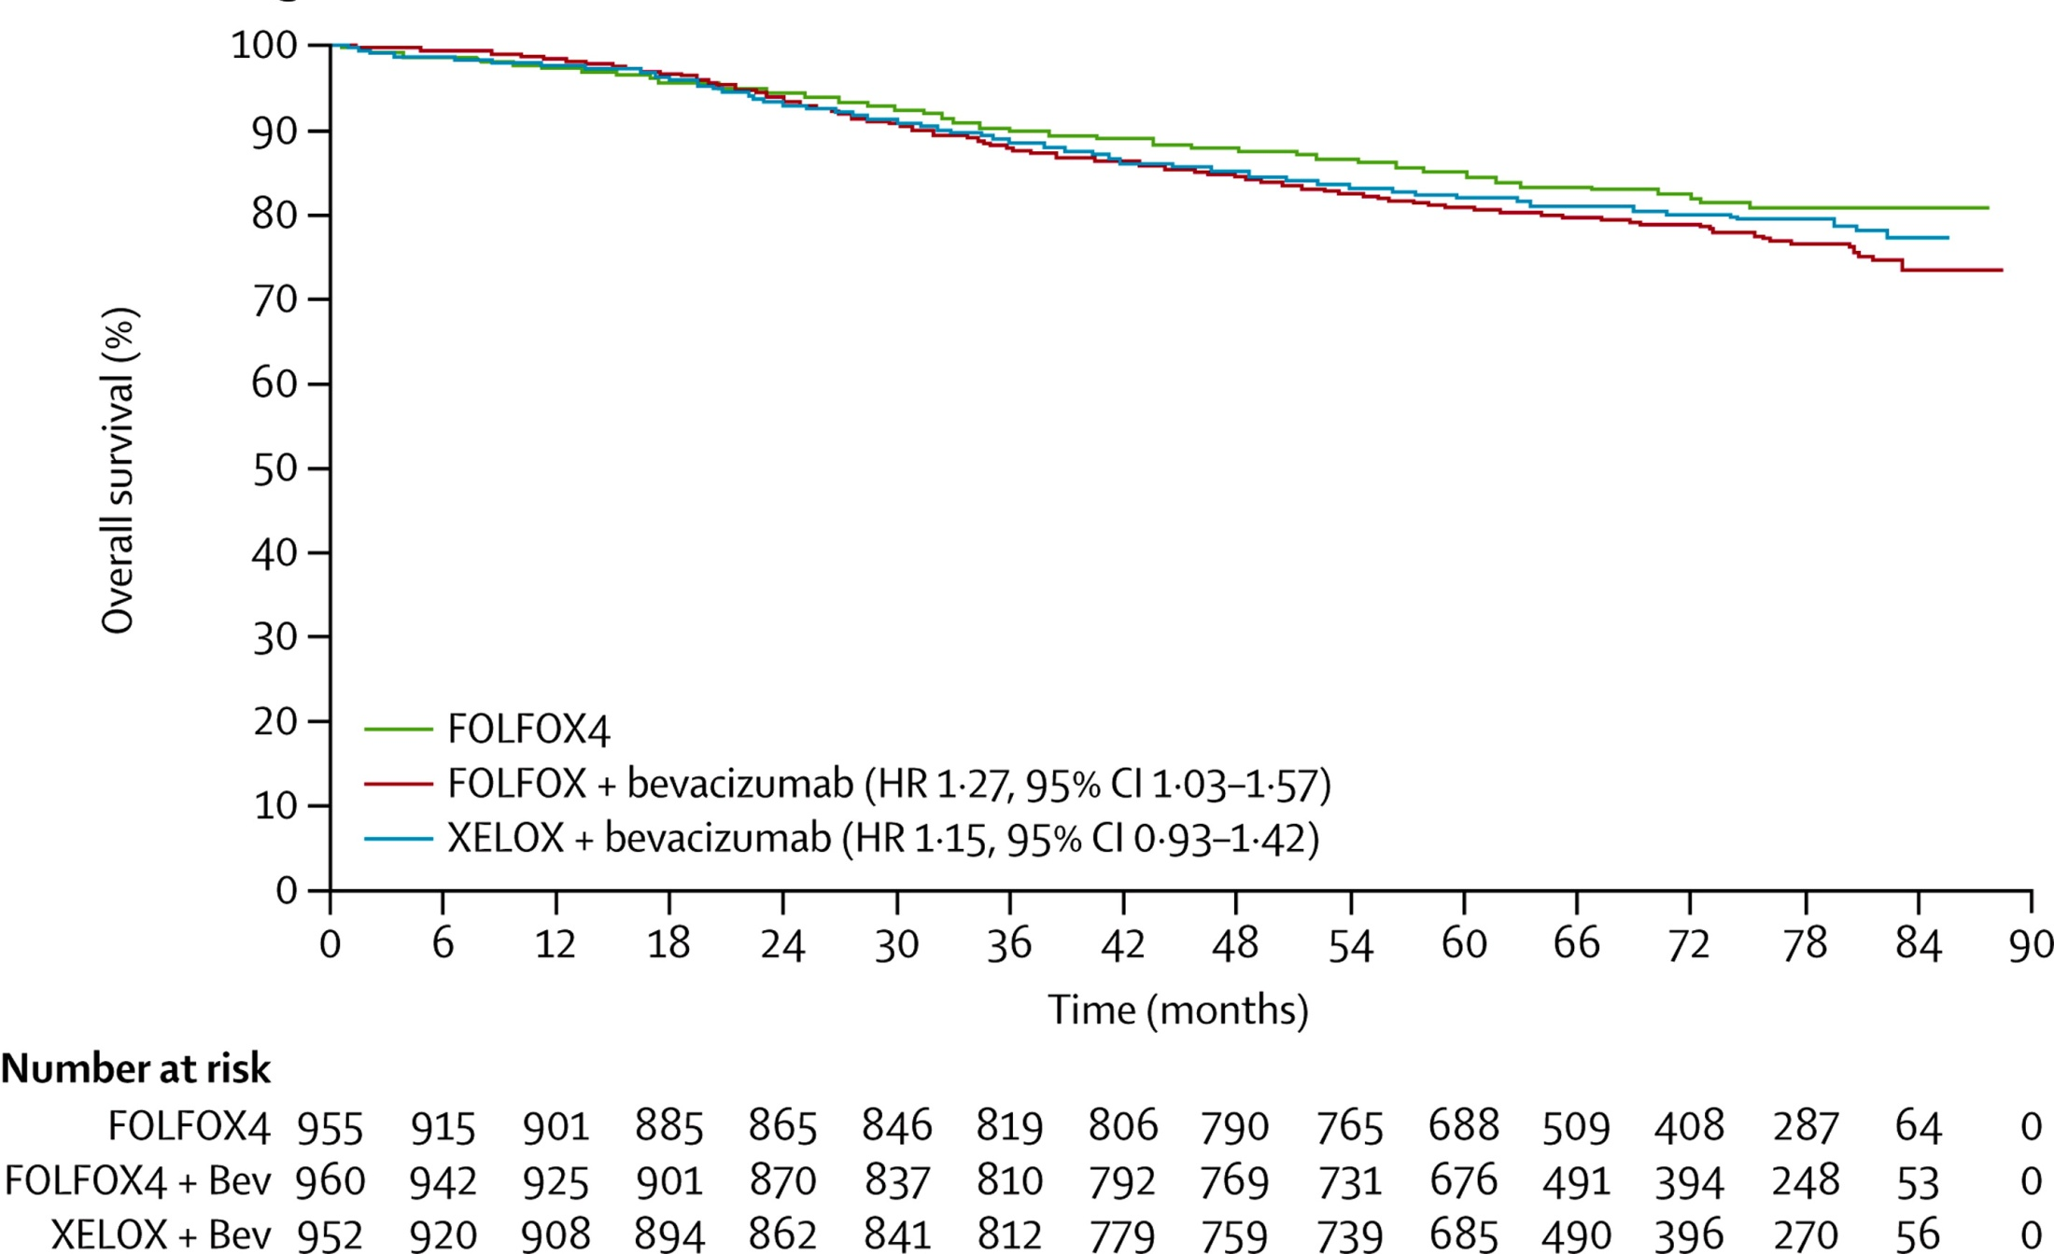
AVANT OS

Slide 35
No Benefit with Cetuximab
N0147 trial: 1760 k-ras wt and 658 k-ras mt pts with SIII CRC.
  no benefit in adding Cetux to FOLFOX
PETACC8: similar futility

Slide 36
Benefit of chemo in Stage II patients
Multiple trials of 5FU based chemo in pts with both SII and III disease have shown DFS and OS benefit in the combined population
  However, significant benefit were seen only in SIII
  Most subgrp analysis of pts with SII showed better DFS and trend towards better OS favouring chemo

Slide 37
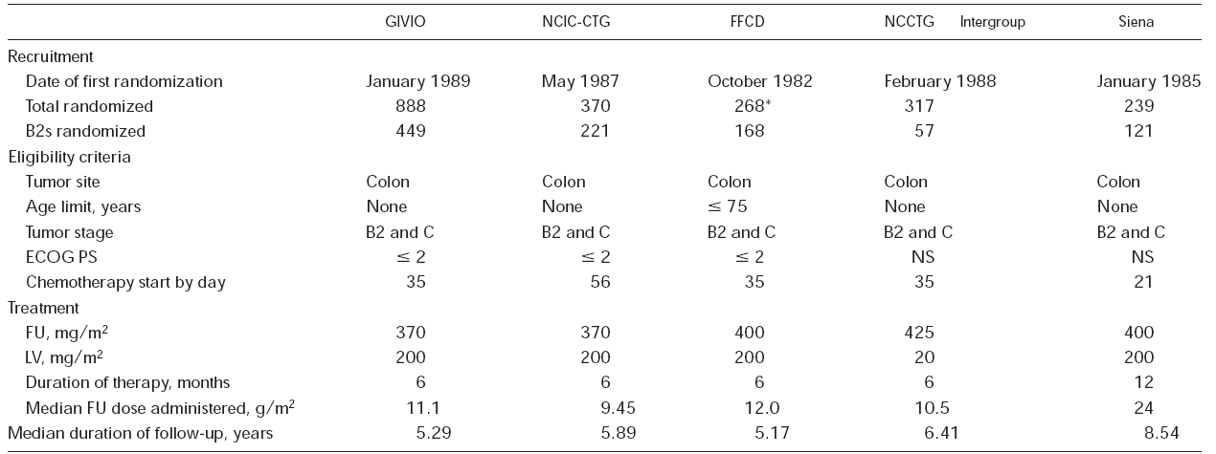
IMPACT B2 pooled analysis of 1016 pts from 5 trials
-5FU/LV vs Observation
Erlichman C. JCO;1999:1356-1363

Slide 38
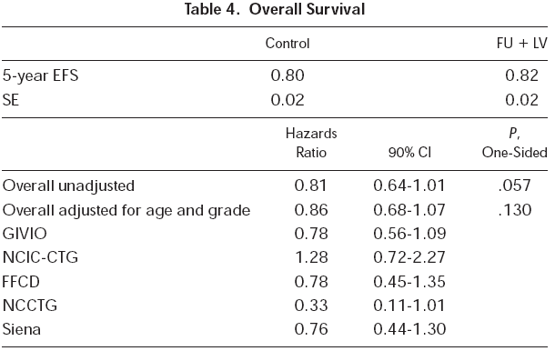
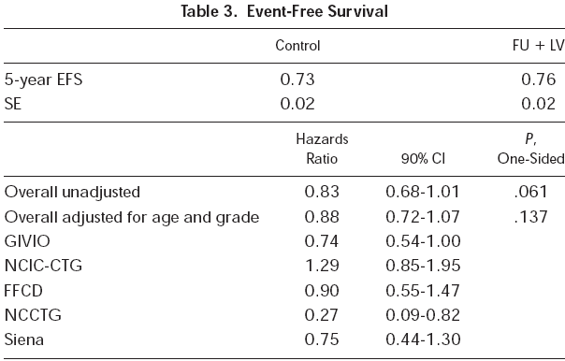
IMPACT B2: Results
3% improvement in EFS, 2% improvement in OS (NS)

Slide 39
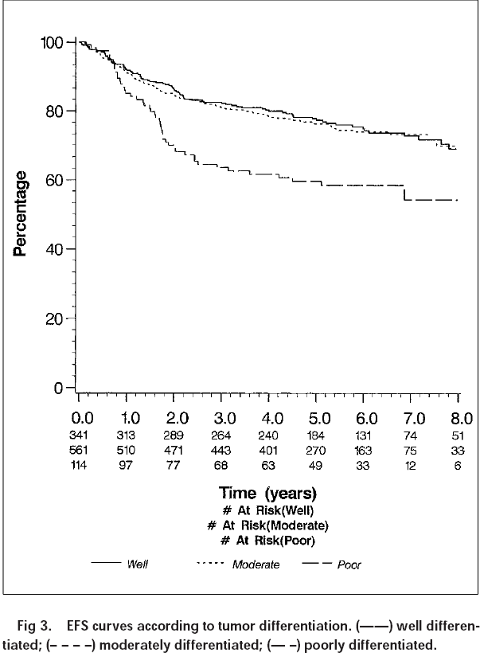
IMPACT B2: effect of tumour differentiation

Slide 40
QUASAR1: largest trial investigating adjuvant 5-FU/LV in stage II colon cancer
3 239 patients randomized to adjuvant 5FU based chemo or observation after surgery
  pragmatic design: pts enrolled based on ‘clear or uncertain indication for adjuvant chemo‘
  no centralised path review
  some had rectal cancer (29%) and hence adjuvant radiotherapy
  stage I (0.5%) or III disease (8%)
  Varying schedules: Mayo 47% RP 57%, high dose and low dose FA allowed
Gray RG et al. Lancet 2007:370;2020-2029

Slide 41
QUASAR1: Results at median 5.5 yr followup
Overall, adjuvant 5-FU significantly improved
  OS RR 0.82, p:0.008
  recurrence rate HR 0.78, p:0.001
In Stage II colon ca, adjuvant 5FU showed marginal improvement in:
  OS HR 0.86 (CI:0.66-1.12)
  RR HR 0.82 (CI:0.63-1.08)
  Assuming 5-yr mortality from CRC is 20%, Relative RR is 18% and absolute RR is 3.6%
No difference in benefit by tumour site, stage, sex, age, schedule
  Reduction in recurrence only apparent in first 2 yrs from randomisation.

Slide 42
Intergroup study
Pooled analysis of 3302 pts with SII and III CRC from 7 RCT comparing 5FU/LV or LVM to surgery alone.
30% RRR in recurrence and 26% RRR in death in overall study population
For stage II, significant improvement in 5-yr DFS (76% v 72%) but no significant improvement in OS (81% v 76%)
Gill S et al. JCO 2004;22(10):1797

Slide 43
Ontario grp analysis
Systematic review of 37 trials and 11 metaanalysis
4187 pts from a subset of 12 trials with SII CRC
5FU arm vs surgery alone
Improved DFS 5-10%
No statistically significant improvement in OS.
ASCO 2004 recommendations:
  Routine use of adjuvant chemo in medically fit pts with SII disease is NOT recommended.
  consider adjuvant chemo in pts with inadequately sampled nodes, perforation or poorly differentiated histology
Benson AB. JCO;200422(16):3408

Slide 44
Benefit of Oxaliplatin in SII
MOSAIC: FOLFOX4 vs 5FU
  Non-significant improvement in 5-yr DFS (84% v 80%) and identical 5-yr OS (87%)
  Greater benefit shown in high-risk stage II (7% DFS, 2% OS) but number was too small to be statistically significant.
NSABP C-07: FLOX vs 5FU/LV
  4-yr DFS 84% vs 81% (not significant)
Above trials do not use surgery alone arm as control.
Tournigand C et al. JCO 2012;30(27):3353
Kuebler JP et al. JCO 2007;25(16):2198
Notes:
T4, perf, obs, <10nodes, poorly differentiated

Slide 45
NCCN Guidelines
Discuss options of chemotherapy with patients who have high-risk characteristics, taking into acc comorbidities and anticipated life expectancy
  Poorly differentiated histology (excluding hose with MSI-H,
  lymphovascular invasion,
  bowel obstruction,
  Localised perforation
  Perineural invasion,
  Indeterminate or positive margin
  Inadequate lymph nodes sampled (<12)
Benefit does not exceed >5%.
MMR testing in pts <50 and/or stage 2 disease
FOLFOX is a reasonable option for intermediate to high risk stage II, but no survival advantage had been demonstrated for the addition of Ox esp in pts >70

Slide 46
Need for Better Risk stratification in SII
Strongest evidence for ‘High-risk criterias’ in NCCN guidelines came from CALGB 9581 long term follow-up data over a median of 7.9 years¹
No robust RCT evidence to show high-risk SII benefit from chemo eg SEER and US intergrp subgrp analyses were negative
High-risk features were prognostic but not predictive
Need better tools to stratify risk of recurrence in stage II disease and predict sensitivity to chemo:
  FOXO3, TS overexp, B-RAF, kRAS, Oncotype-Dx, ColoPrint
  Deficient MMR tumours (do not benefit from 5FU)
  NONE has predictive utilities
1) Niedzwiecki D et al. JCO 2011;29(33):3146
Notes:
dMMR prevalence in S2 is ~20% characteristically proximal tumour with mucinous histo/Tumour infil lymph. Better prognosis. IHC is rapid way of screen cw PCR testing for MSI that takes 6 weeks.

Slide 47
Adjunctive Therapy: Aspirin Benefit from Nurses’ Health Study and Health Professionals F/U studies
COX-2 is overexpressed in 80-85% of CRCs and is inhibited by aspirin¹
  Post-cancer aspirin use CRC-specific death rate 15% vs non-users 19% HR 0.71
  Benefit even more pronounced in pts who were not taking aspirin prior to cancer Dx. HR 0.53
  Expression of COX-2 was a/w benefit from aspirin
PIK3CA²
  Post-cancer aspirin use in pts whose tumour harboured PIK3CA mutations was associated with marked reduction in CRC-specific death. HR 0.18
BRAF³
  Aspirin users have lower risk of BRAFwt tumours. HR0.73
  Tumours have lower expression of PTGS2
  Association independent of PIK3CA, kRAS status
Above data are observational. Routine PIK3CA testing to guide aspirin use post-cancer is not prime-time.
1) Chan AT et al. JAMA 2009;302(6):649
2) Liao X et al. NEJM 2012;367(17):1596
3) Nishihara T et al. JAMA 2013;309(24):2563
Notes:
1279 Participants were enrolled in 2 cohorts in 1980 and 1986 prior to the diagnosis of cancer and followed up for median of 11.8 yrs
964 pts. Hypothesis: aspirin downregulation of PIK3CA via PTGS2 signalling results in different outcomes.

Slide 48
Summary
Adjuvant chemotherapy should be encouraged for stage III patients with FOLFOX. Capecitabine is equivalent to infusional 5FU.
High risk stage II patients should be considered carefully w/ 5FU based regimens showing some benefit , and capecitabine an appropriate substitute
Incorporation of biologics do not add additional benefit
Aspirin as adjunctive therapy is not ready for prime-time

