Slide 1
CUP Carcinoma of unknown primary

Slide 2
Case 1
60 year old female px to hospital for an angiogram of the lower limb of intermittent claudication likely PVD.
PMHx:
Hypertension
Hypercholesterolemia
Likely COPD- no formal diagnosis
Social Hx:
Retired personal care attendant.
Longstanding smoker, still smoking
approximately 40pack years .
ECOG 1.

Slide 3
Progress
Angiogram complicated by a retroperitoneal bleed
CT abdo:
multiple liver lesions and lung nodules
Staging:
Wide spread bone liver metastasis
Multiple pulmonary nodules through both lungs with the largest in the right lung measuring 20 mm.
CT-guided core biopsy of liver lesion
highly suspicious of malignancy non diagnostic.
Referred to oncology:
History obtained of headache for many months very persistent and often worse on lying flat and in the mornings.
CT brain.
>23 metastases
Mx?

Slide 4
Case 2
47 year old female px with severe back pain on b/g of months of being generally unwell n/v/ anorexia with 6 KG of weight loss over 2/12
Nil other sx
PMHX:
HT
Obesity
Social:
Married with 3 children
Occasional ETOH
Non-smoker
Father died of Lung Cancer 70’s(Smoker)

Slide 5
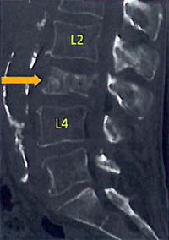
X-ray unremarkable

Slide 6
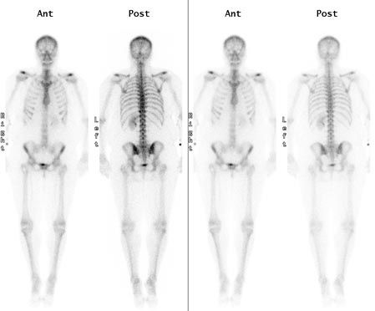
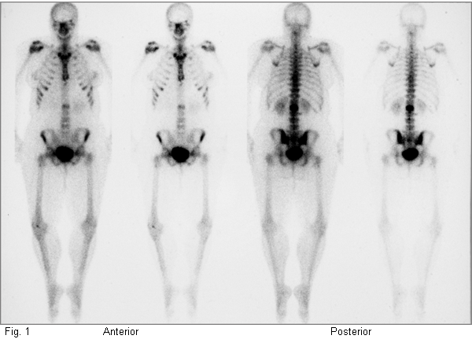
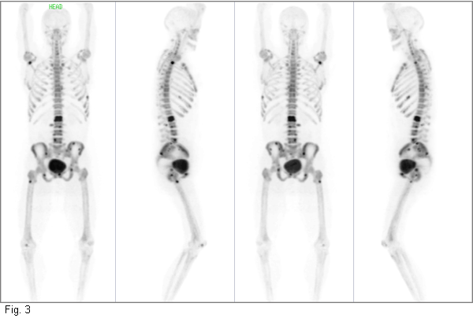

Slide 7
Case 2
Staging CT C/A/P:
intra-abdominal lymphadenopathy and metastasis to bone, liver
Nil primary seen
Pet Scan:
Wide spread metastatic disease including lung liver and bone , nil primary seen
Biopsy liver: Adenocarcinoma Ck 7-, CK20+
Mx?

Slide 8
Case 3

Slide 9
Metastases
What are they?
Cancer cells that leave the original tumor site and migrate to other parts of the body
Migrate to other parts of the body via
bloodstream
lymphatic system
direct extension

Slide 10
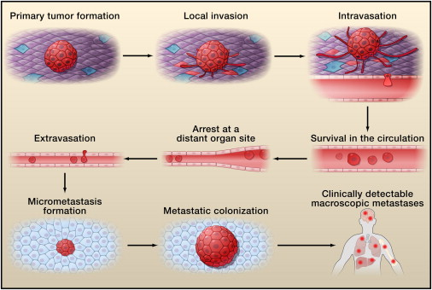
The development of metastases¹
1- Hanahan et al 2011

Slide 12
? Why do cancers go to specific sites
? arrest within capillary beds due to the layout of the vasculature and size restrictions imposed by blood vessel diameters
? actively home to specific organs via genetically pre-determined interactions b/w cancer cells and the luminal walls of the microvasculature
Unknown

Slide 13
Cancer of unknown primary site (CUP)
Histologically proven metastatic tumours whose primary site cannot be identified during pretreatment evlaution⁴
4- 5 % of all invasive cancers⁵
8th most common cancer in men
9th most common in women
Sx:
Usually from the metastatic disease
Early dissemination, unpredictable, aggressive
LN only mets median survival 6-9 months
Extranodal median survival 2 months
4- NCCN guidelines 5- Hainworth et al 2013

Slide 14
CUP
Adeno CA
70% CUPs.
2/3 primary lung, pancreas, hepatobiliary tree and kidney
Px mets to liver, lungs, lymph nodes, and/or bones.
SCC
5 % CUPs
Classic sites of SCC
Px lymphadenopathy
Changing face of head and neck SCC
Poorly Differentiated
20- 25 % CUP
Cannot distinguish between a carcinoma, sarcoma, melanoma or haematologic malignancy based upon light microscopy
Very important to keep testing

Slide 15
CUP
Neuroendrocrine
1 % CUP
Low-grade neuroendocrine carcinoma
liver metastases.
High-grade neuroendocrine carcinoma
metastases in multiple sites
5 major subtypes
Well- moderately differenced adeno
Poorly differentiated adeno/ Undifferentiated adeno / undifferentiated carcinoma
SCC
Poorly differentiated malignant neoplasms
Neuroendoricne
Multiple chromosomal abnormalities and overexpression genes
EGFR,CKIT, PDGR,RAS,BCL2,Her2
Targets for the future

Slide 16
Favorable Prognosis
Papillary adenocarcinoma of the peritoneal cavity in women
Poorly differentiated carcinoma with a midline distribution
Poorly differentiated neuroendocrine carcinomas
Adenocarcinoma involving only the axillary LN women
SCC involving cervical lymph nodes
SCC isolated inguinal adenopathy
Blastic bone metastases + elevated PSA men
Single, small, potentially resectable tumour

Slide 17
Poor prognosis
Male
Poor performance status
Adenocarcinoma with multiple sites of mets (liver, lung, bone)
Non-papillary malignant ascites (adenocarcinoma)
Peritoneal metastases
Multiple cerebral mets (adenocarcinoma or SCC)
80%

Slide 18
Workup:
History
Symptoms
Pain
Change in bowel habit
Melena
Cough
PMHX
Hepatitis C
Screening
Pap smears, mammogram
Social Hx
Smoking
Squamous Cell
Lung, Head and neck, Esophagus
Occupation
Asbestosis
Family Hx
Examination
Baseline investigations
Pathology
Imaging
Sites of secondary disease
Pattern of distribution

Slide 19
Classic sites of disease
Tumour | Typical sites of mets
Bladder | Bone, liver, lung
Breast | Bone, brain, liver, lung
Colorectal | Liver, lung, Peritoneum
Kidney | Adrenal , bone, brain, liver, lung
Lung | Adrenal gland, bone, brain, liver, other lung
Melanoma | Bone, brain, liver, lung, skin/muscle
Ovary | Liver, lung, peritoneum
Pancreas | Liver, lung, peritoneum
Prostate | Adrenal gland, bone, liver, lung
Stomach | Liver, lung, peritoneum
Thyroid | Bone, liver, lung
Uterus | Bone, liver, lung, peritoneum, vagina
American Cancer Society Cancer of Unknown Primary [Revised 7/2/14, cited 16/8/14] Available at http://www.cancer.org/cancer/cancerofunknownprimary/detailedguide/cancer-unknown-primary-cancer-of-unknown-primary

Slide 20
CUP Workup ctd
Tumour markers
Generally a guide only
Not alone in diagnosis
Further Imagining
PET
Other
Colonoscopy
Gastroscopy
Biopsy
Adenocarcinoma
Squamous cell carcinoma
Neuroendocrine carcinoma,
well differentiated or poorly differentiated
Mesothelioma
Melanoma
Germ cell tumor
Poorly differentiated tumors
carcinomas
lymphoma
sarcoma
Other
Hormone positive

Slide 21
Immunohistochemistry
Process of detecting specific proteins in biological tissues
Detects antigens by binding antibodies
In CUP
Useful to guide cell-type determination and pathological diagnosis
Good for the characterisation of poorly differentiated or undifferentiated tumours
Not uniformly specific or sensitive
Has not been proven to improve outcomes

Slide 22
Immunohistochemistry
Common Antigens
TTF-1
thyroid and lung
WT1
mesothelioma
S100
melanoma, clear cell sarcoma, glioma
Cytokeratins 7/20
2 most common immunostains used in CUP CK
CK 20
GIT
CK 7
lung, ovary, endometrium, thyroid breast

Slide 24
Molecular profiling
Using gene signatures/ expression profiles to determine likely site of origin
More accurate than IHC in poorly differentiated or undifferentiated carcinoma
Predicts up to 75% of cases in some trials
Multiple GEP assays
Outcome data not yet available GEP
Shouldn't be used routinely yet, but can be considered
Combination IHC and GEP
increase diagnostic accuracy

Slide 25
Treatment

Slide 26
Treatment
Optimum treatment difficult without the identification of the site of origin

Slide 27
Treatment of CUP
1) Treat by Primary site
If a primary site can be identified or is strongly suggested
2) Favorable Prognosis
Tailored treatment approach
Locoregional treatment
Specific chemotherapy
Likely to provide clinical benefit and prolong survival
3) Poor Prognosis
Empiric setting chemo is recommended but benefit is questionable
Combinations platinum + one another cytotoxic agents taxanes, gemcitiabine, irontecan

Slide 28
Best Treatment in poor prognostic groups?

Slide 29
Meta-analysis
Search databases
Ovid MEDLINE, EMBASE, Cochrane
1980- 2011

Slide 30
Inclusion Criteria
Studies on chemotherapy for the unfavorable subset of CUP
First line treatment
Excluded;
Favorable subsets

Slide 31
Methods:
Multiple meta-regression model for testing the significance of the differences b/w platinum and no-platinum; taxane and no taxane;
P1T1, P1T0, P0T1, and P0T0
Pre- defined subgroup analysis
male
histology of moderate- to well differentiated adenocarcinoma
ECOG<2
liver metastasis,
multiple metastatic sites
year of the study

Slide 32
Results
1389 potentially relevant studies, 1281 were excluded
32 of them met all the criteria for inclusion
7 RCTs
1 nonrandomised trial where two treatment arms were evaluated.
1 consecutive case series study
23 studies were single arm clinical trials
66% contained platinums
34% included taxanes
14 studies reported prospective calculation of the study size
1 RCT clear description of the method of allocation concealment
No RCT was blinded

Slide 33
Results
Across all chemotherapy
Median survival 9.0 months (95% CI: 8.1–9.8),
1-year survival rate 35.6% (95% CI: 32.0–39.3),
2- year survival rate 18.6% (95% CI: 15.4–21.7)
Platinum vs non-platinum
Median survival time of 9.4 vs 7.2 months;
1-year survival rate of 36.9% vs 29.6%;
2-year survival rate of 19.7% vs 11.9%
Taxane vs non-taxane
Median survival 9.6 months vs 8.3 months
1-year survival rate 41.3% vs 30.8%
2- year survival rate 21.2% vs 16.4%

Slide 34
Results
Outcome | Regime | Coefficient | P-value
Median survival months | Platinum | .76 (-1.14 to 2.67) | .43
 | Taxane | 1.52(.12-2.92) | .03
 | No Platinum No Taxane | Reference
 | Platinum No Taxane | .78(-1.16-2.72) | .43
 | No Platinum Taxane | 2.58(-1.09-6.26) | .17
 | Platinum and Taxane | 2.02(-.05 to 4.09) | .06

Slide 35
Results
the median survival related to
histology
ECOG
The 1- and 2-year survival probabilities were related
gender
ECOG performance status
Presence of liver metastasis

Slide 36
Summary of analysis
Lots of potential confounders
Consider taxane/platinum if patient well enough

Slide 37
NCCN
Treat only:
Patients with disseminated disease who are symptomatic have a PS of 1-2
Or
asymptomatic patients with a PS of 0 with aggressive disease

Slide 40
General chemo principles
Adeno
Consider cisplatin, taxane, gem combos
Poorly differentiate adneo or carcinoma or undifferentiated CUP seem to be highly response to cisplatin
SCC
5fu, platinums

Slide 41
Summary
CUP- Heterogeneous group
Consider IHC or GEP to assist diagnosis
Treatment:
if PS allows
1)Treat as Primary
or
2)By Prognosis
Good prognosis
Poor prognosis
Consider taxane
Future:
Better testing
more directed treatment

Slide 42
Case 1
A repeat biopsy (liver):
showed metastatic carcinoma, strong staining with CK7 and TTF-1
Ax: Likely Lung Primary
Mx:
Urgent Radiotherapy to the brain
Consideration to be given to Palliative chemo + bisphosphonate
Carbo/gem
Progress:
Completed radiotherapy to the brain
Await daughter return from OS
Came for routine oncology appointment
New right hip pain
X-ray: pathological fracture
Surgery
Died 1.5 weeks later

Slide 43
Case 2
Mx:
Colonoscopy
Mass detected at the large bowel
splenic flexure
Biopsy: Adeno Ck 7-, CK20+
RAS mutant
Tumour markers:
Elevated CEA
Chemo?
Yes- as per met bowel CA
FOLFOX/Avastin

Slide 44
References
Hanahan, D. Weinbery, R. Hallmarks of Cancer: The Next Generation, Cell March 2011;144;5;646–674
Valastyan, S. Weinbery, R Tumor Metastasis: Molecular Insights and Evolving Paradigms Cell Volume 147, Issue 2, 14 October 2011, Pages 275–292
Hainworth, J. Greco, A. Overview of the classification and management of cancers of unknown primary site UpToDate [created January 2013, cited 16/8/14] Accessed from :www.uptodate.com
J Lee1, S Hahn*,1,2,3, D-W Kim1,4, J Kim3, S N Kang3, S Y Rha6, K B Lee7, J-H Kang8 and B-J Park
Evaluation of survival benefits by platinums and taxanes for an unfavourable subset of carcinoma of unknown primary: a systematic review and meta-analysis British Journal of Cancer (2013) 108, 39–48 | doi: 10.1038/bjc.2012.516

